Slide 1
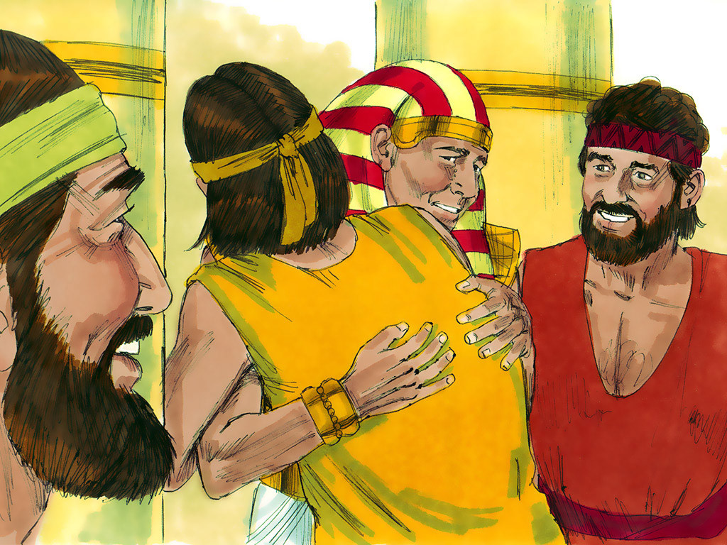
JOSEPH - 5
Notes:
5-6

Slide 2
Notes:
Rule Chart

Slide 3
Notes:
Prayer Pattern

Slide 4
Notes:
Song: “All that is Good”

Slide 5
Notes:
Memory Verse

Slide 8
1
2
3
4

Slide 9
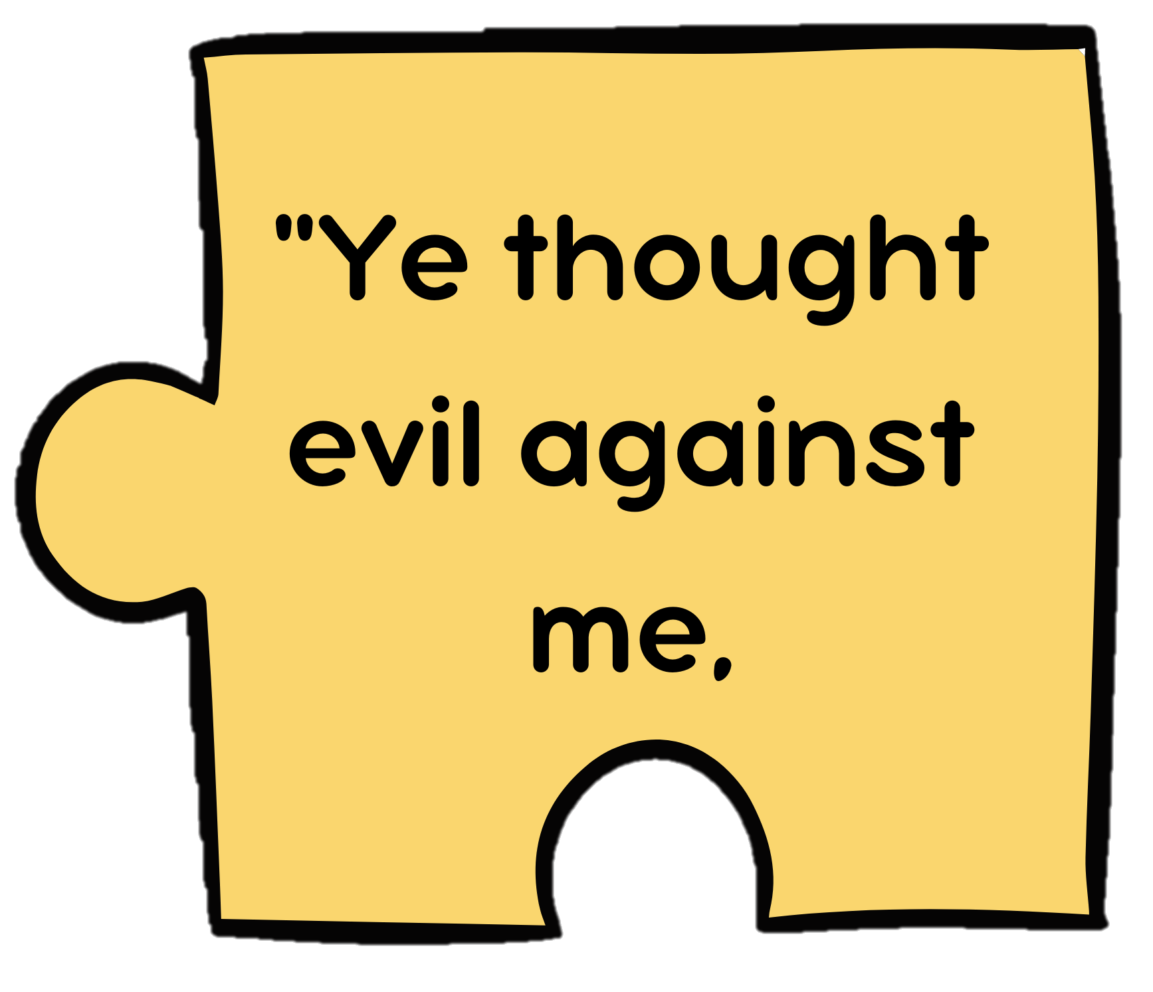
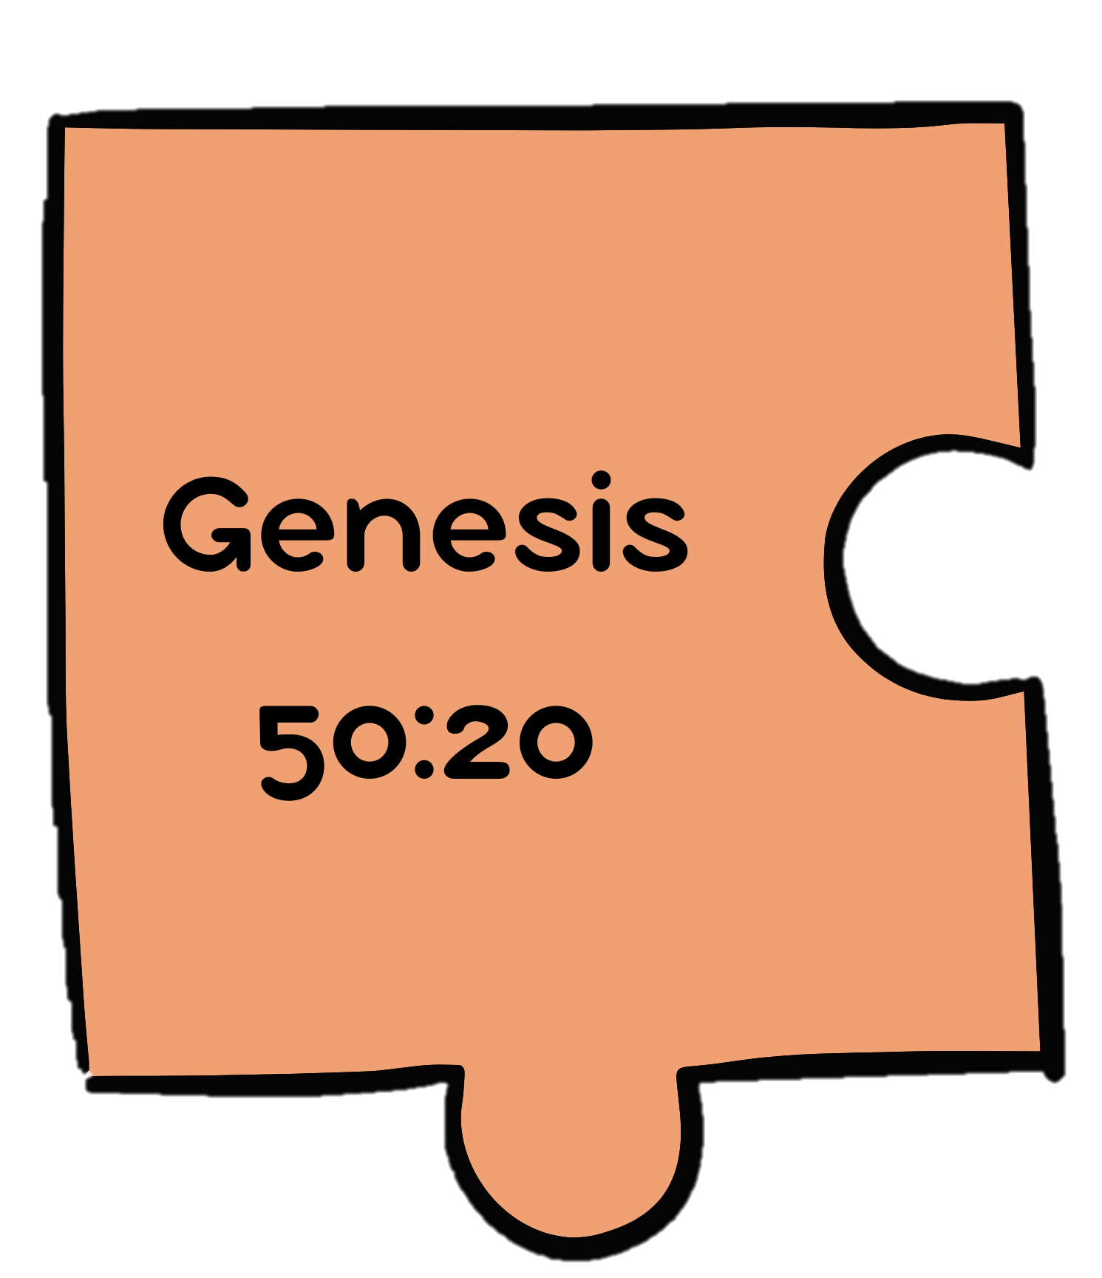

Slide 12
Notes:
Song: “Sovereign One”

Slide 15
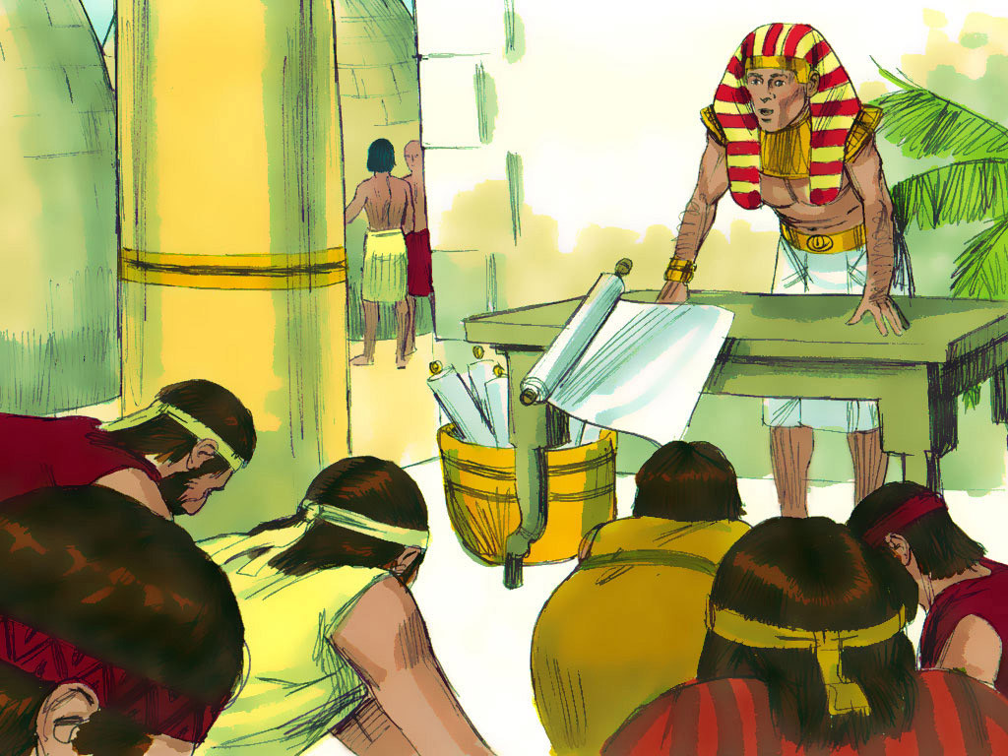

Slide 16
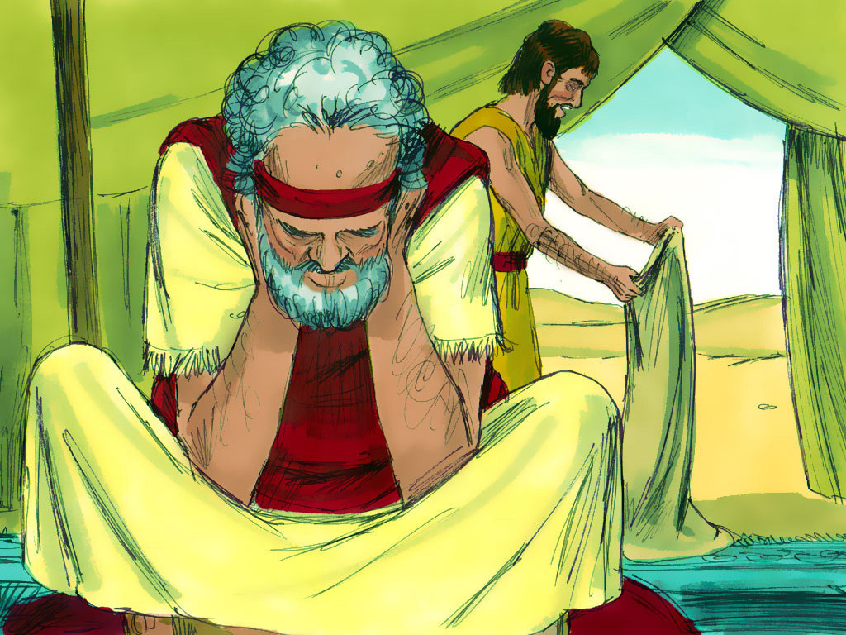

Slide 17
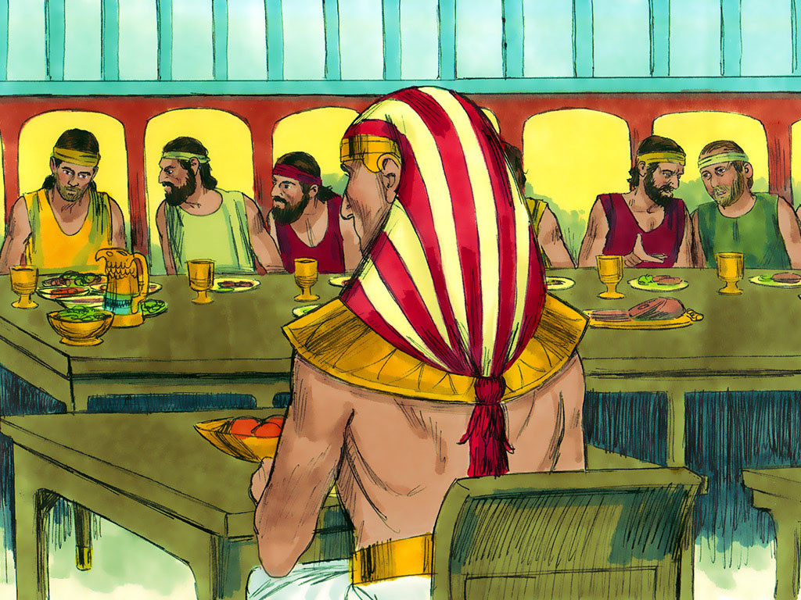

Slide 18
Notes:
5-5

Slide 20
Notes:
5-5

Slide 21
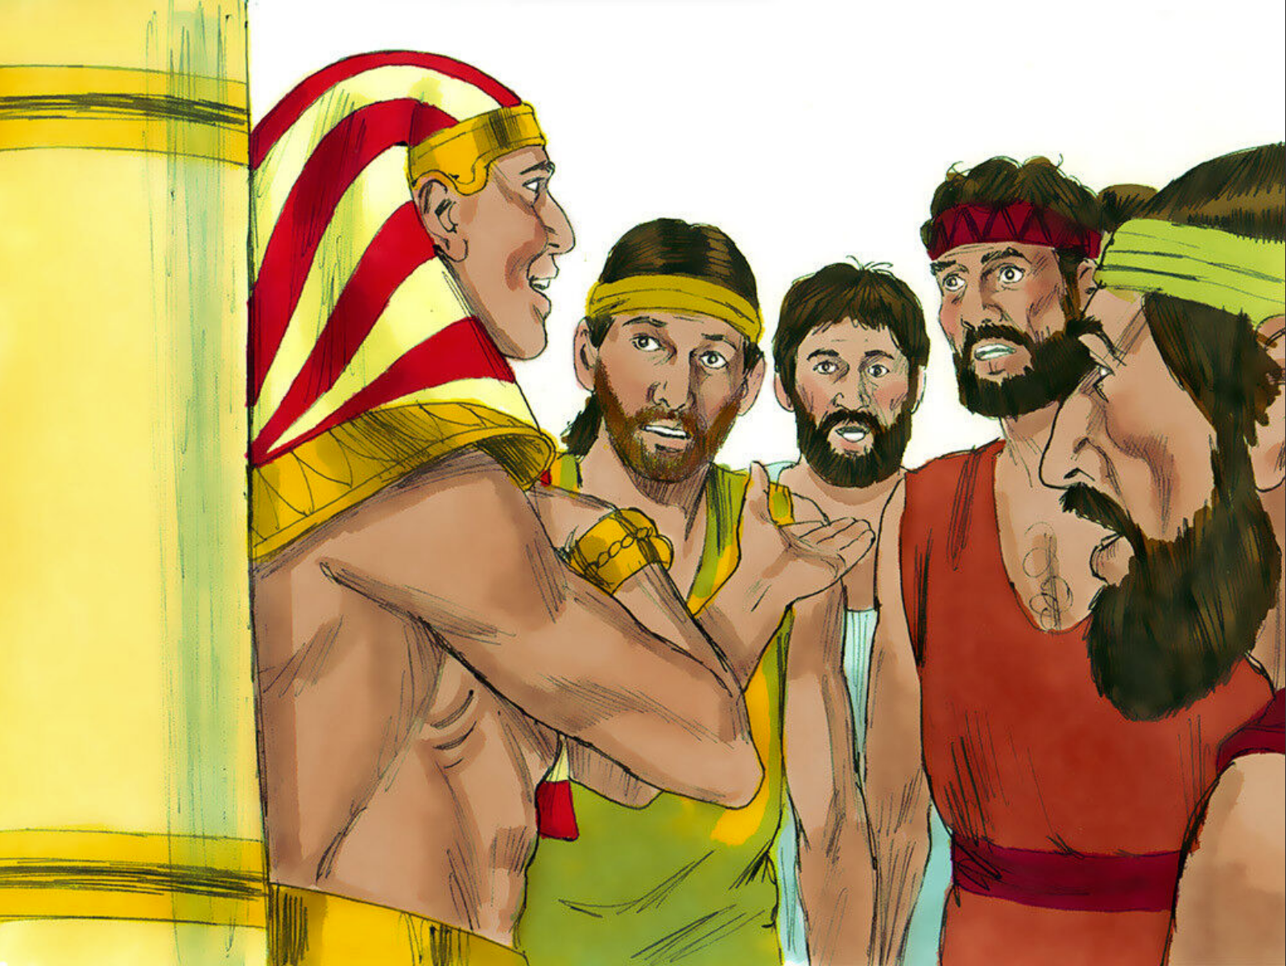

Slide 23
Notes:
5-6

Slide 28
Notes:
5-6

Slide 31
