Slide 1
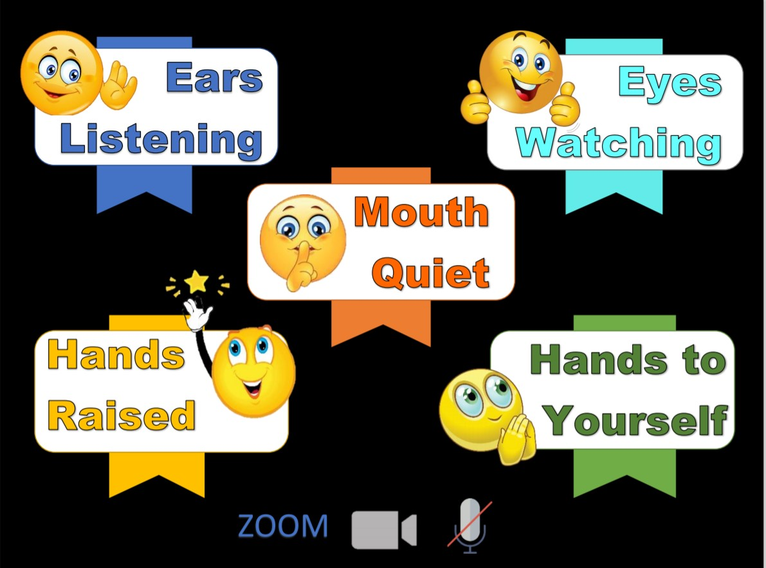
Memory Verse
Main Truth
Books of the Bible

Slide 2
Notes:
GNC Intro:

Slide 3
Notes:
Rule Chart:

Slide 4
Dear Heavenly Father,
Thank You for
______________
Please
_____________
In Jesus’ name,
Amen.
Notes:
Prayer

Slide 5
Notes:
Song: “Jesus, Strong and Kind!”

Slide 6
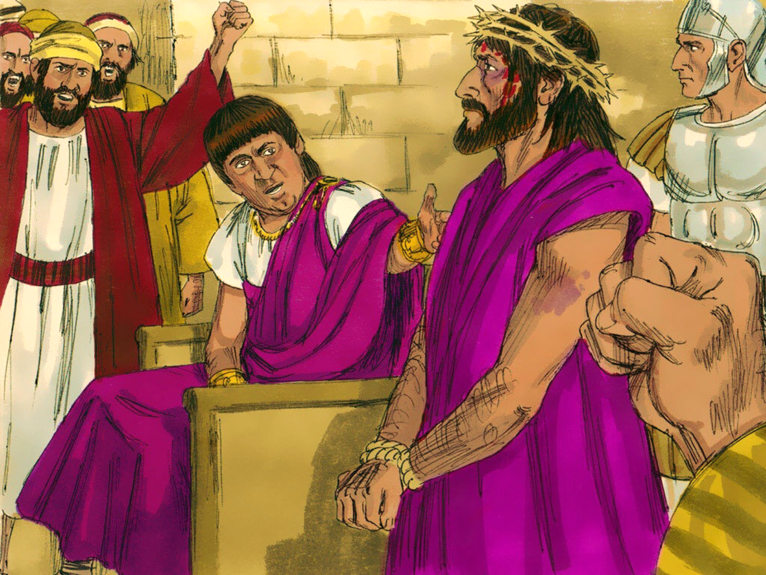
The King Is Mocked!
Matthew 26:57-27:31, Mark 14: 53 – 15:20,
Luke 22:54-23:25, John 18:13-19:16

Slide 7
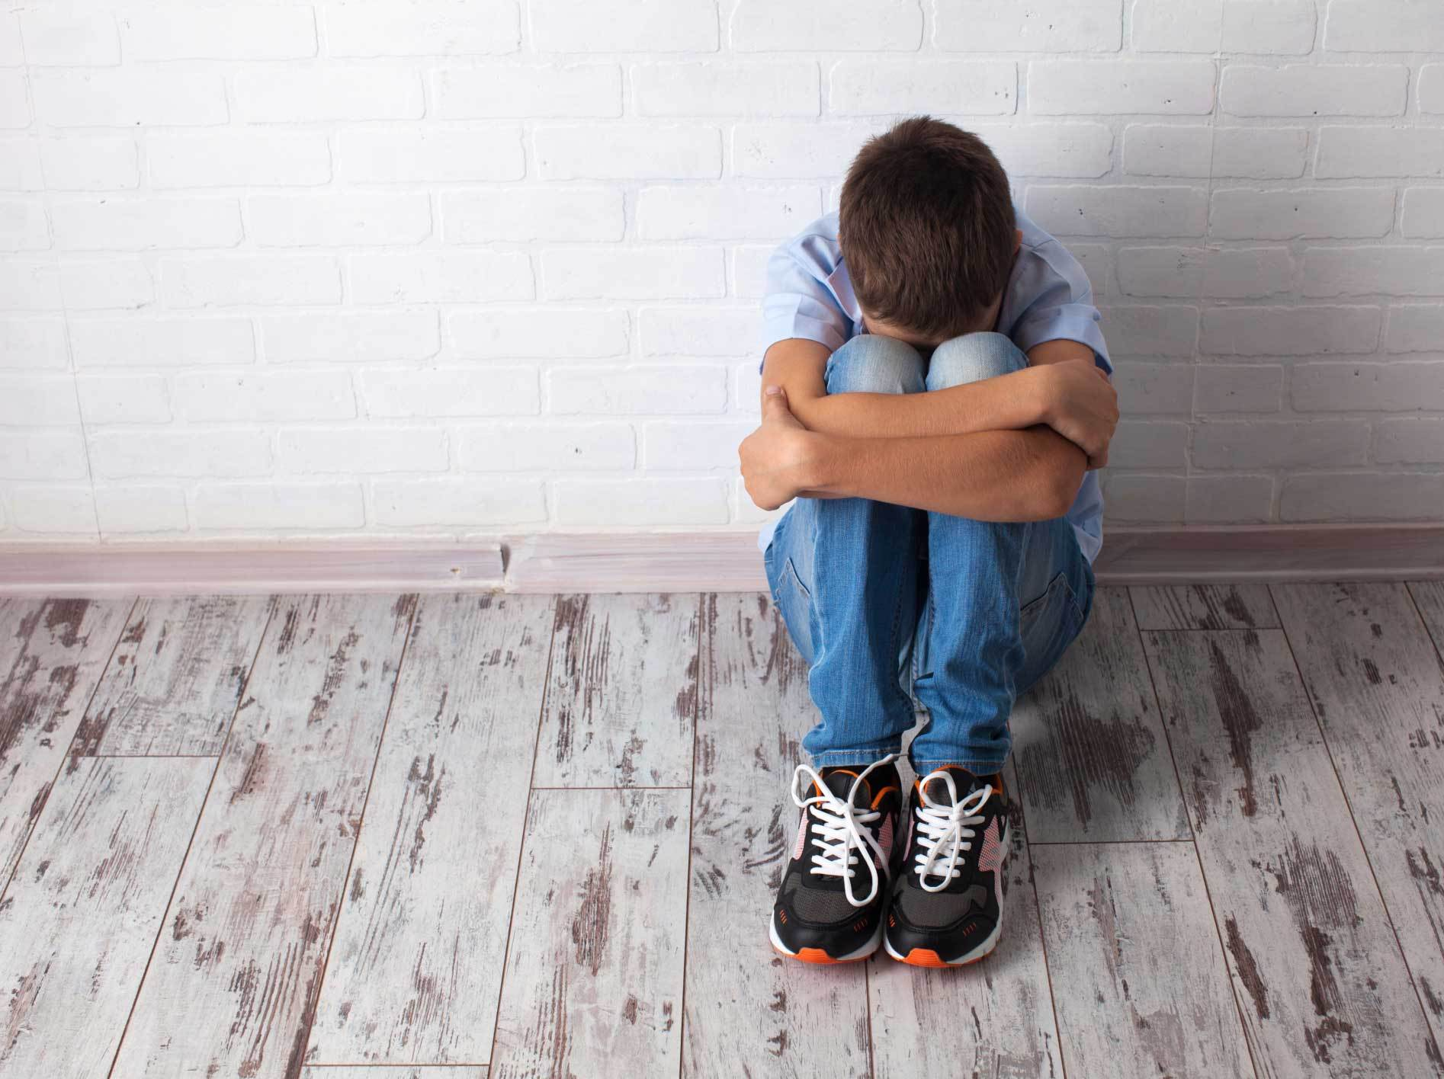
It’s unfair!

Slide 8
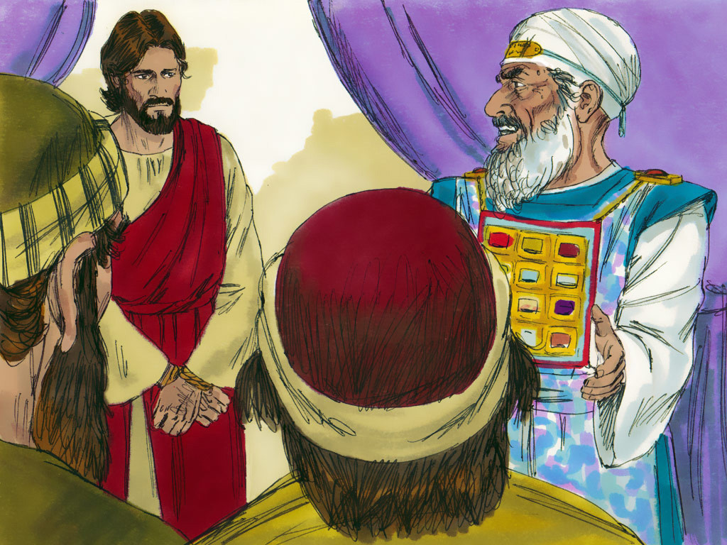
Jesus answered, “I am.”
“Are You the Son of God.”

Slide 9
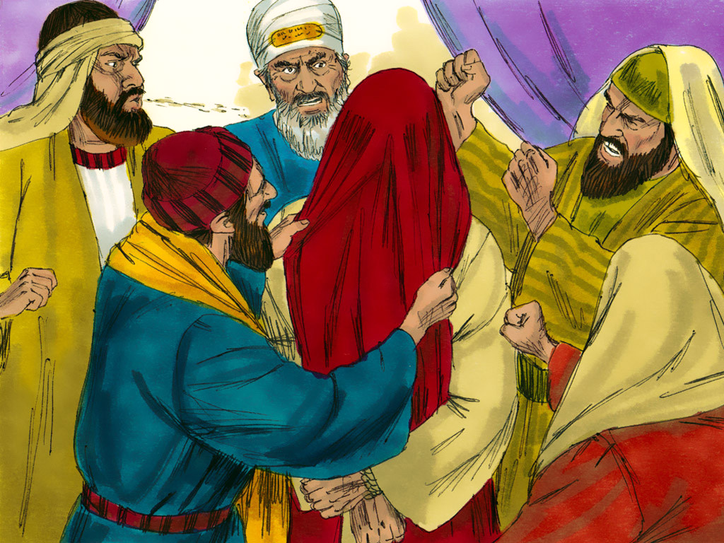
He is guilty!
He deserves to die!

Slide 10
God
wants to help you
control your tongue

Slide 12
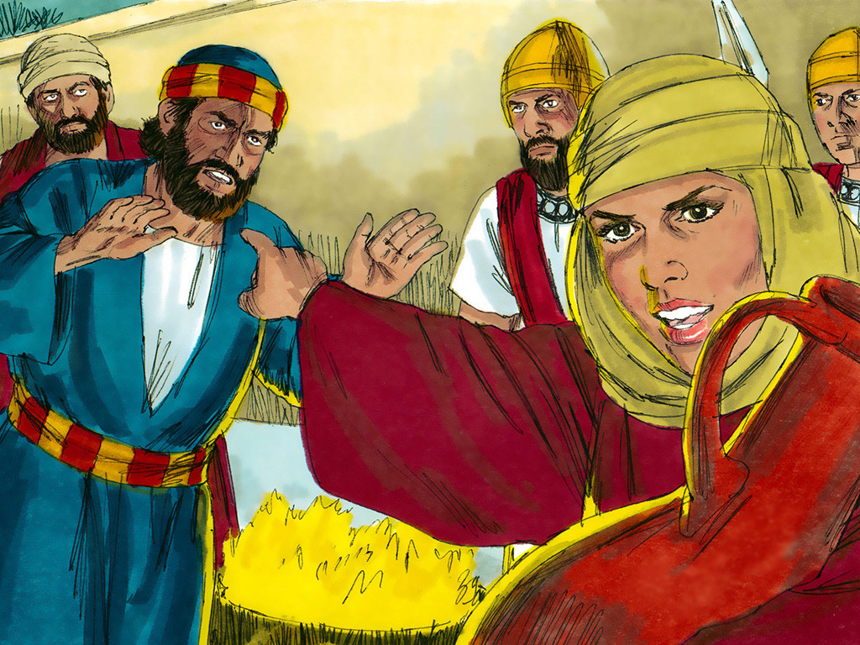

Slide 13
“I am!”
“Are You the King
of the Jews?”

Slide 14
Crucify Him!
Crucify Him!

Slide 15
Romans 3:23
“For all have SINNED,
and come short of
the glory of God.”

Slide 16
Crucify Him!
Crucify Him!

Slide 17
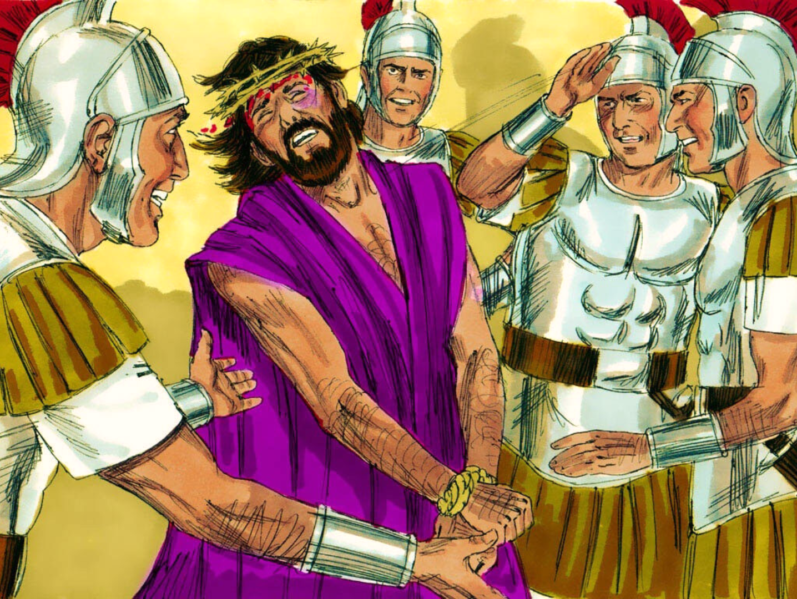

Slide 18
God
wants to help you
control your tongue

Slide 19
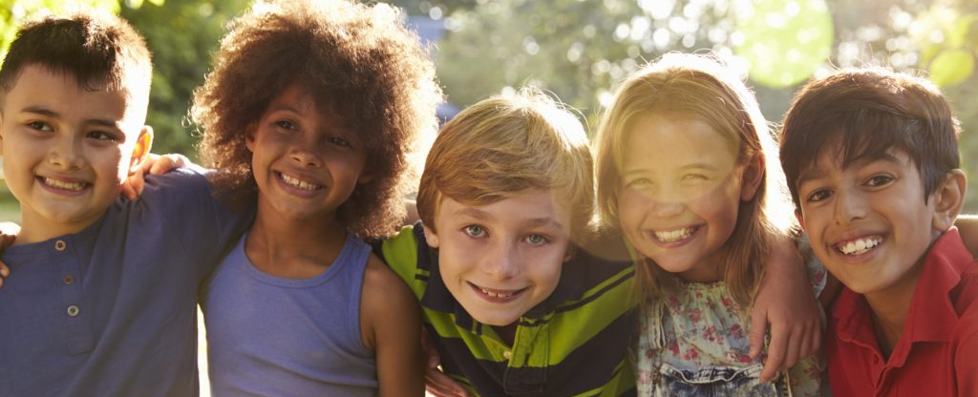
Ephesians 4:29
“Let no corrupting talk
come out of your mouths,
but only such as is good for building up….”

Slide 22
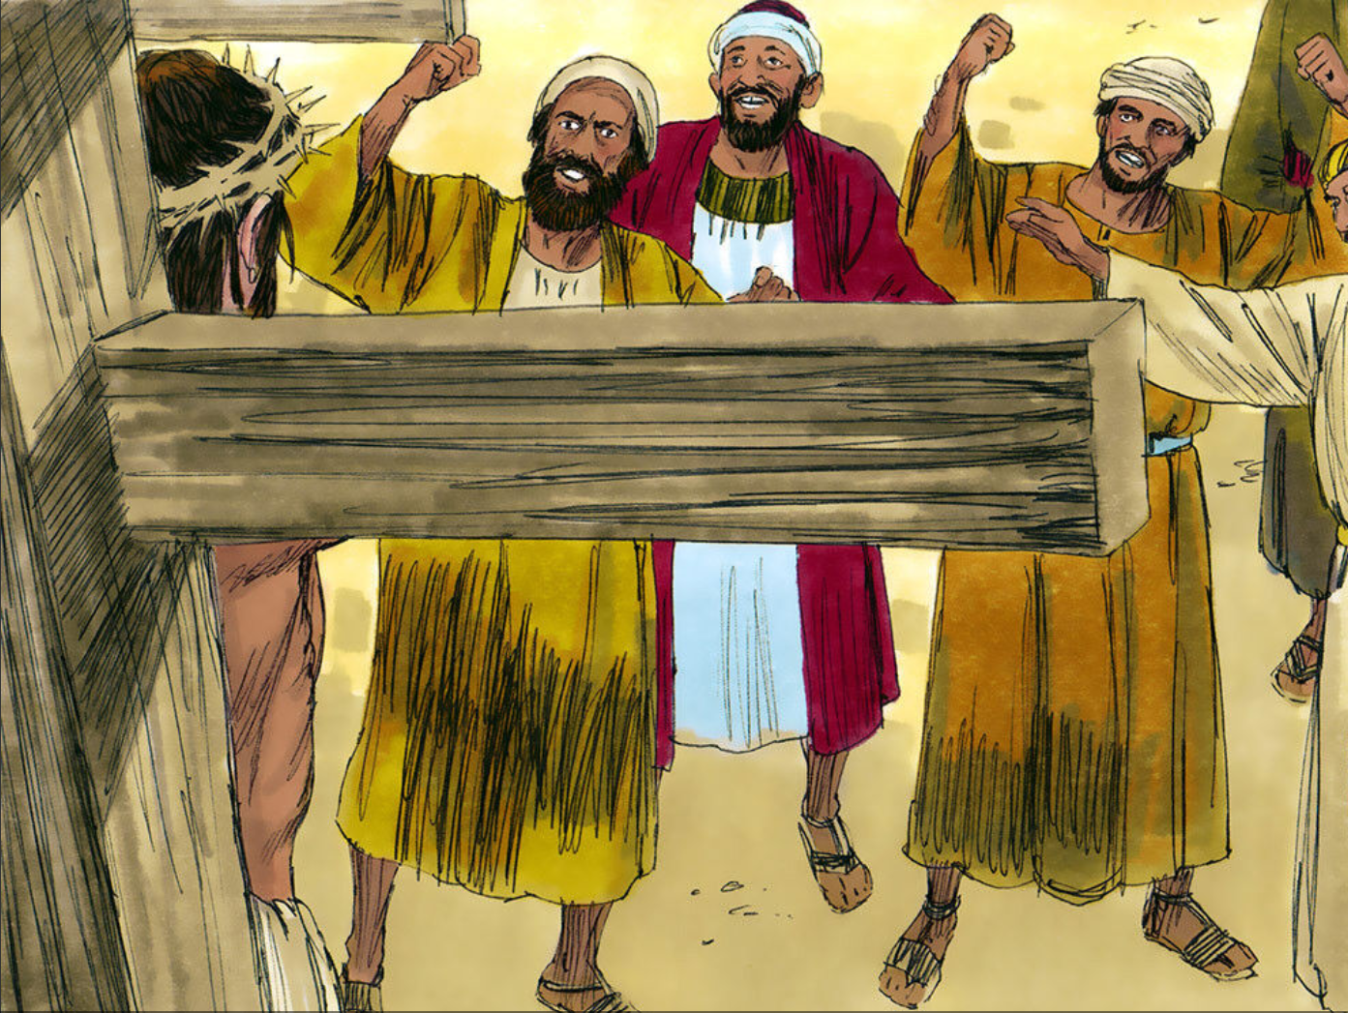
1 Peter 3:18
“…Christ also hath once suffered
for sins, the Just for the unjust,
that He might bring us to God….”

Slide 23
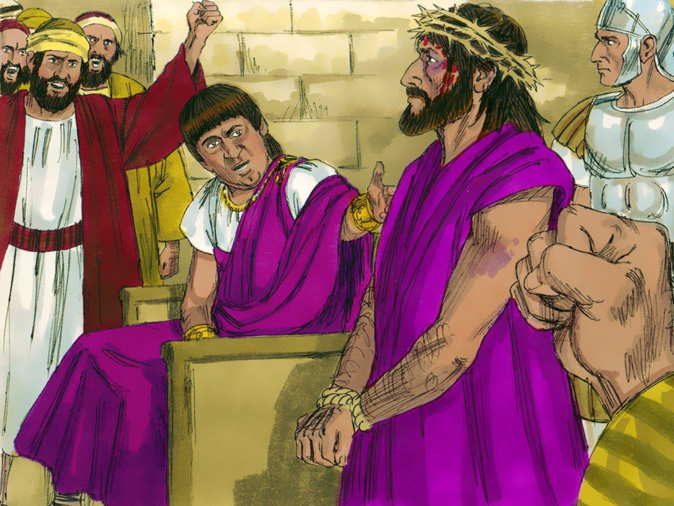

Slide 24
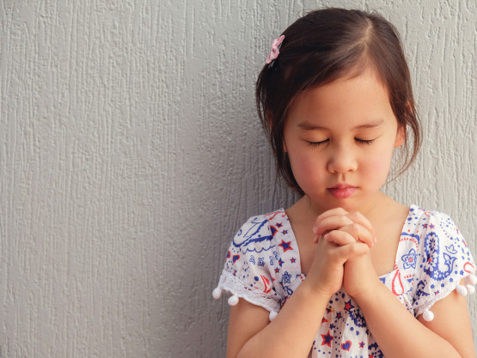
Acts 16:31
“…Believe on
the Lord Jesus Christ,
and thou shalt be saved….”

Slide 25
God
wants to help you
control your tongue

Slide 26
Ephesians 4:29
“Let no corrupting talk
come out of your mouths,
but only such as is good for building up….”

Slide 27
Notes:
Song: “Obedience Is!”

Slide 29
1 Peter 3:18
“…Christ also hath once suffered
for sins, the Just for the unjust,
that He might bring us to God….”

Slide 30
Learning About the bible

Slide 31
Gospels
Matthew
Mark
Acts
Luke
John
HISTORY
Romans
Philippians
1 Timothy
Paul’s Letters
1 Corinthians
Colossians
2 Timothy
2 Corinthians
1 Thessalonians
Titus
Galatians
2 Thessalonians
Philemon
Ephesians
Hebrews
Notes:
Who can name the four Gospels? Who can tell me the book of History?
Paul’s Letters are next. Who can say all 14 of them?

Slide 32
1 John
General Letters
(7)
James
2 John
1 Peter
3 John
2 Peter
Jude
1 Peter
James
2 Peter
Notes:
The next group of books in the New Testament is called General Letters.
These seven books, or letters, were written by four different men.
The book of James was written by Jesus’ half brother.
Peter, one of the 12 disciples, wrote two books: First and Second Peter.
Let’s practice the names of these three letters. Now we can review all the names of the books of the New Testament that we have learned.
(Practice several times saying the names of the four Gospels, the book of History, the 14 books of Paul’s Letters, and three of the General Letters.)

Slide 33
Notes:
Review game
See NEXT SLIDE for how to play.

Slide 34
Notes:
Review game - “Where Is Thumper Rabbit?” – “I can’t seem to find Thumper Rabbit. Can you help me? I know he is here somewhere, but he looks so much like his brothers and sisters. If you answer a question correctly you may help me look for him.” Prepare by choosing one of the numbers on the board and writing it on a “secret paper.” When a child answers a review question, he may choose any number on the board. If it is the one written in the “secret paper” he finds Thumper. When he chooses the wrong one you may click to go BACK a slide to show the “That’s not Thumper” slide. Then click back to show the numbers again. If he chooses the correct number click for NEXT slide to show the “You found Thumper” slide.

Slide 35
Notes:
Review game
See PREVIOUS SLIDE for how to play.

Slide 36
Notes:
Review Invitation - At the end of the club tell the children “After I say ‘Amen’ you may log off, if you wanted to talk to me about asking Jesus to be your Saviour please stay on and I will help you after the others have logged off.”

Slide 37
Notes:
You can Screen Share these Counseling Card slides to go through as you normally would.

