Slide 2
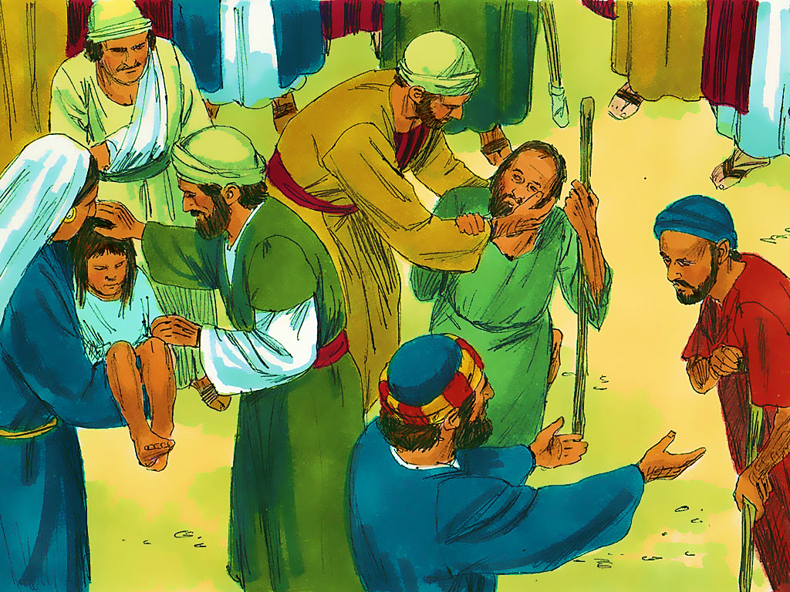
3-1
Notes:
3-1

Slide 4
3-1
Notes:
3-1

Slide 5
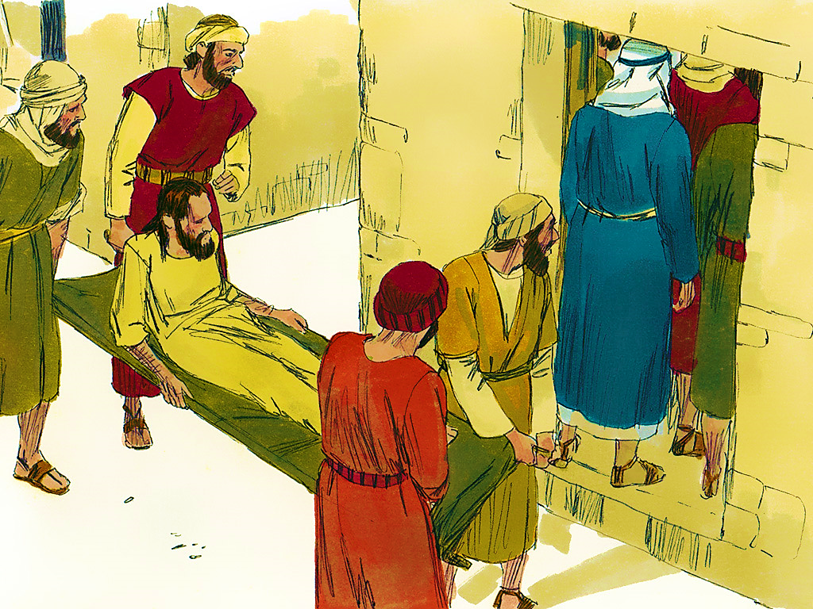
3-2
Notes:
3-2

Slide 6
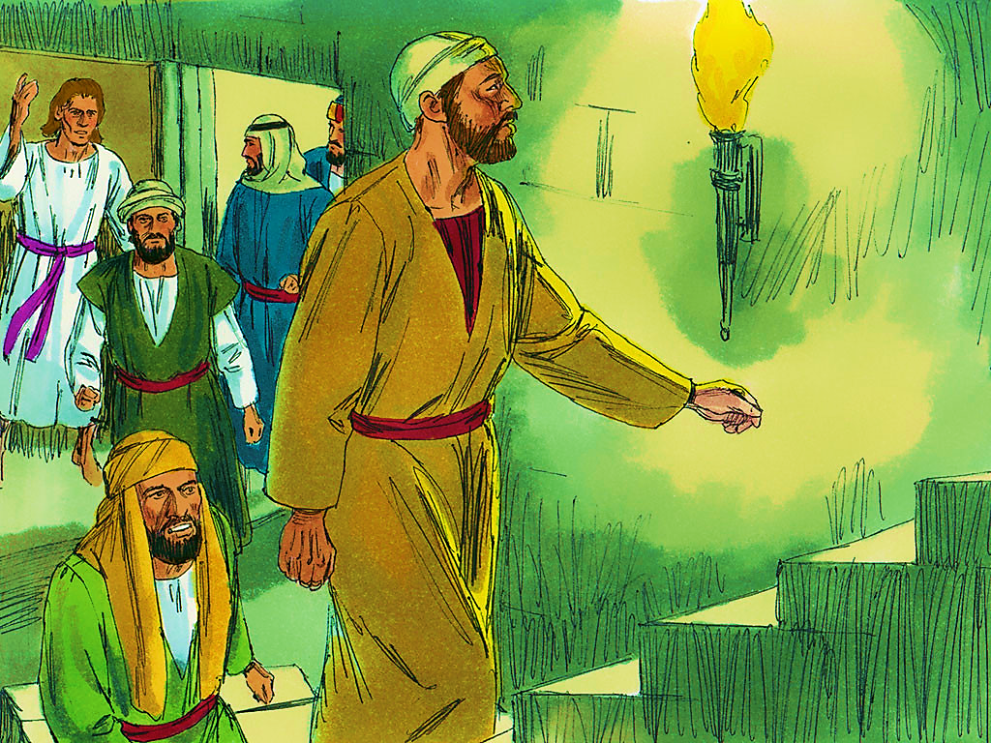
3-3
Notes:
3-3

Slide 8
3-3
Notes:
3-3

Slide 9
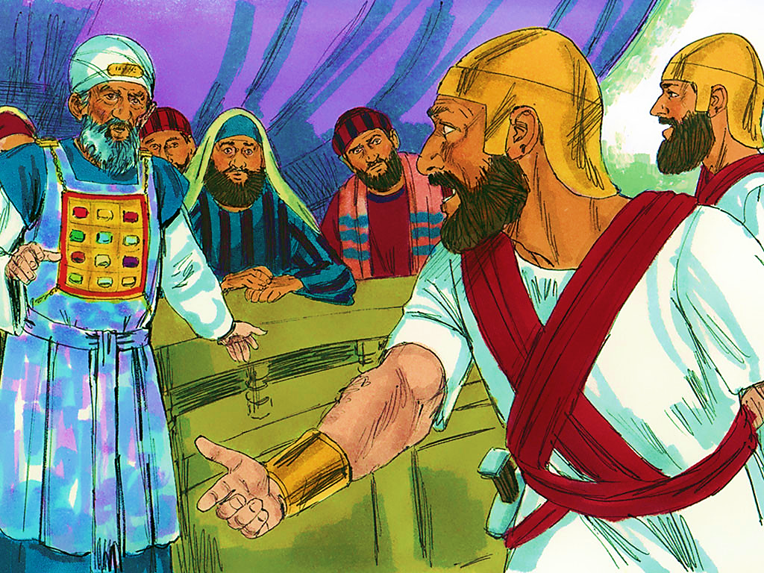
3-4
Notes:
3-4

Slide 10
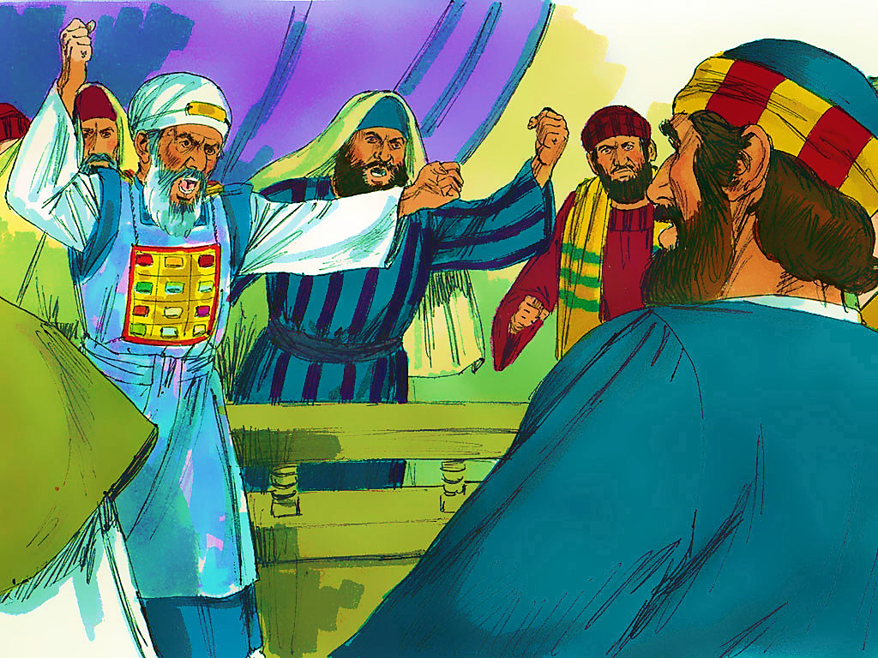
3-5
Notes:
3-5

Slide 11
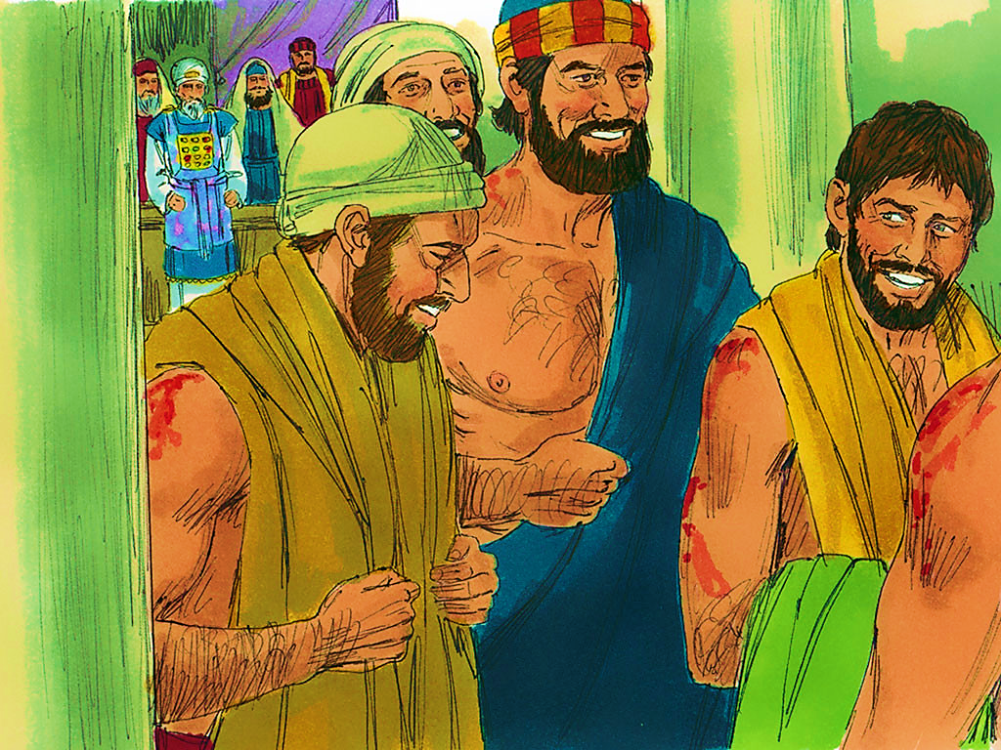
3-6
Notes:
3-6

Slide 13
Notes:
End Lesson

