Slide 2
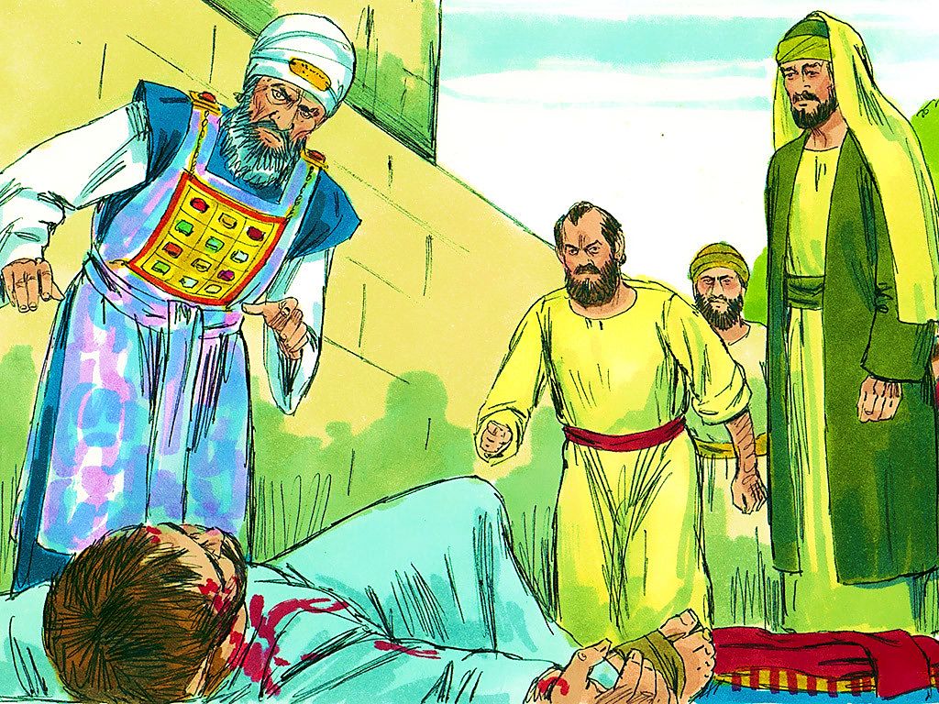
4-1
Notes:
4-1

Slide 3
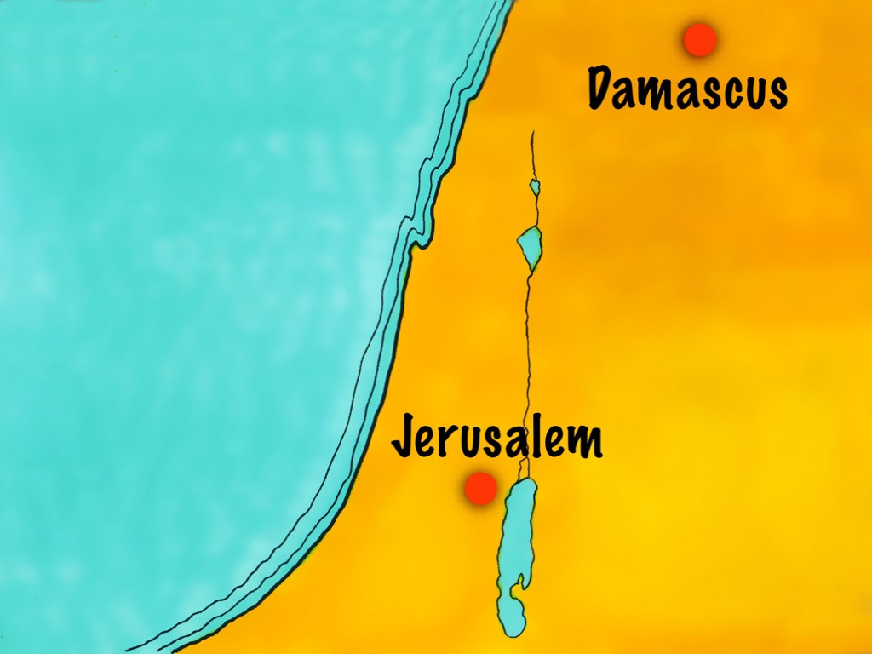
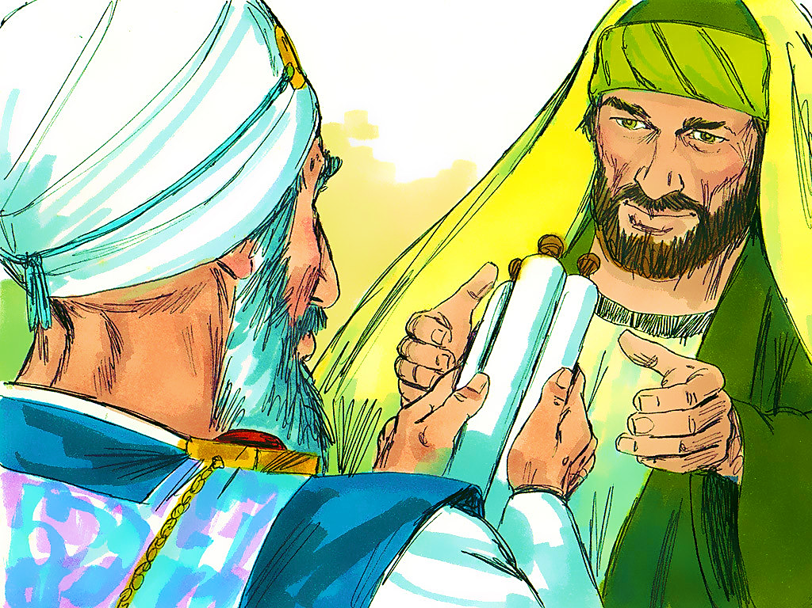
4-2
Notes:
4-2

Slide 4
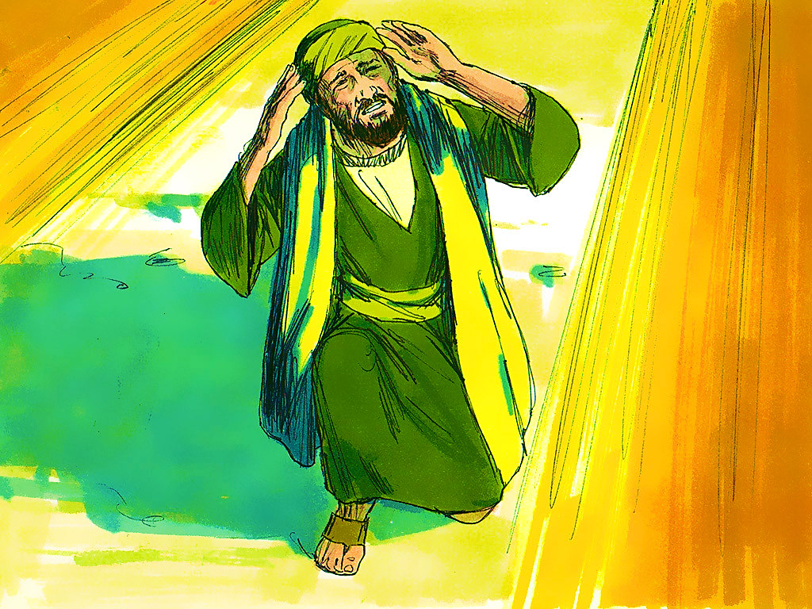
4-3
Notes:
4-3

Slide 6
4-3
Notes:
4-3

Slide 7
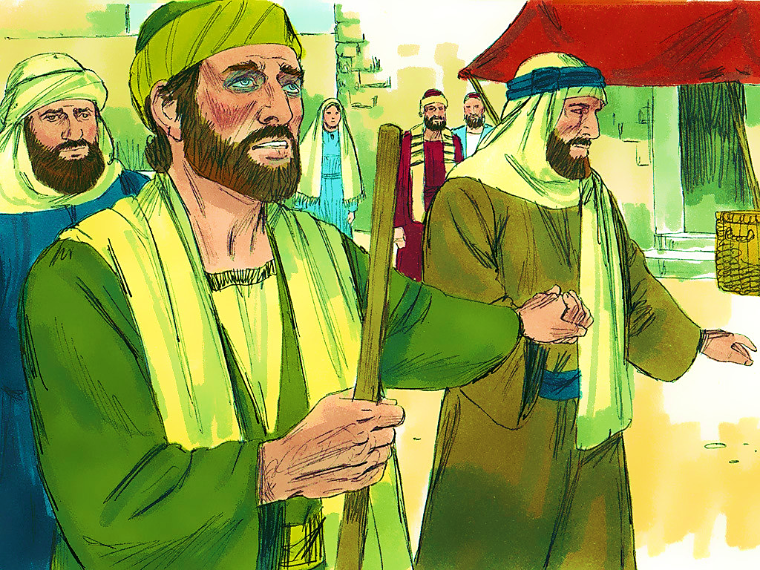
4-4
Notes:
4-4

Slide 9
4-4
Notes:
4-4

Slide 10
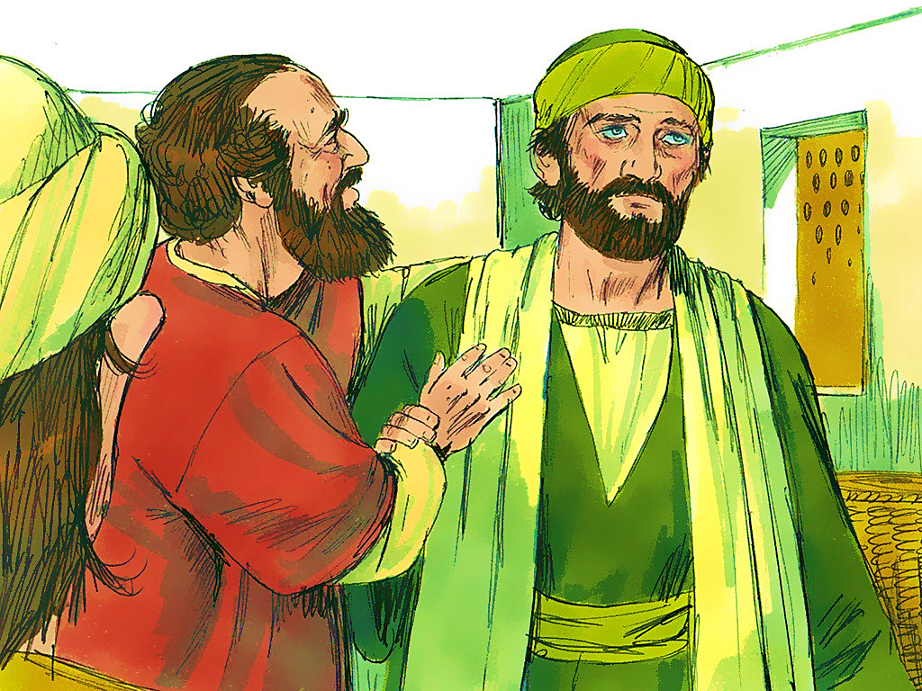
4-5

Slide 11
4-6
Notes:
4-6

Slide 13
Notes:
End Lesson

