Slide 1
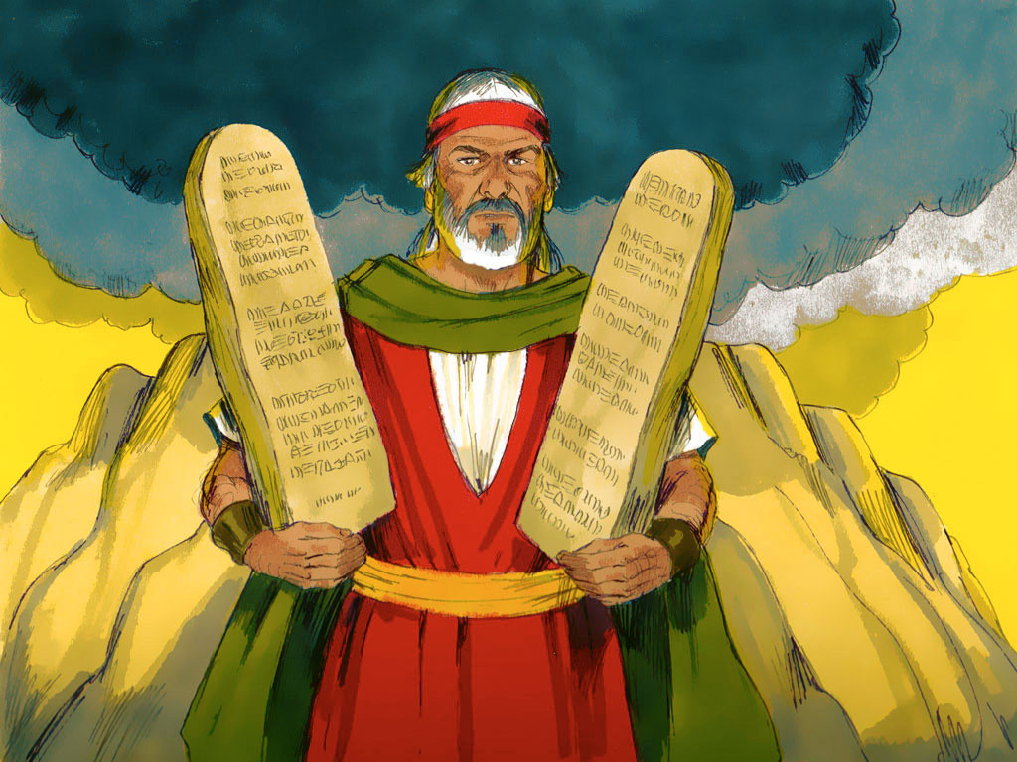
MOSES #8
“God’s Purpose for the Law”

Slide 2
Notes:
Rule Chart

Slide 3
Notes:
Prayer

Slide 4
Notes:
Song: “All that is Good”

Slide 7
Notes:
Song: “My God is Powerful”

Slide 8
Notes:
Bible Lesson

Slide 9
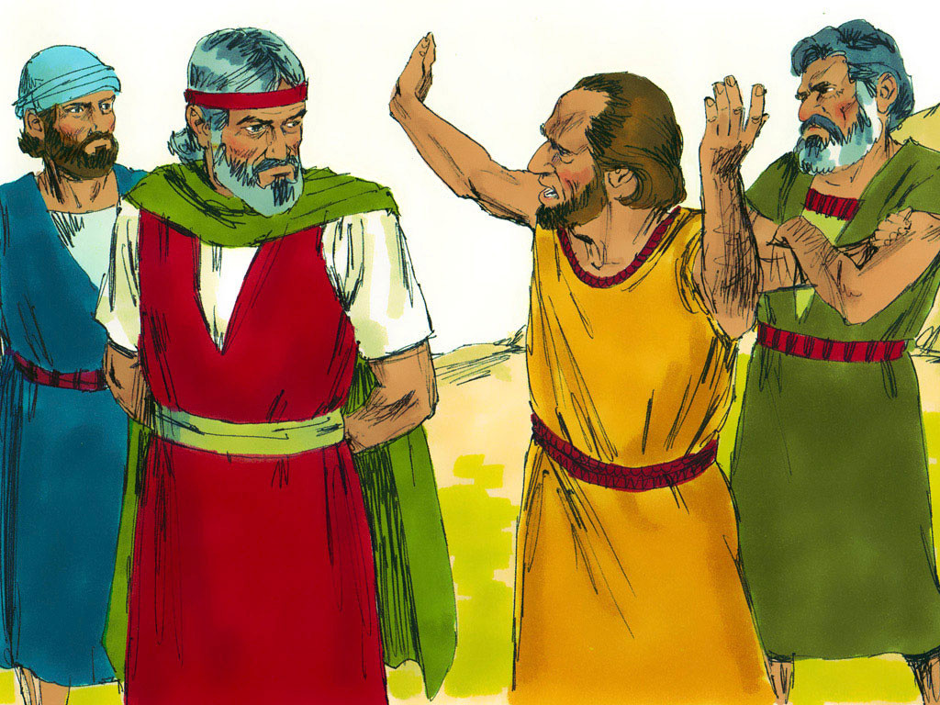
Notes:
1-1

Slide 10
Notes:
SIN

Slide 11
Notes:
1-1

Slide 12
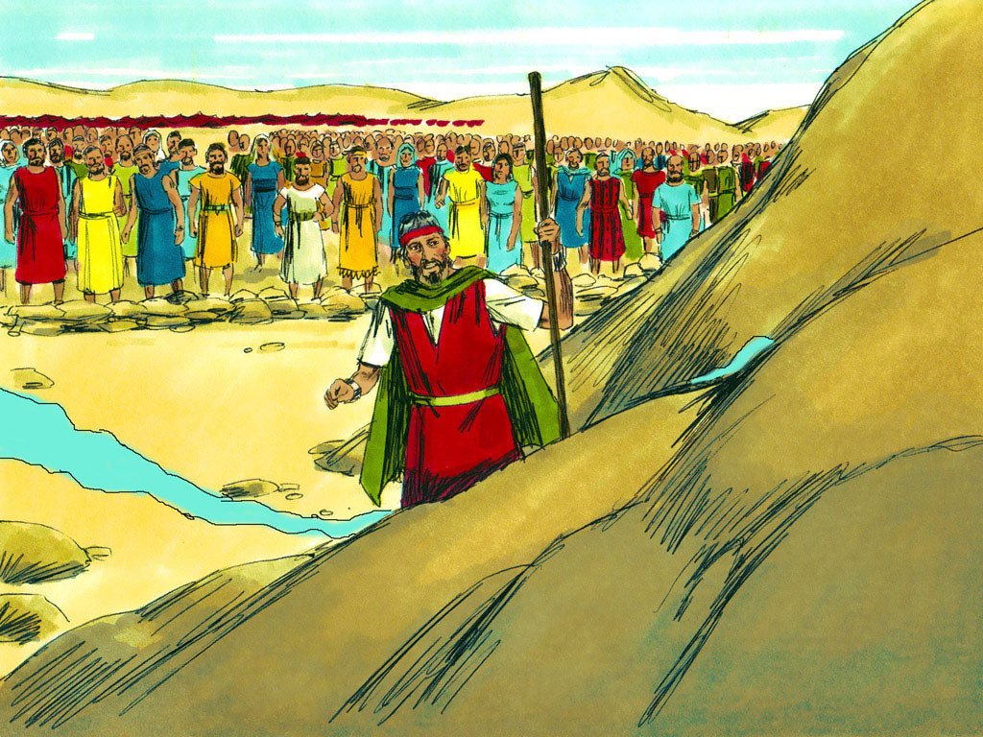
Notes:
1-2

Slide 13
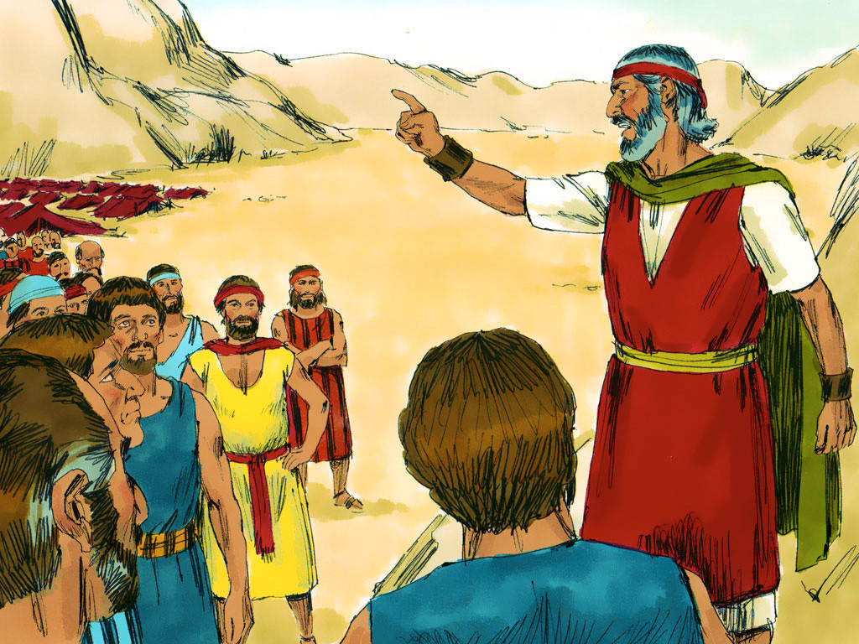
Notes:
1-3

Slide 15
Notes:
1-3

Slide 16
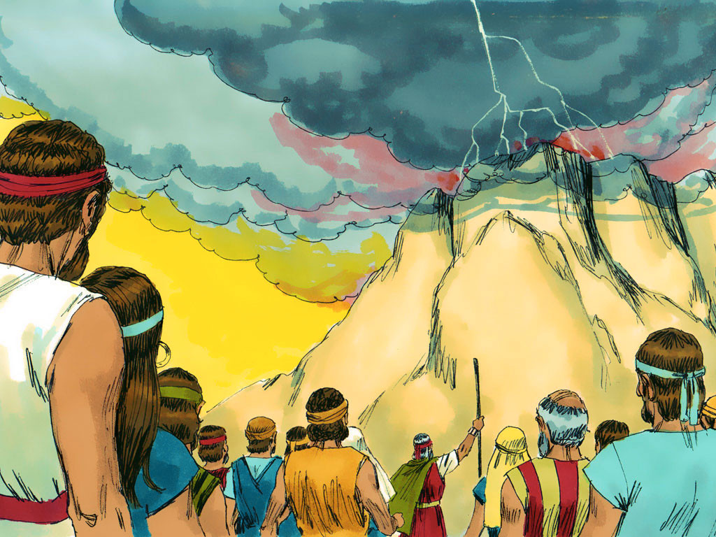
Notes:
1-4

Slide 17
Notes:
1-5.1

Slide 18
Notes:
1-5.2

Slide 21
Notes:
1-5.1

Slide 22
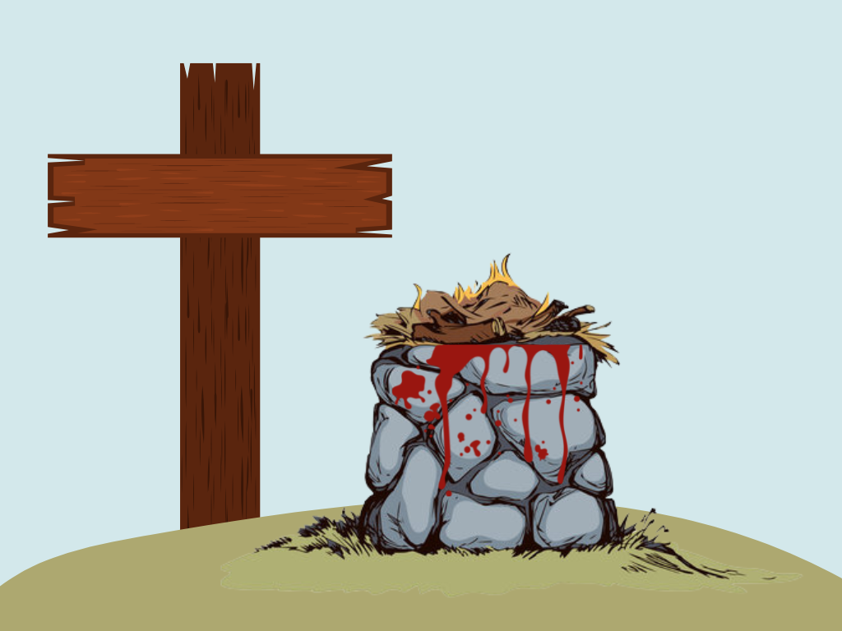

Slide 23
1 Corinthians 15:3-4 – “…Christ died for our sins…
He was buried, and…
He rose again
the third day….”

Slide 28
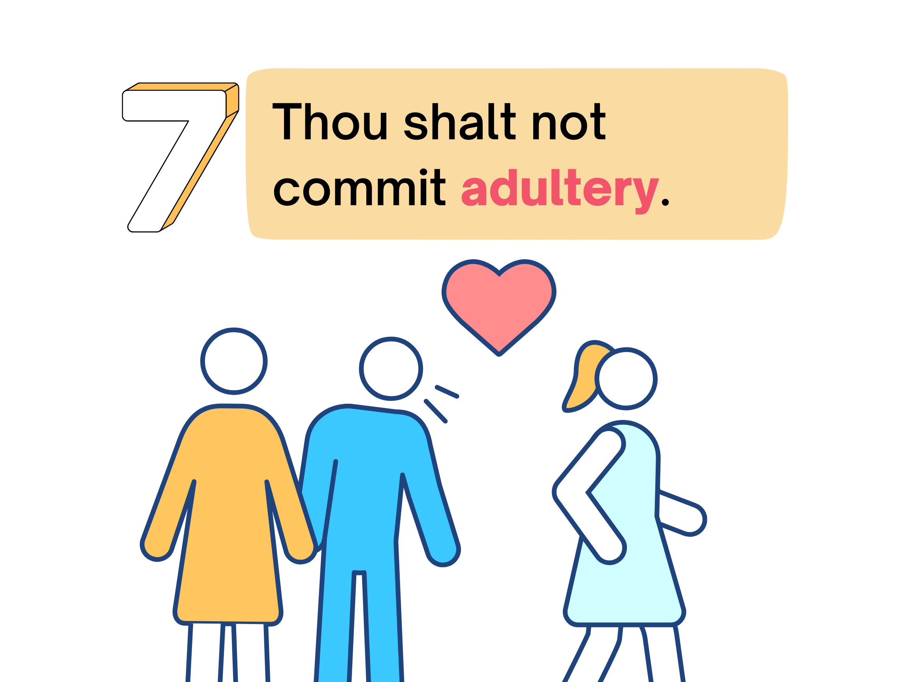
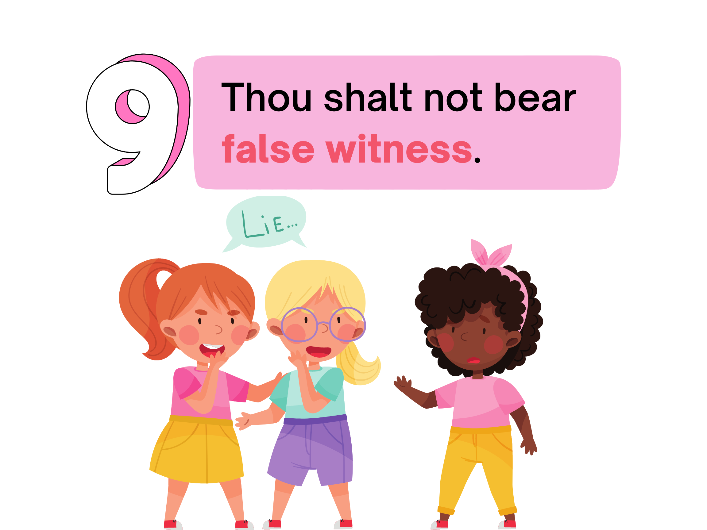
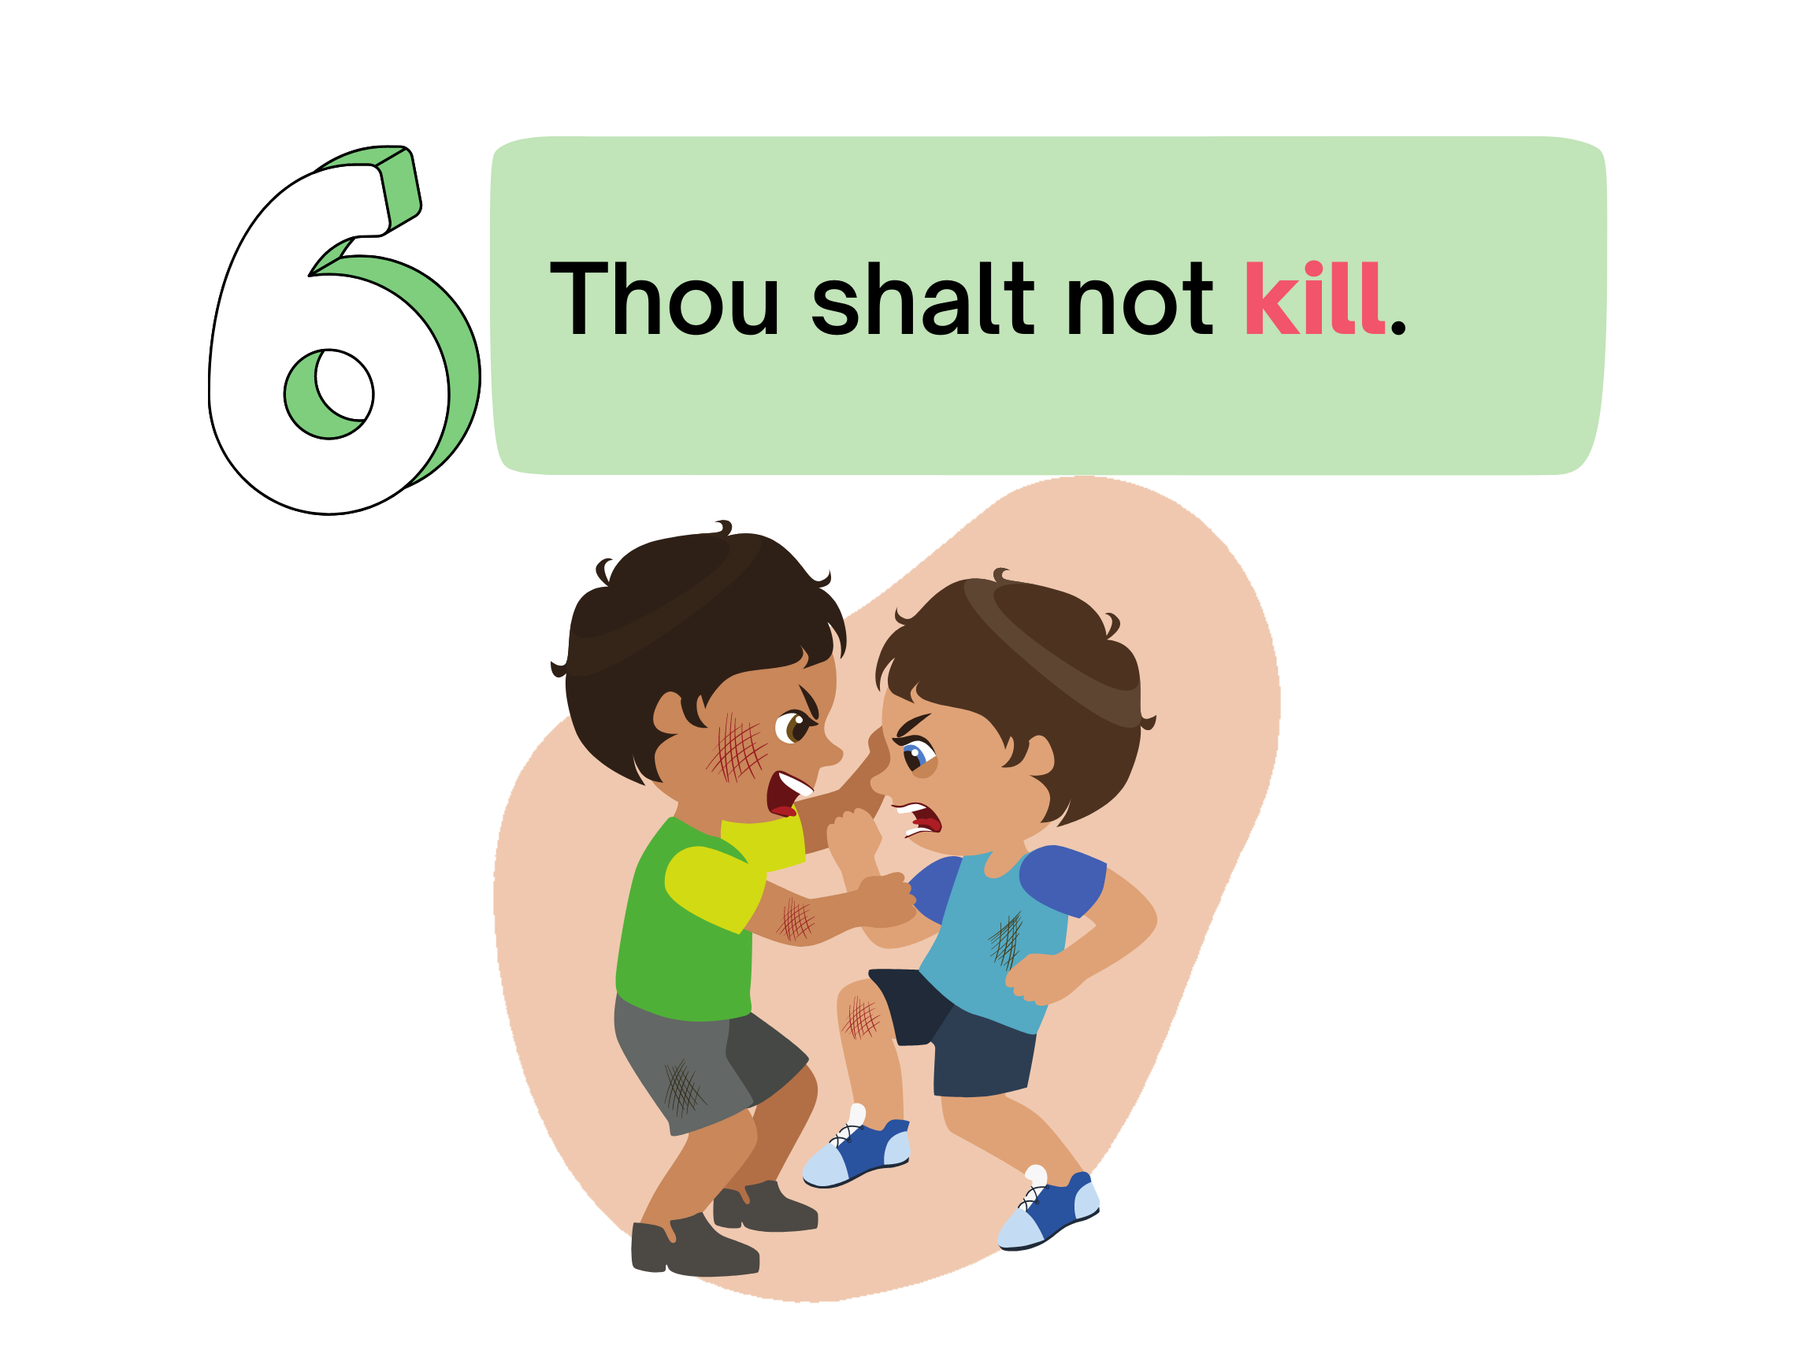
1
2
3
4
5
6
7
8
9
10
A
B
C
D
E
F
G
H
I
J

