Slide 1
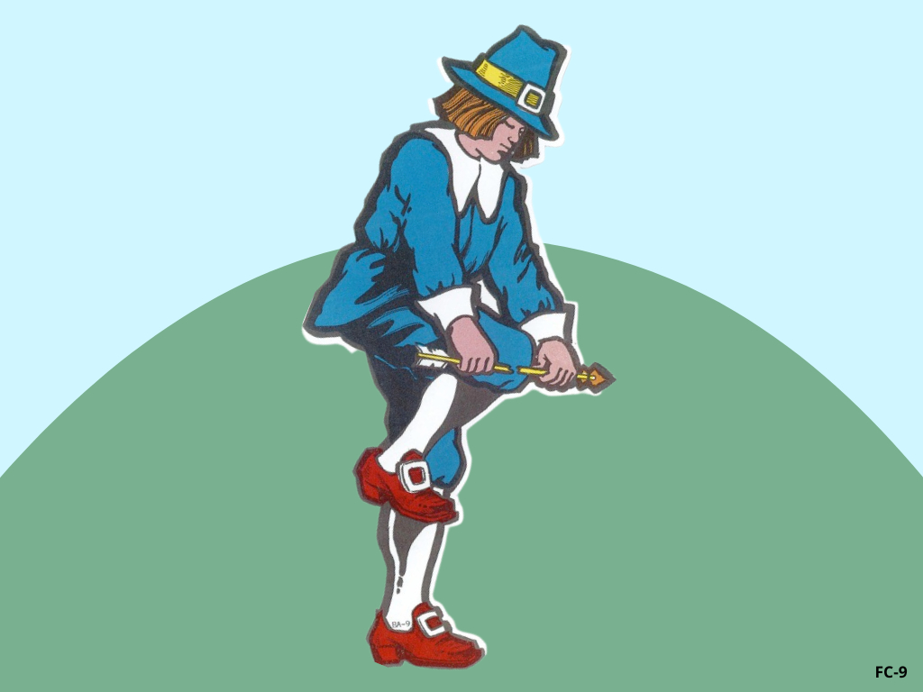
Broken Arrow

Slide 2
Notes:
Rule Chart

Slide 9
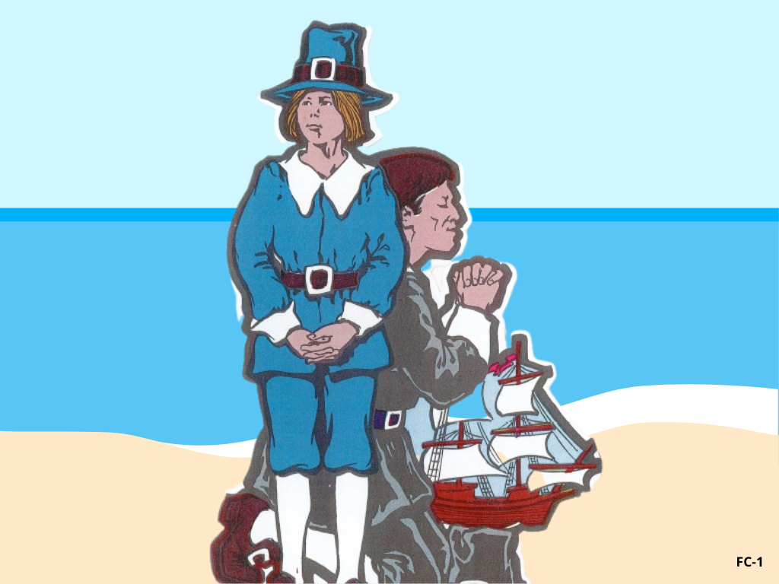

Slide 10
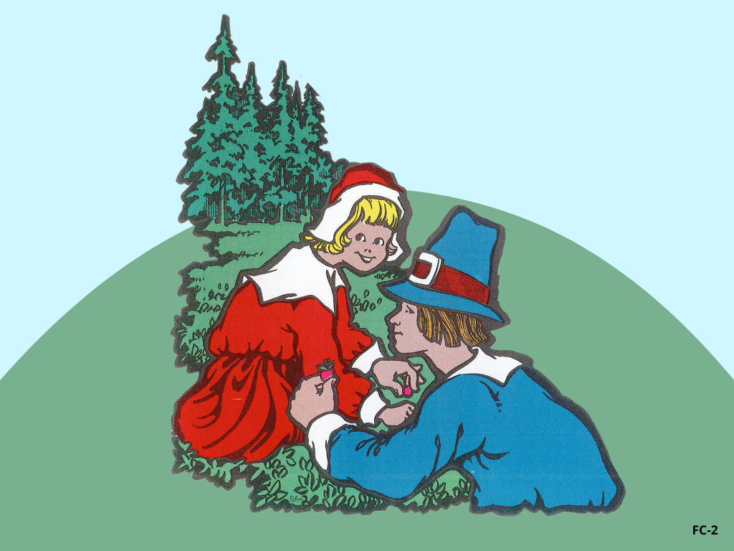

Slide 12
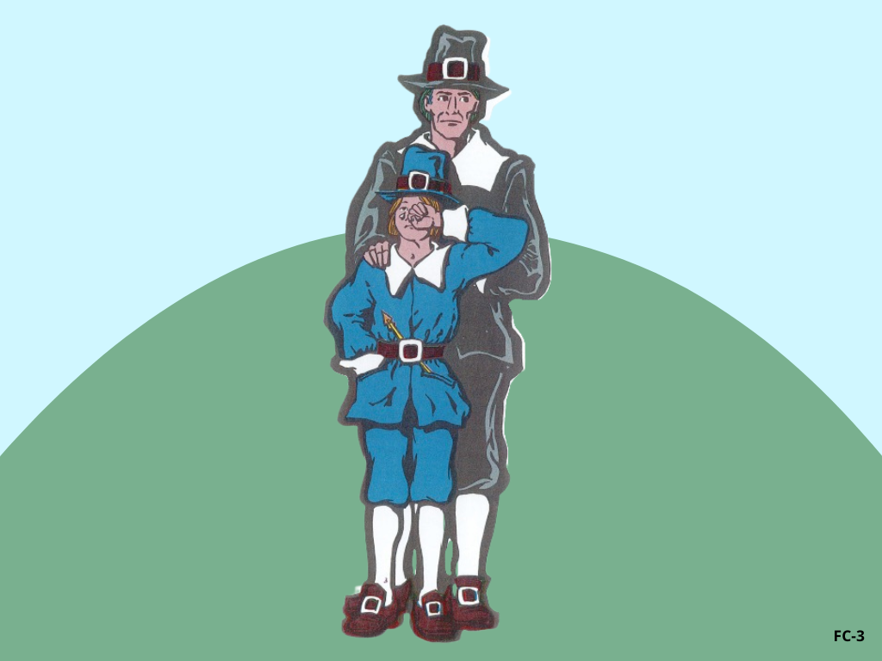

Slide 13
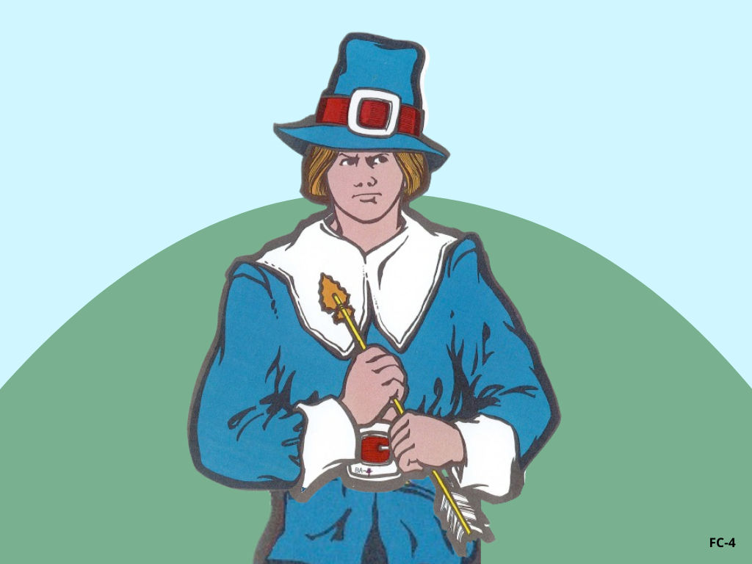

Slide 17
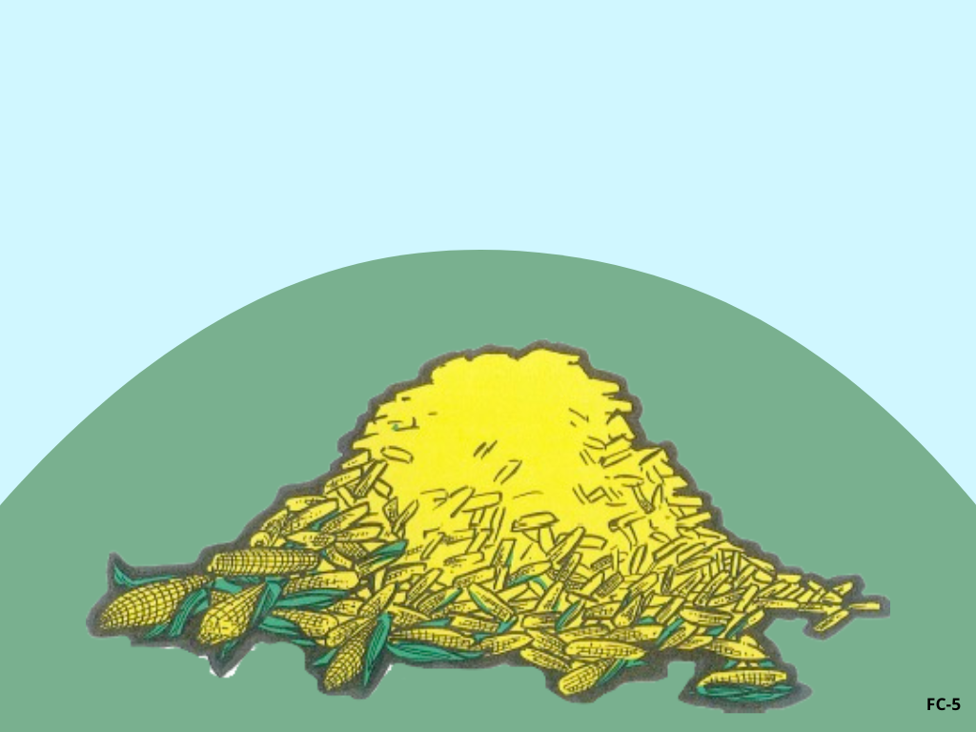

Slide 18
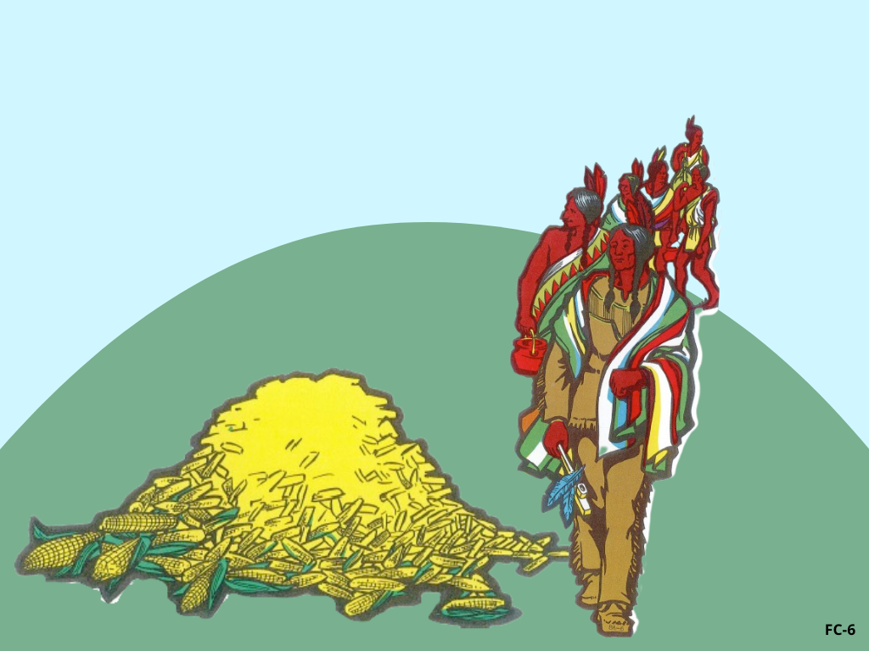

Slide 21
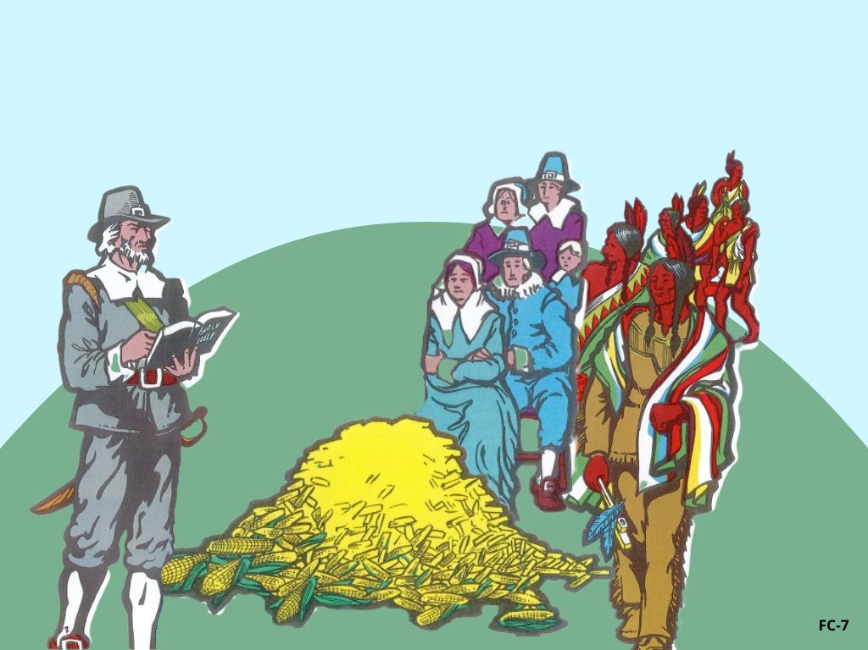

Slide 23
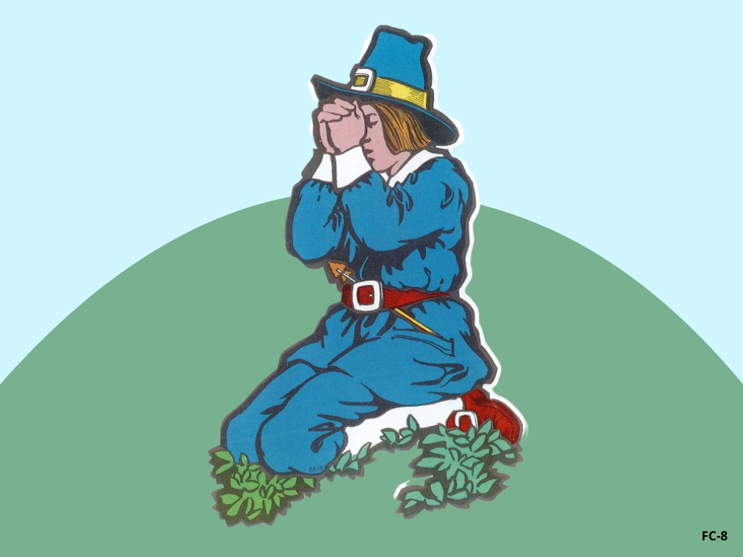

Slide 28
Review
G
A
M
E

Slide 29
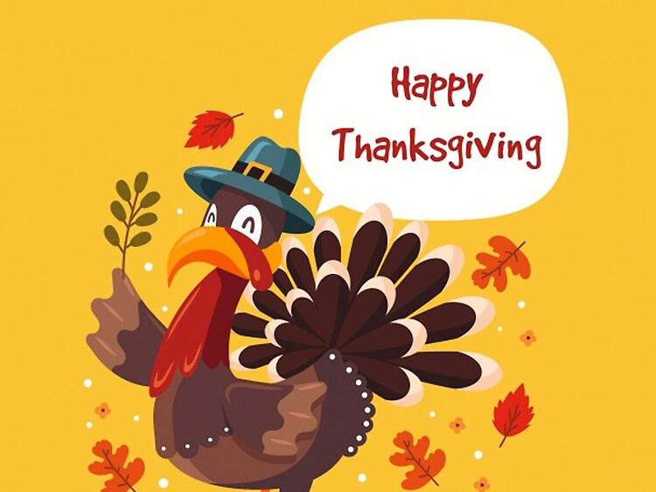

Slide 30
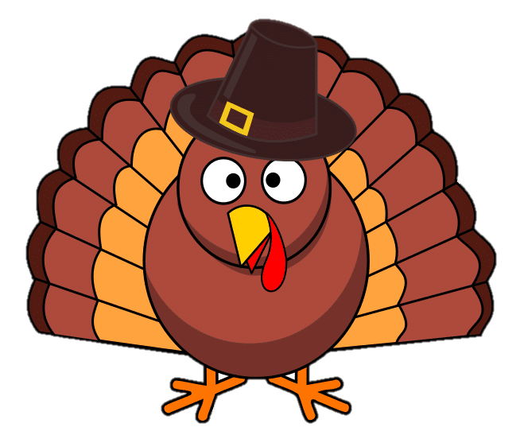
Turkey Victory Game
Notes:
Divide the class into 2 teams and ask the review question. Once a team answer correctly, click on the turkey to race to the line. The team who get to the line first wins.

