Slide 1
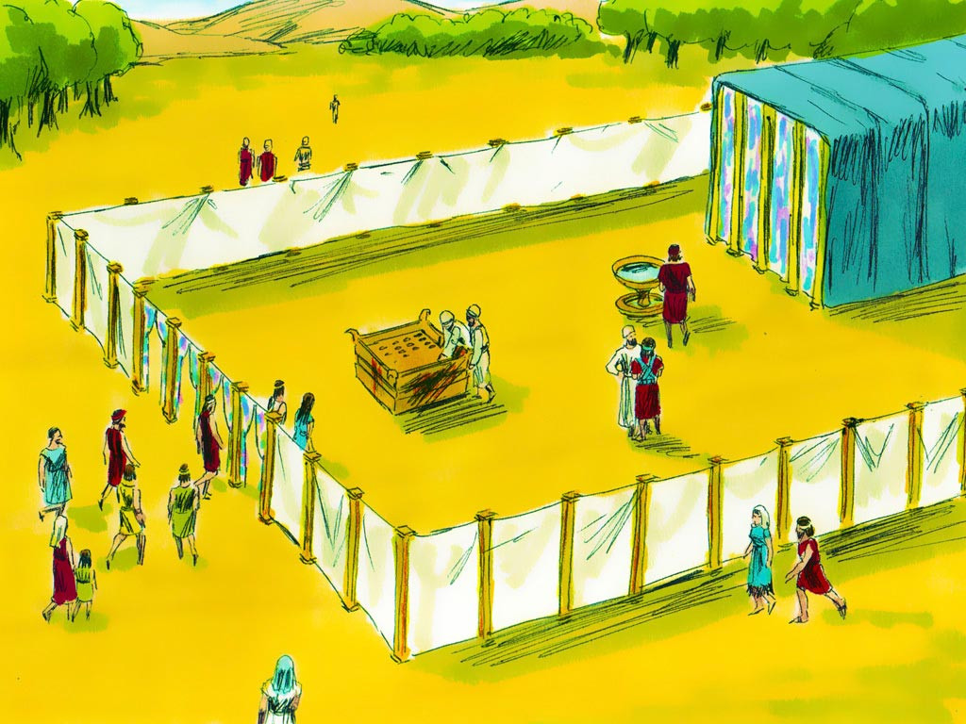
Tabernacle Review

Slide 2
Notes:
Rule Chart

Slide 3
Notes:
Prayer

Slide 4
Notes:
Song: “All that is Good”

Slide 8
Notes:
Song: The Gospel

Slide 10
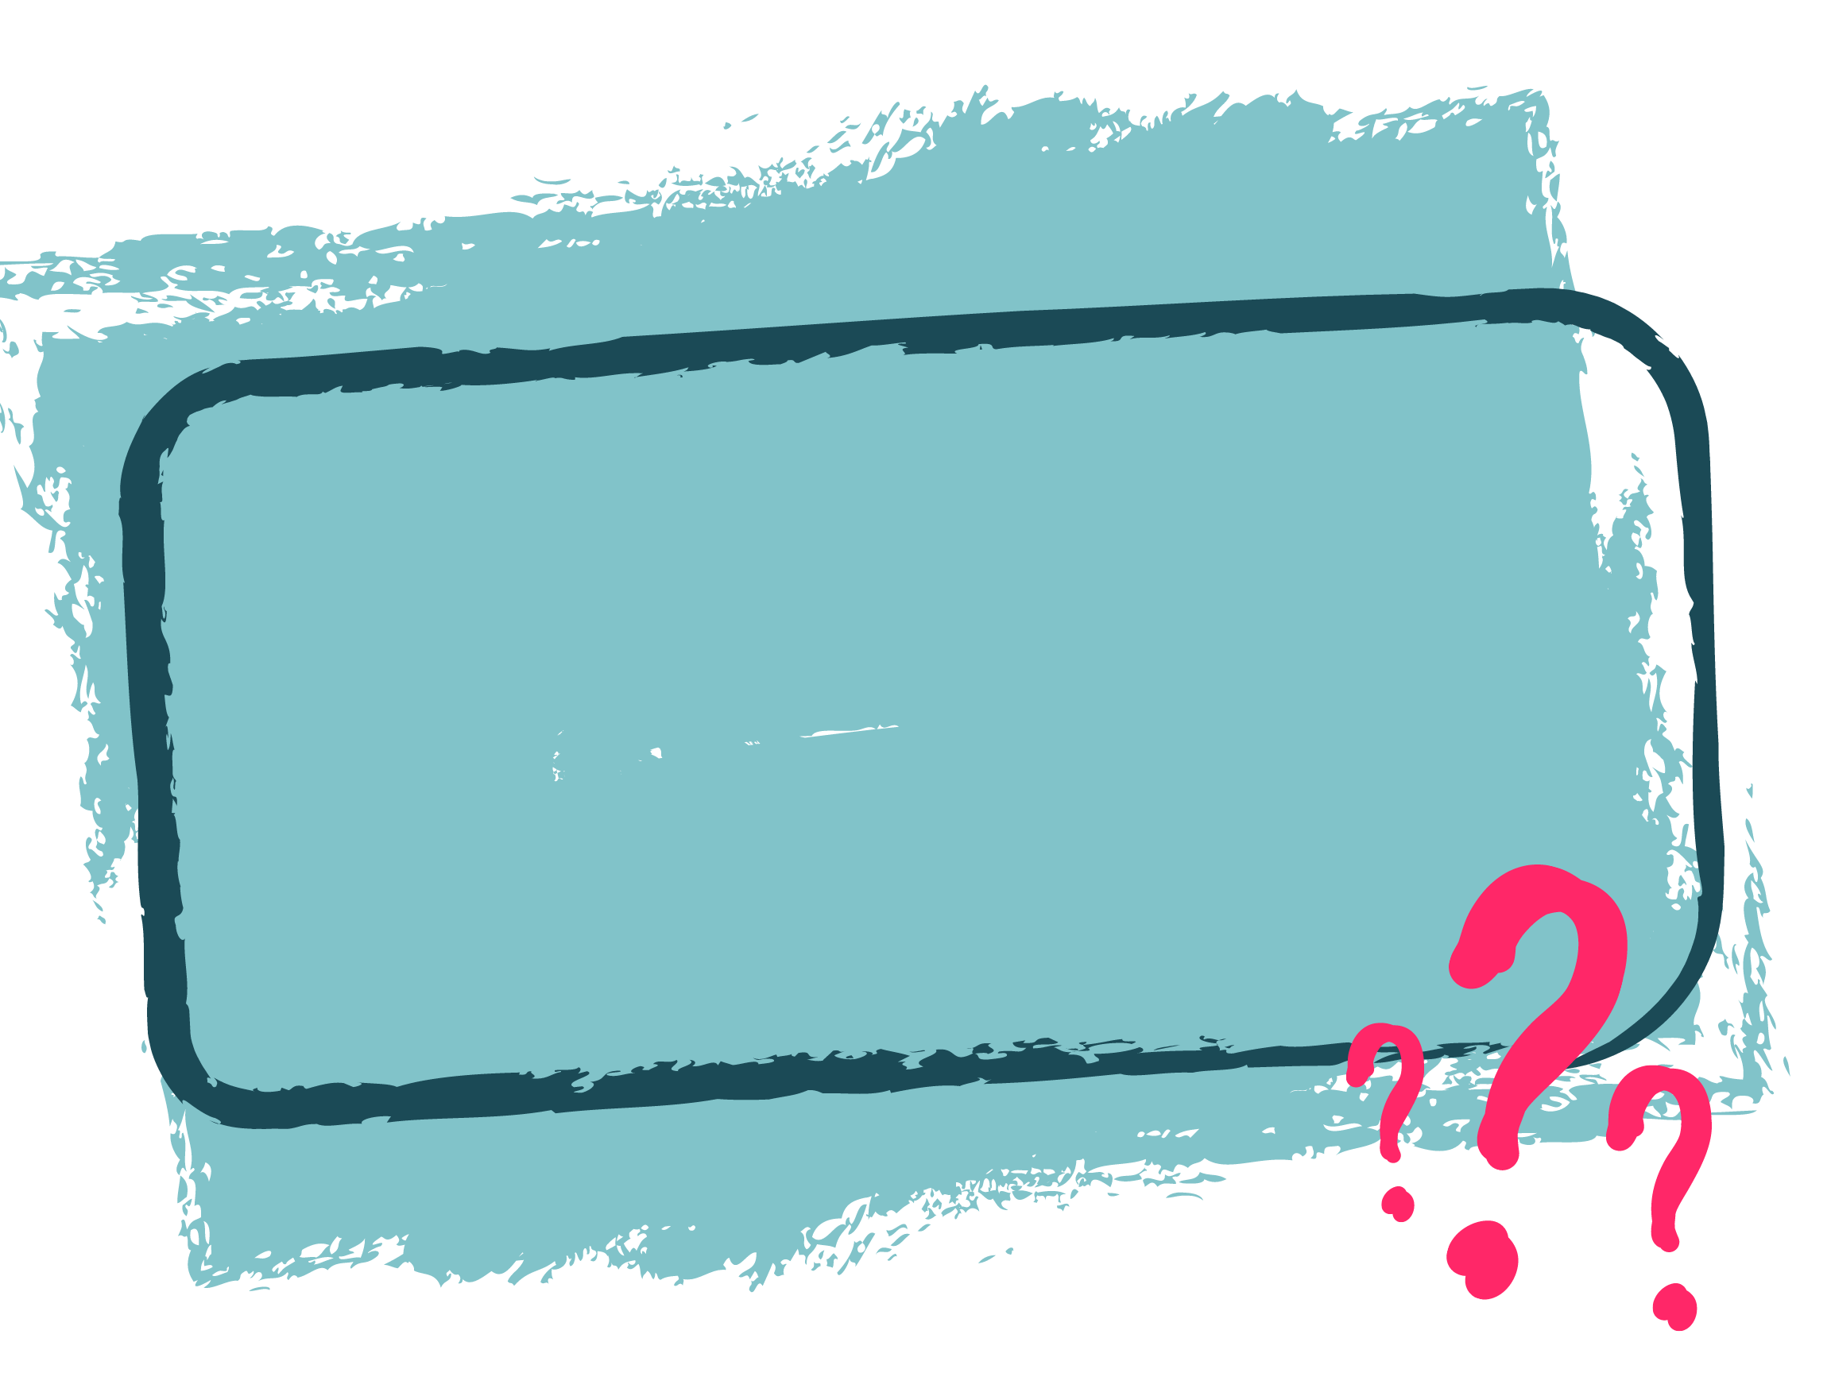
Review Questions

Slide 11
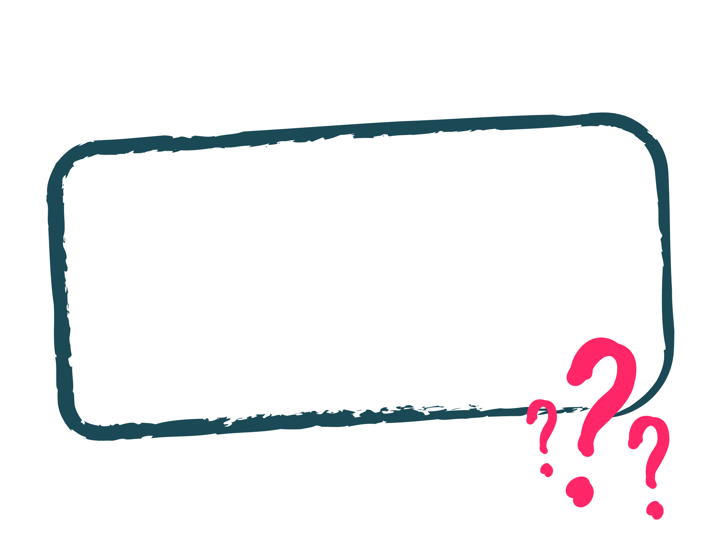
What did Moses tell the people of Israel that God wanted them to do at the beginning of our story?

Slide 12
Why did God want the people to bring an offering?

Slide 13
Why did God want the people to build a Tabernacle?
A.) He was bored and thought it would be a good idea to give this job to the people.
B.) He was lonely and needed to be near the people.
C.) He loved His people and wanted to make a way for them to meet with Him.

Slide 14
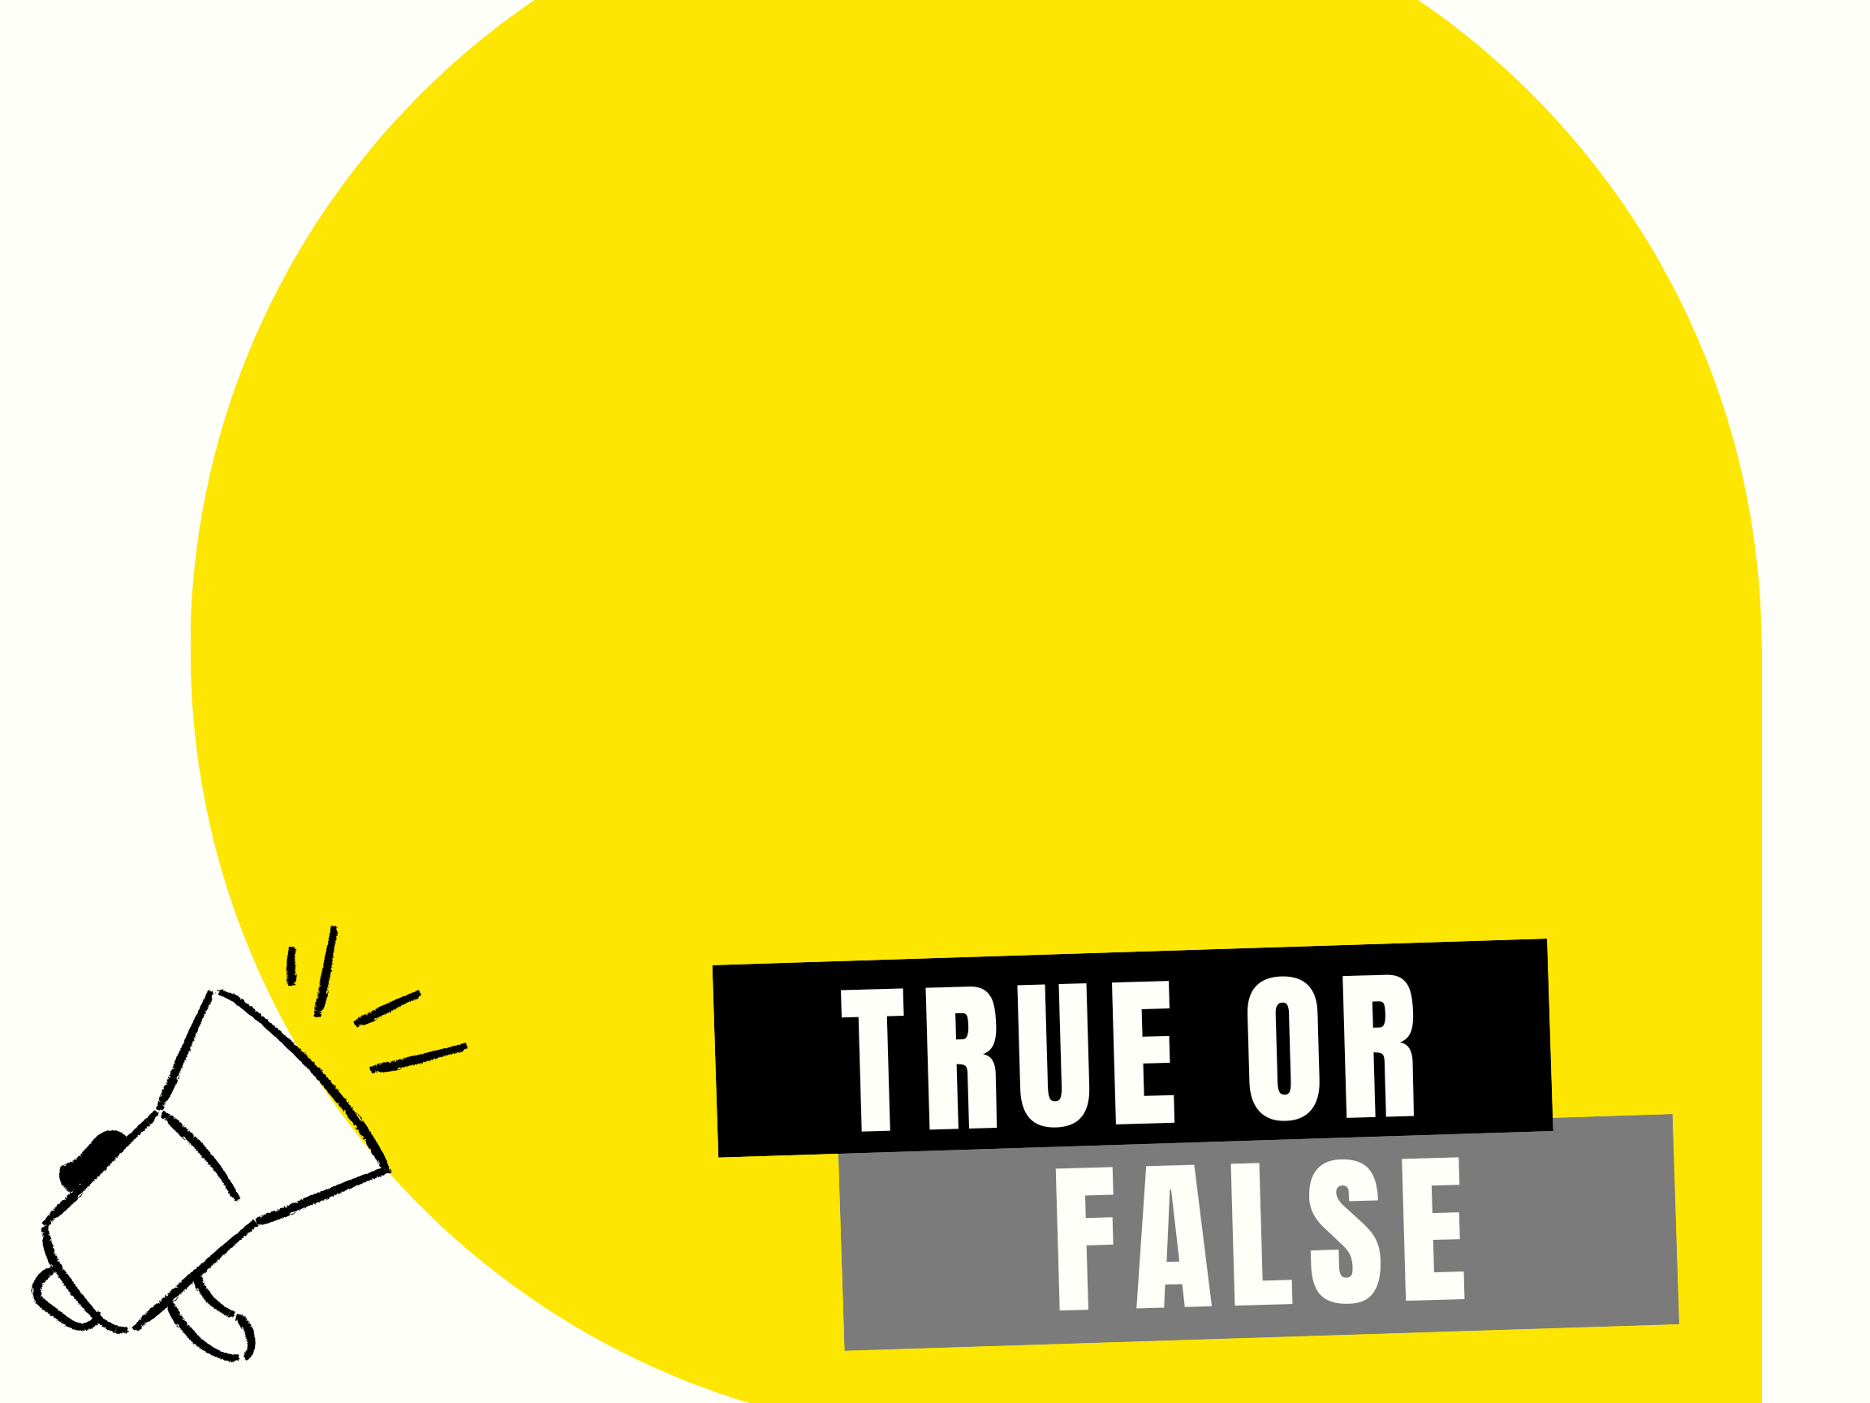
The people did not want to bring their offerings to build the Tabernacle.

Slide 15
The people brought more than the builders needed to
build the Tabernacle and
had to be told to stop.

Slide 16
How did the people get all those nice, expensive things they would use to build
the Tabernacle?

Slide 17
We learned that if you
know Jesus as your Savior, YOU SHOULD BE WILLING TO GIVE WHAT YOU HAVE TO GOD.
What is one way you can do that?

Slide 18
What did the curtains around the Tabernacle remind the people of?

Slide 19
What was the one way the people could go into the courtyard of the Tabernacle
to have their sins forgiven?

Slide 20
Who was the door a picture of?

Slide 21
True or False
Just like the door is the
only way into the Tabernacle, believing on Jesus as your Savior from sin is the only way you can be saved from your sin and have a wonderful relationship with God.

Slide 22
What did Jesus do to make the only way sinners like you and me can be saved from our sin?

Slide 23
After the Tabernacle was built, what did God tell the people to do because of their sins?
A.) Build a golden calf
B.) Bring a sacrifice to God
C.) Just tell God they were really sorry

Slide 24
True or False
When the people offered a
sacrifice, it didn’t matter if the animal was sick or hurt.

Slide 25
It was very important they obeyed this rule because the animal was a picture of
Whom?

Slide 26
Inside the Tabernacle was a room called the Holy Place. Name one thing the Priest would have seen when he went inside.

Slide 27
Inside the Most Holy Place or Holy of Holies was the Ark of the Covenant and the Mercy Seat. Why was this the most special part of the Tabernacle?

Slide 28
True or False
God still commands us to
go to a Tabernacle and have a High Priest offer sacrifices to Him and pray for us.

Slide 29
What special thing did God do to show that people could come
to Him without a High Priest?
A.) He put a rainbow in the sky.
B.) He caused fire to come down
from the sky.
C.) When Jesus died on the cross, God tore the veil that separated the Holy Place from the Most Holy Place.

