Slide 1
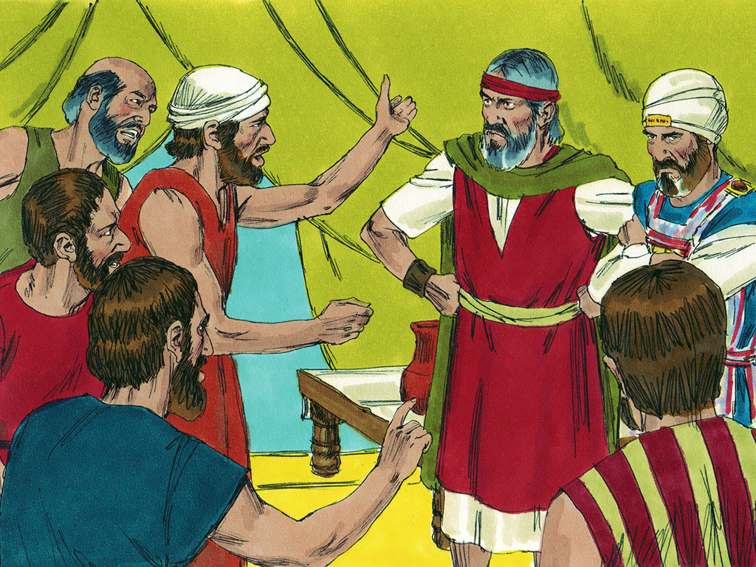
MOSES # 11
“God’s Punishment for Disobedience”

Slide 3
Notes:
Rule Chart

Slide 4
Notes:
Prayer

Slide 8
Notes:
Song: “My God is Powerful”

Slide 9
Notes:
Bible Lesson

Slide 10
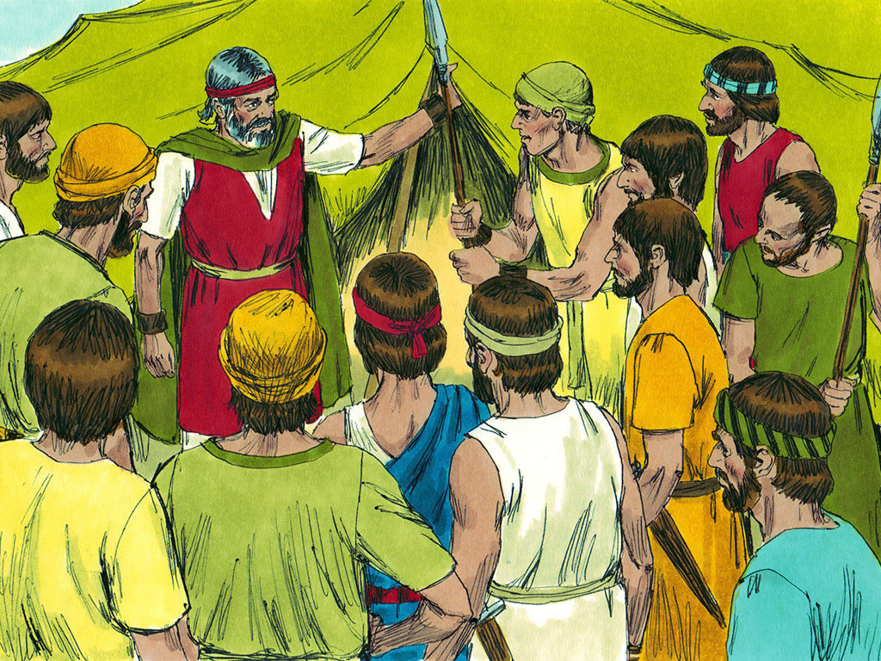

Slide 14
Notes:
3-1

Slide 16
Notes:
3-1

Slide 17
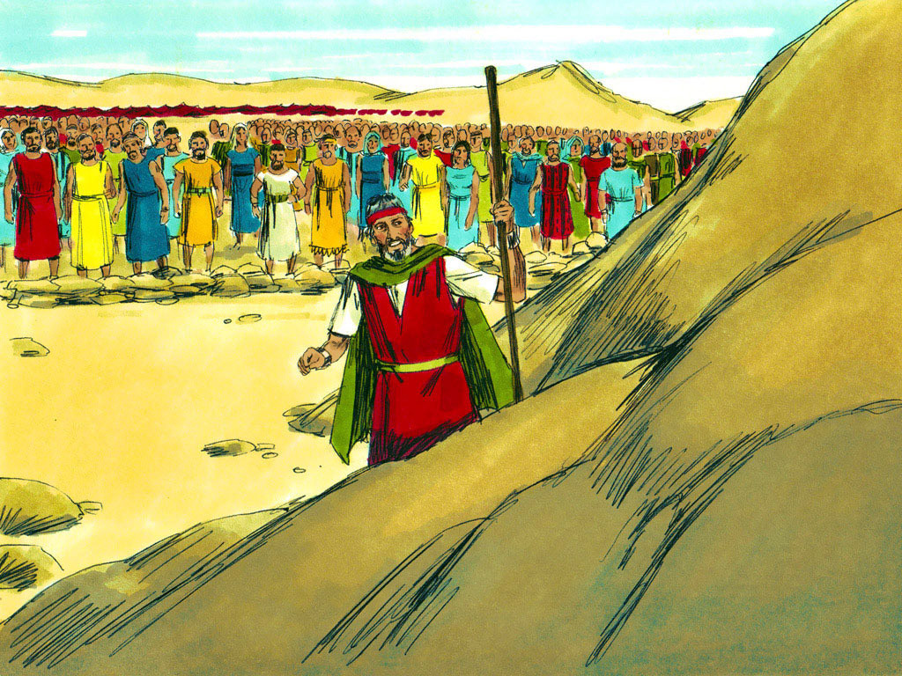

Slide 20
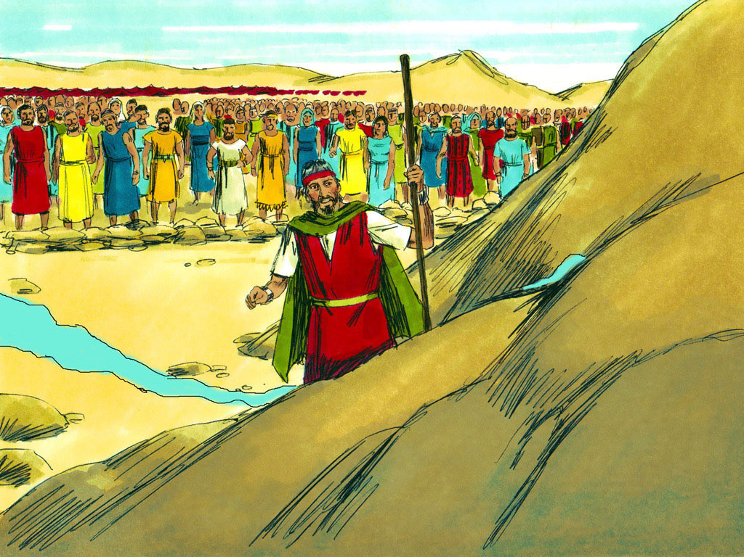

Slide 21
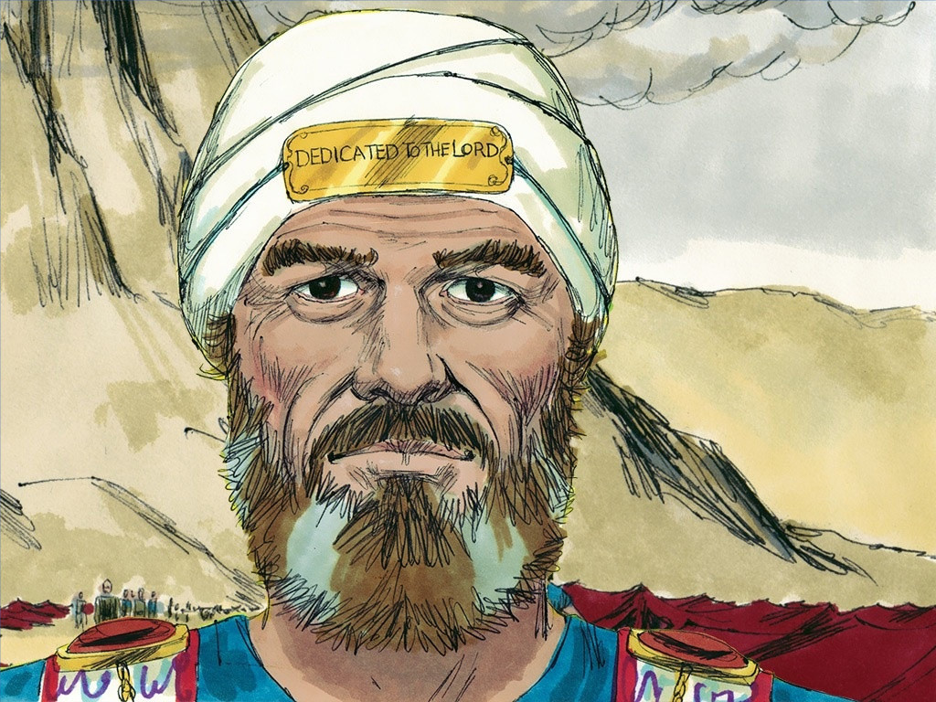

Slide 22
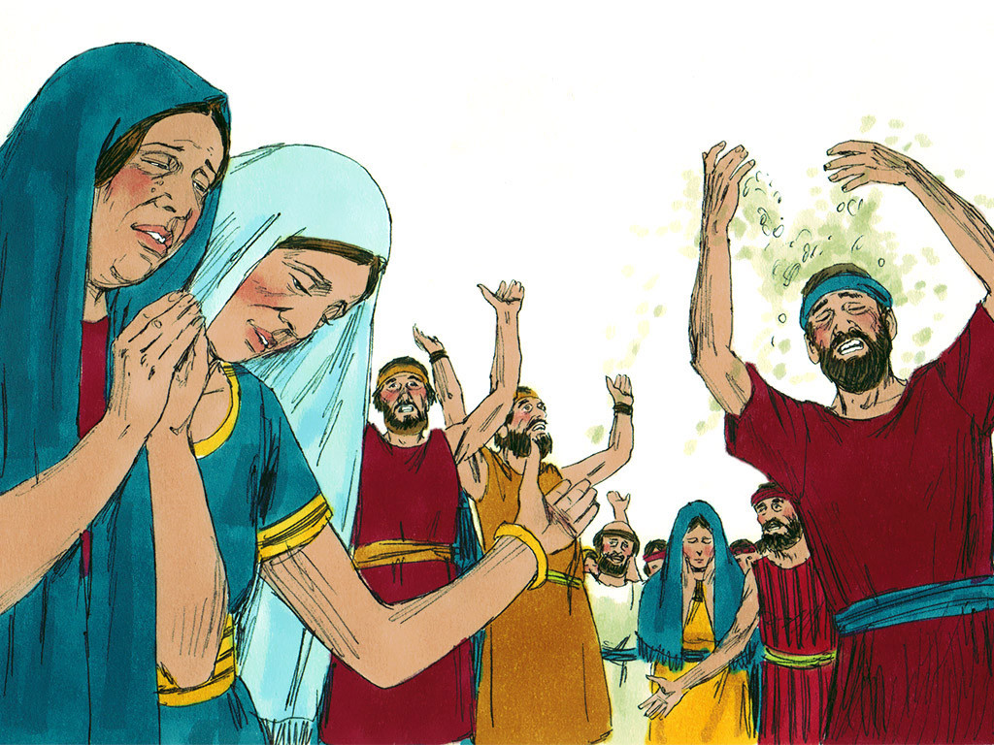

Slide 27
YES
YES
500
200
NO
NO
400
300
NO
YES
100
NO
YES
100
YES
NO
300
500
200
400

