Slide 1
Notes:
Intro: Welcome to Good News Club

Slide 2
Notes:
Rule Chart

Slide 3
PRAYER
Notes:
Opening Prayer

Slide 5
Memory
Verse

Slide 6
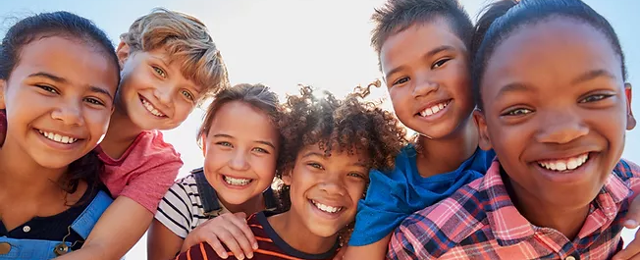
1 Corinthians 15:57
“But thanks be to God,
which giveth us the victory
through our Lord Jesus Christ.”

Slide 9
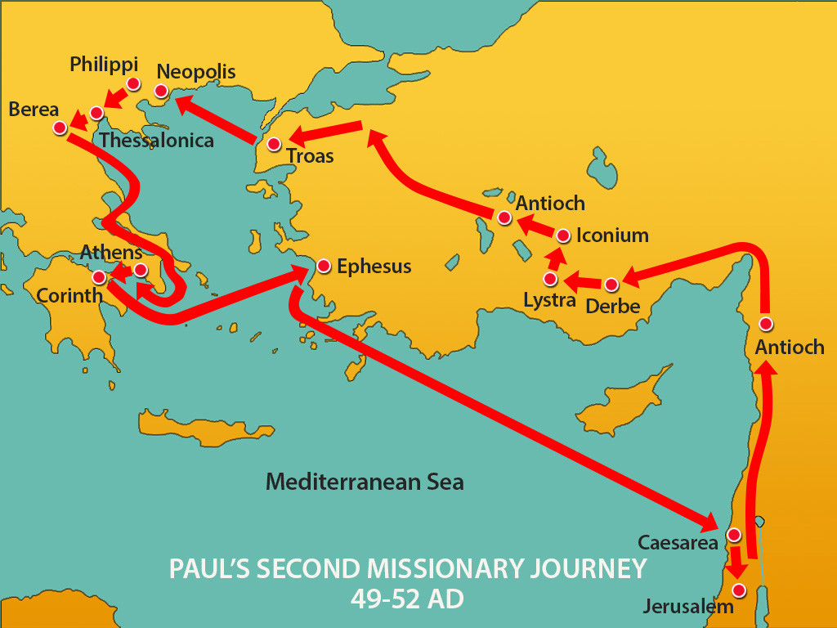
5-A

Slide 10
You need Jesus’ help
to have victory
over sin.

Slide 11
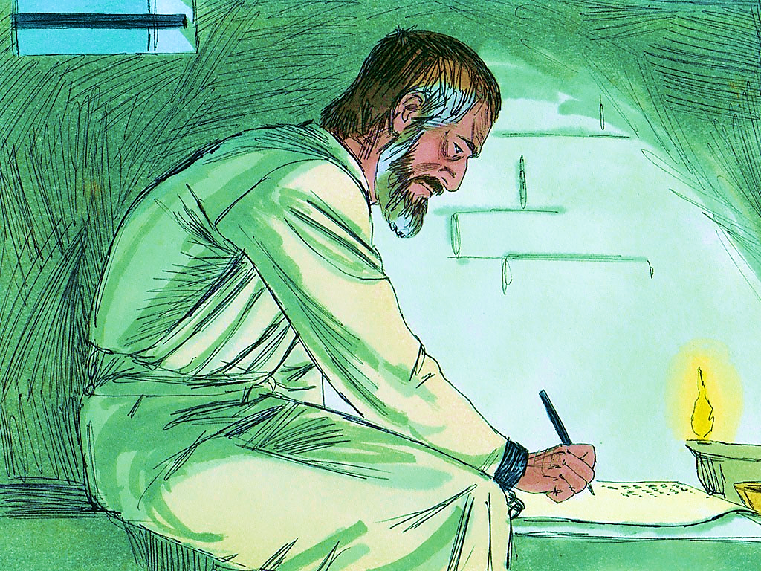
5-1

Slide 12
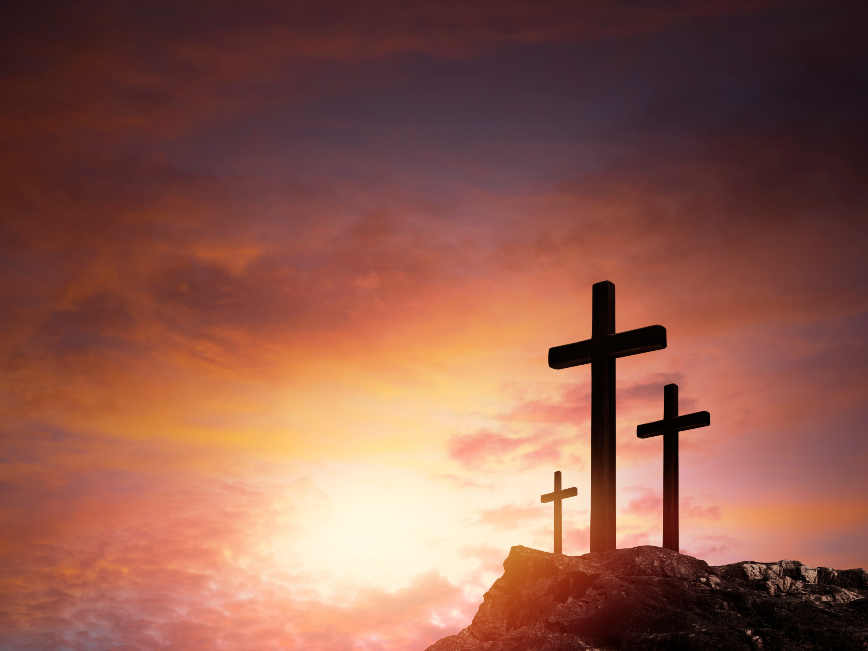
Romans 5:6
“For when we were yet
without strength, in due time
Christ died for the ungodly.”

Slide 13
5-1

Slide 14
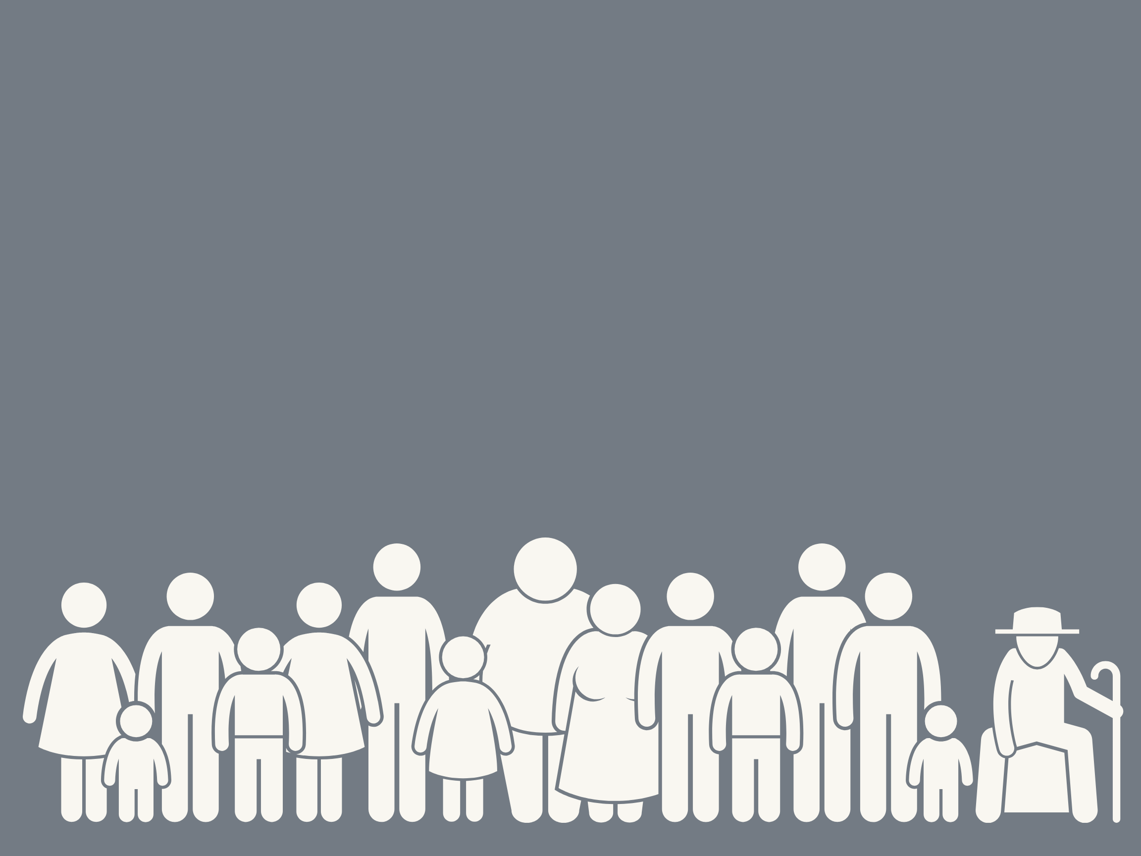
Romans 3:23
“For all have sinned,
and come short of
the glory of God.”

Slide 15
5-1

Slide 16
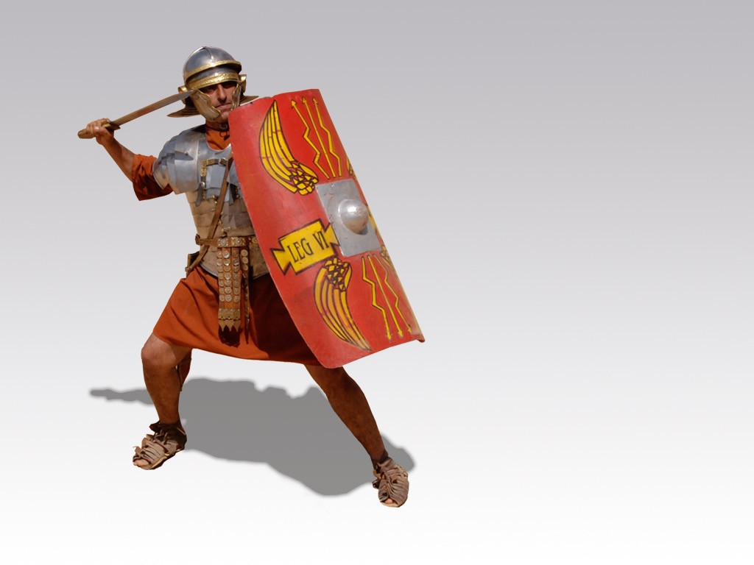
5-2

Slide 17
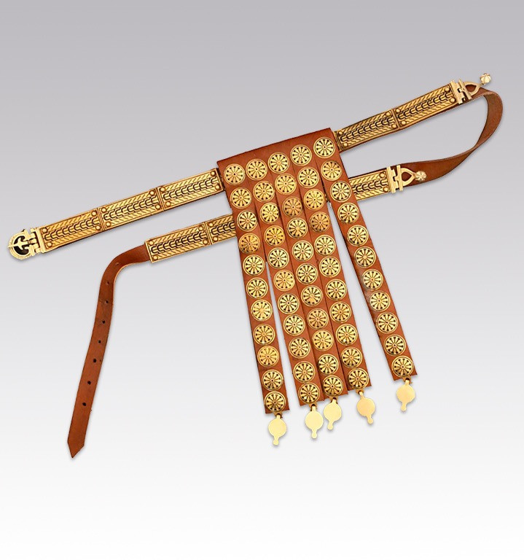
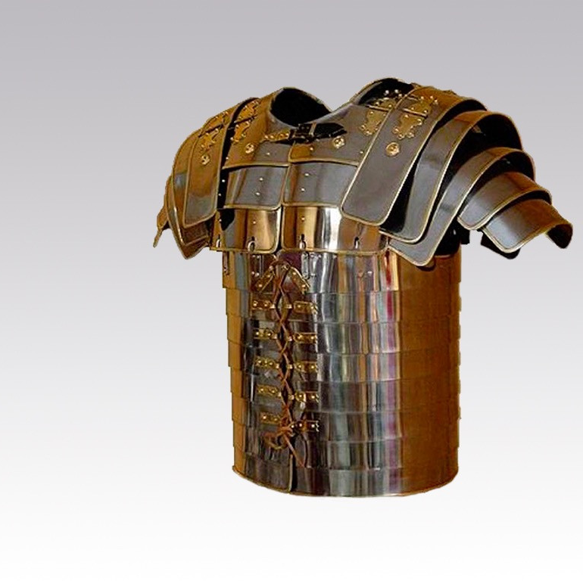
Breastplate of
Righteousness
Belt of Truth
5-3

Slide 18
You need Jesus’ help
to have victory
over sin.

Slide 19
1 Cor. 15:57
“But thanks be to God,
which giveth us the victory
through our Lord Jesus Christ.”

Slide 20
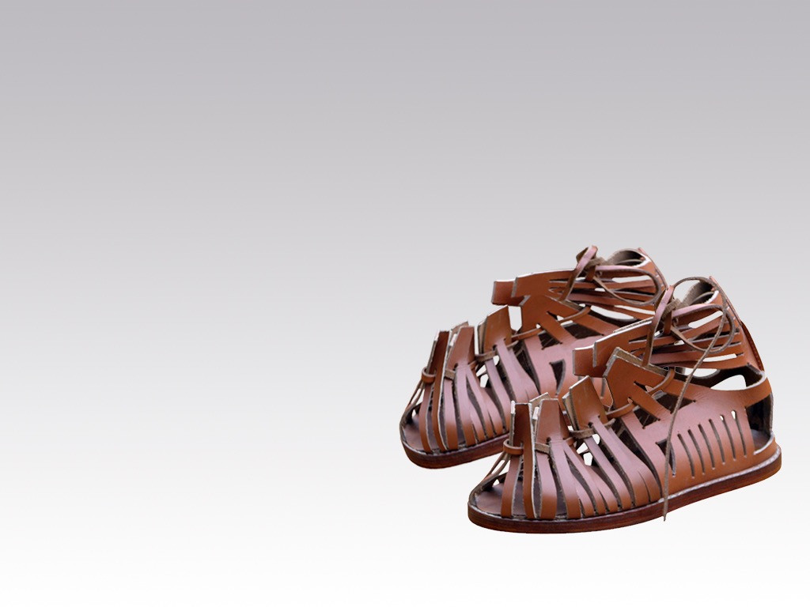
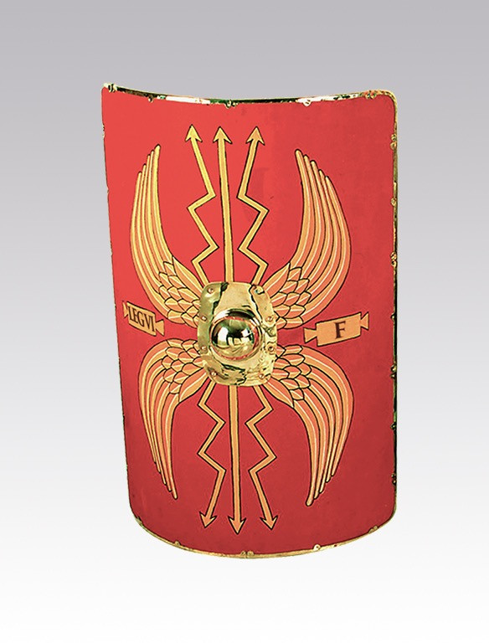
Shoes of the
Gospel of Peace
Shield of Faith
5-4

Slide 21
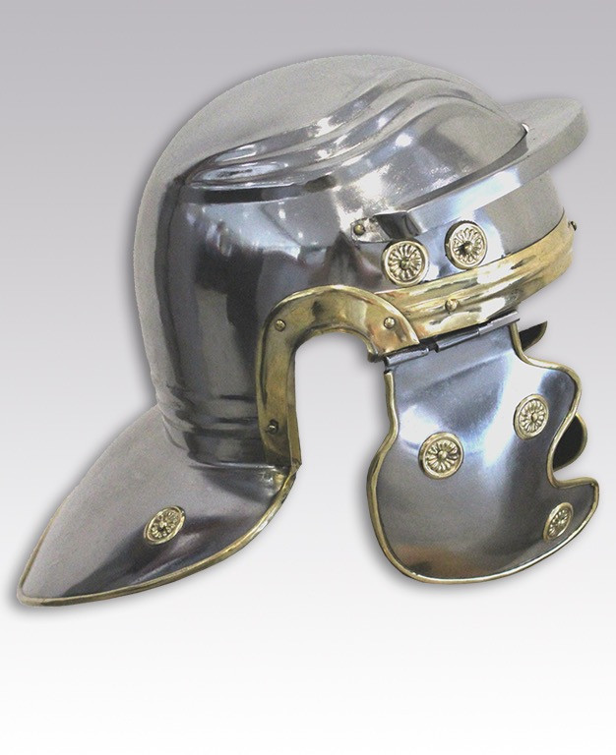
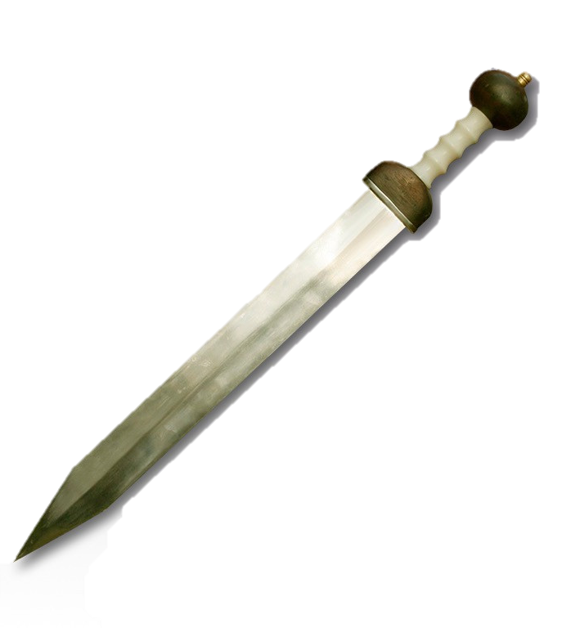
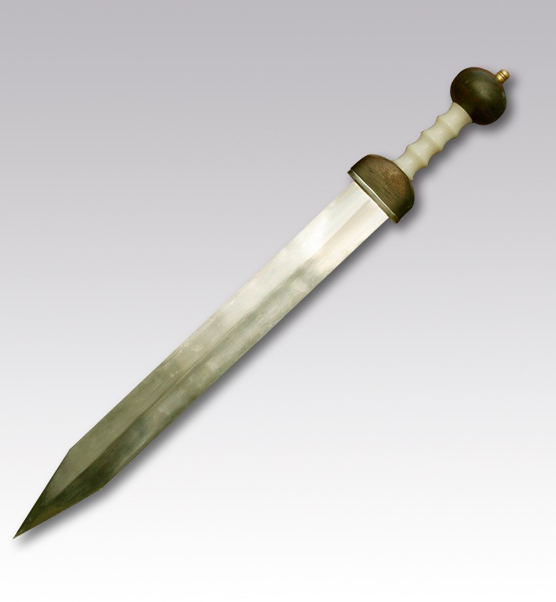
Helmet of
Salvation
Sword of
the Spirit
5-5

Slide 22
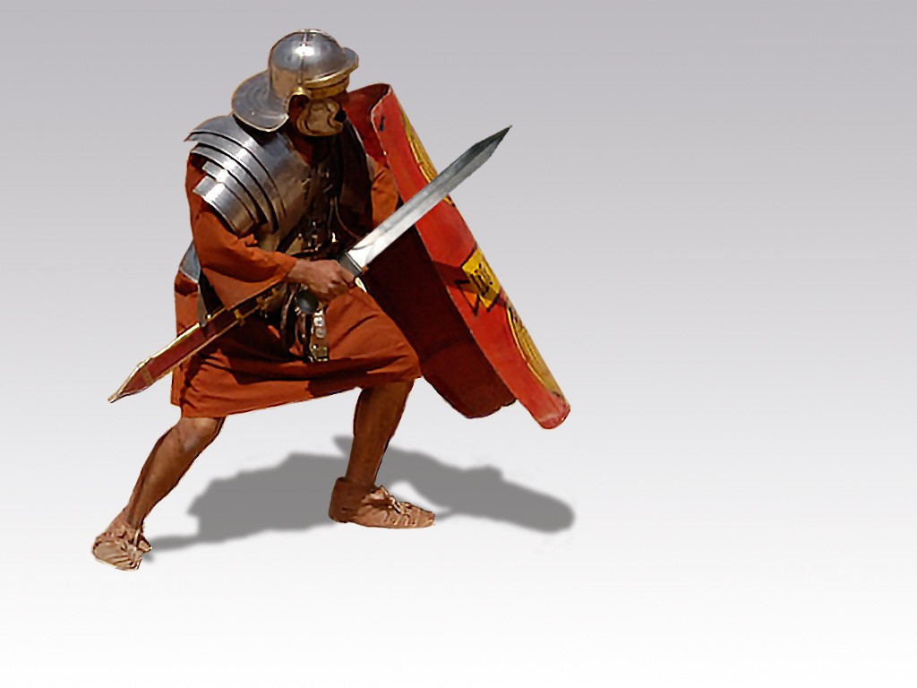
5-6

Slide 23
You need Jesus’ help
to have victory
over sin.

Slide 24
1 Cor. 15:57
“But thanks be to God,
which giveth us the victory
through our Lord Jesus Christ.”

Slide 25
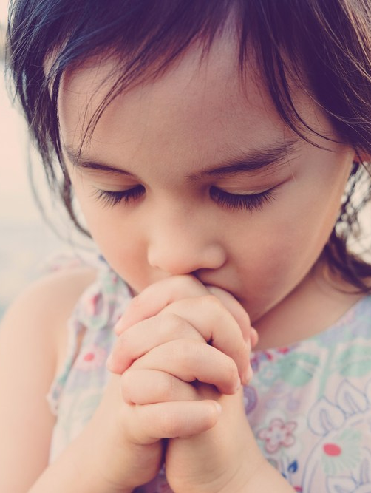
1 John 5:12
“He that hath the Son hath life;
and he that hath not
the Son hath not life.”

Slide 32
Review
G
A
M
E

Slide 33
“Ways to
Serve God”
Once a child answers correctly,
click on the slide
and as each hat is uncovered,
be sure to emphasize that
this hat reminds us
of one way a person can serve God.

Slide 34
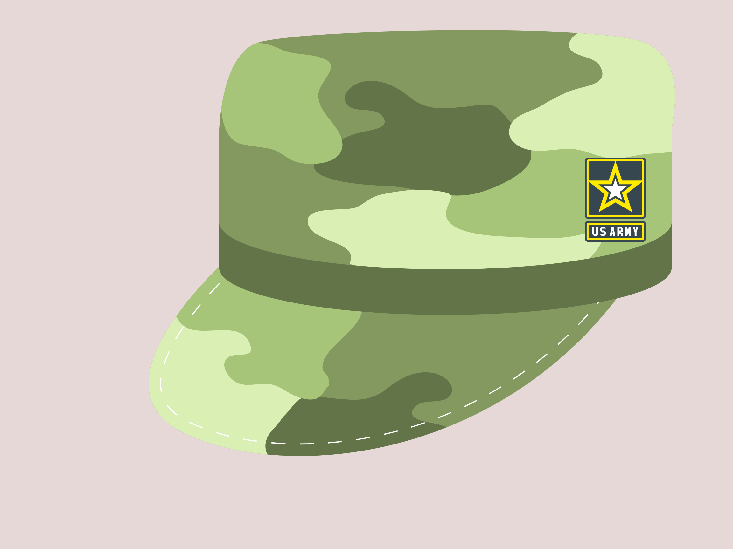
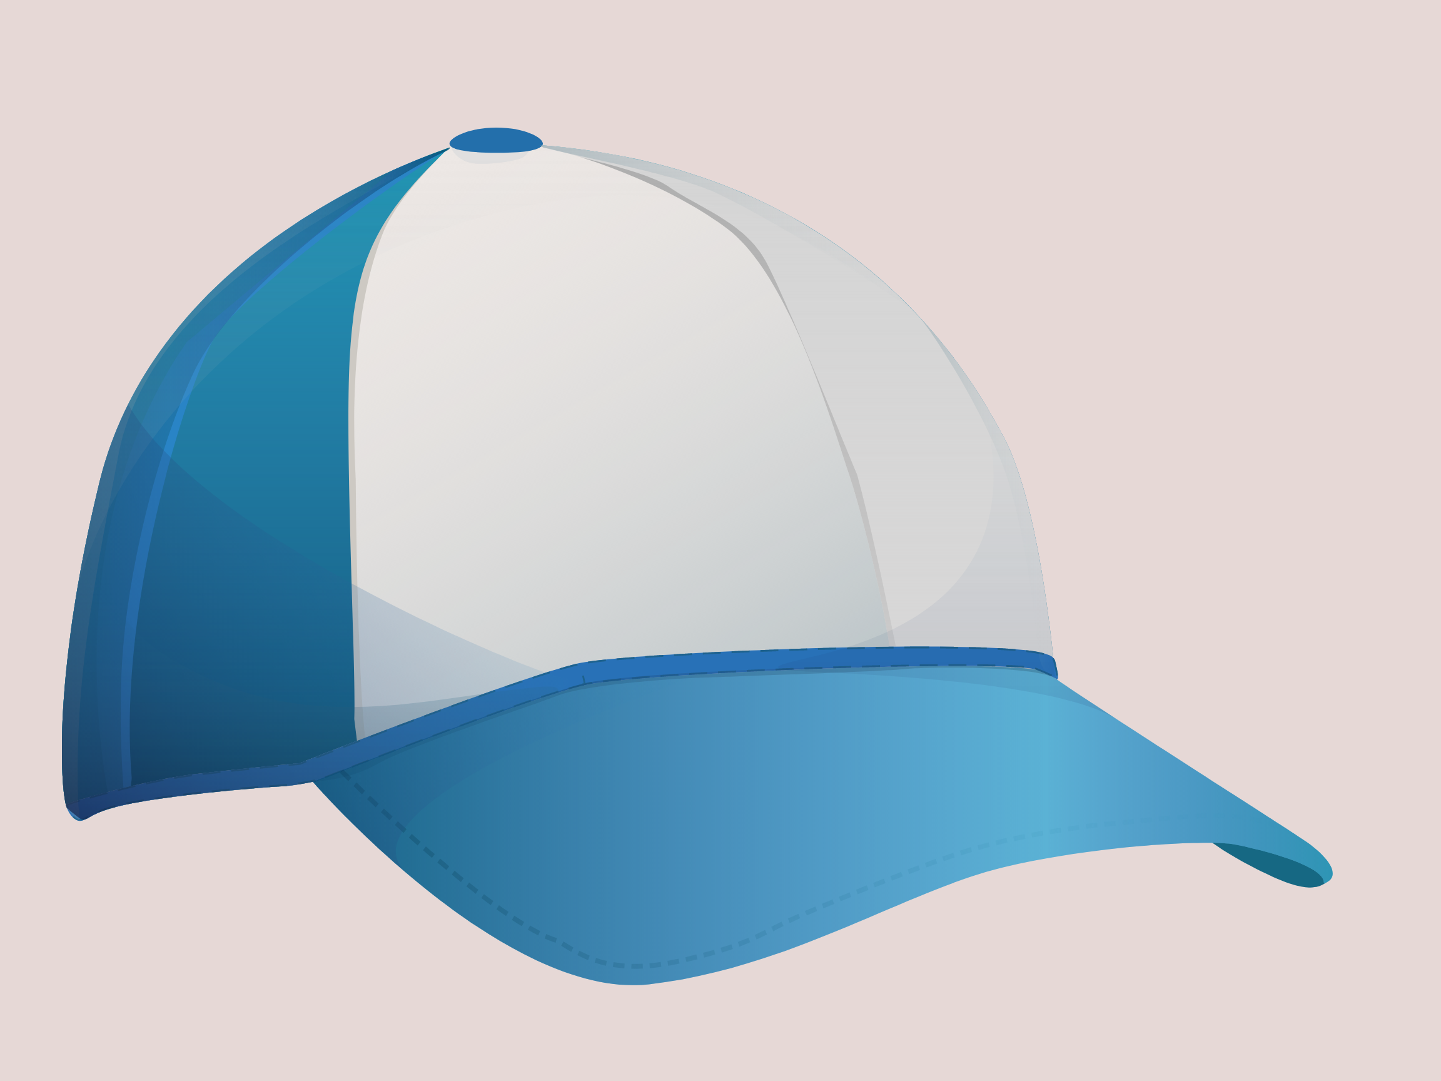
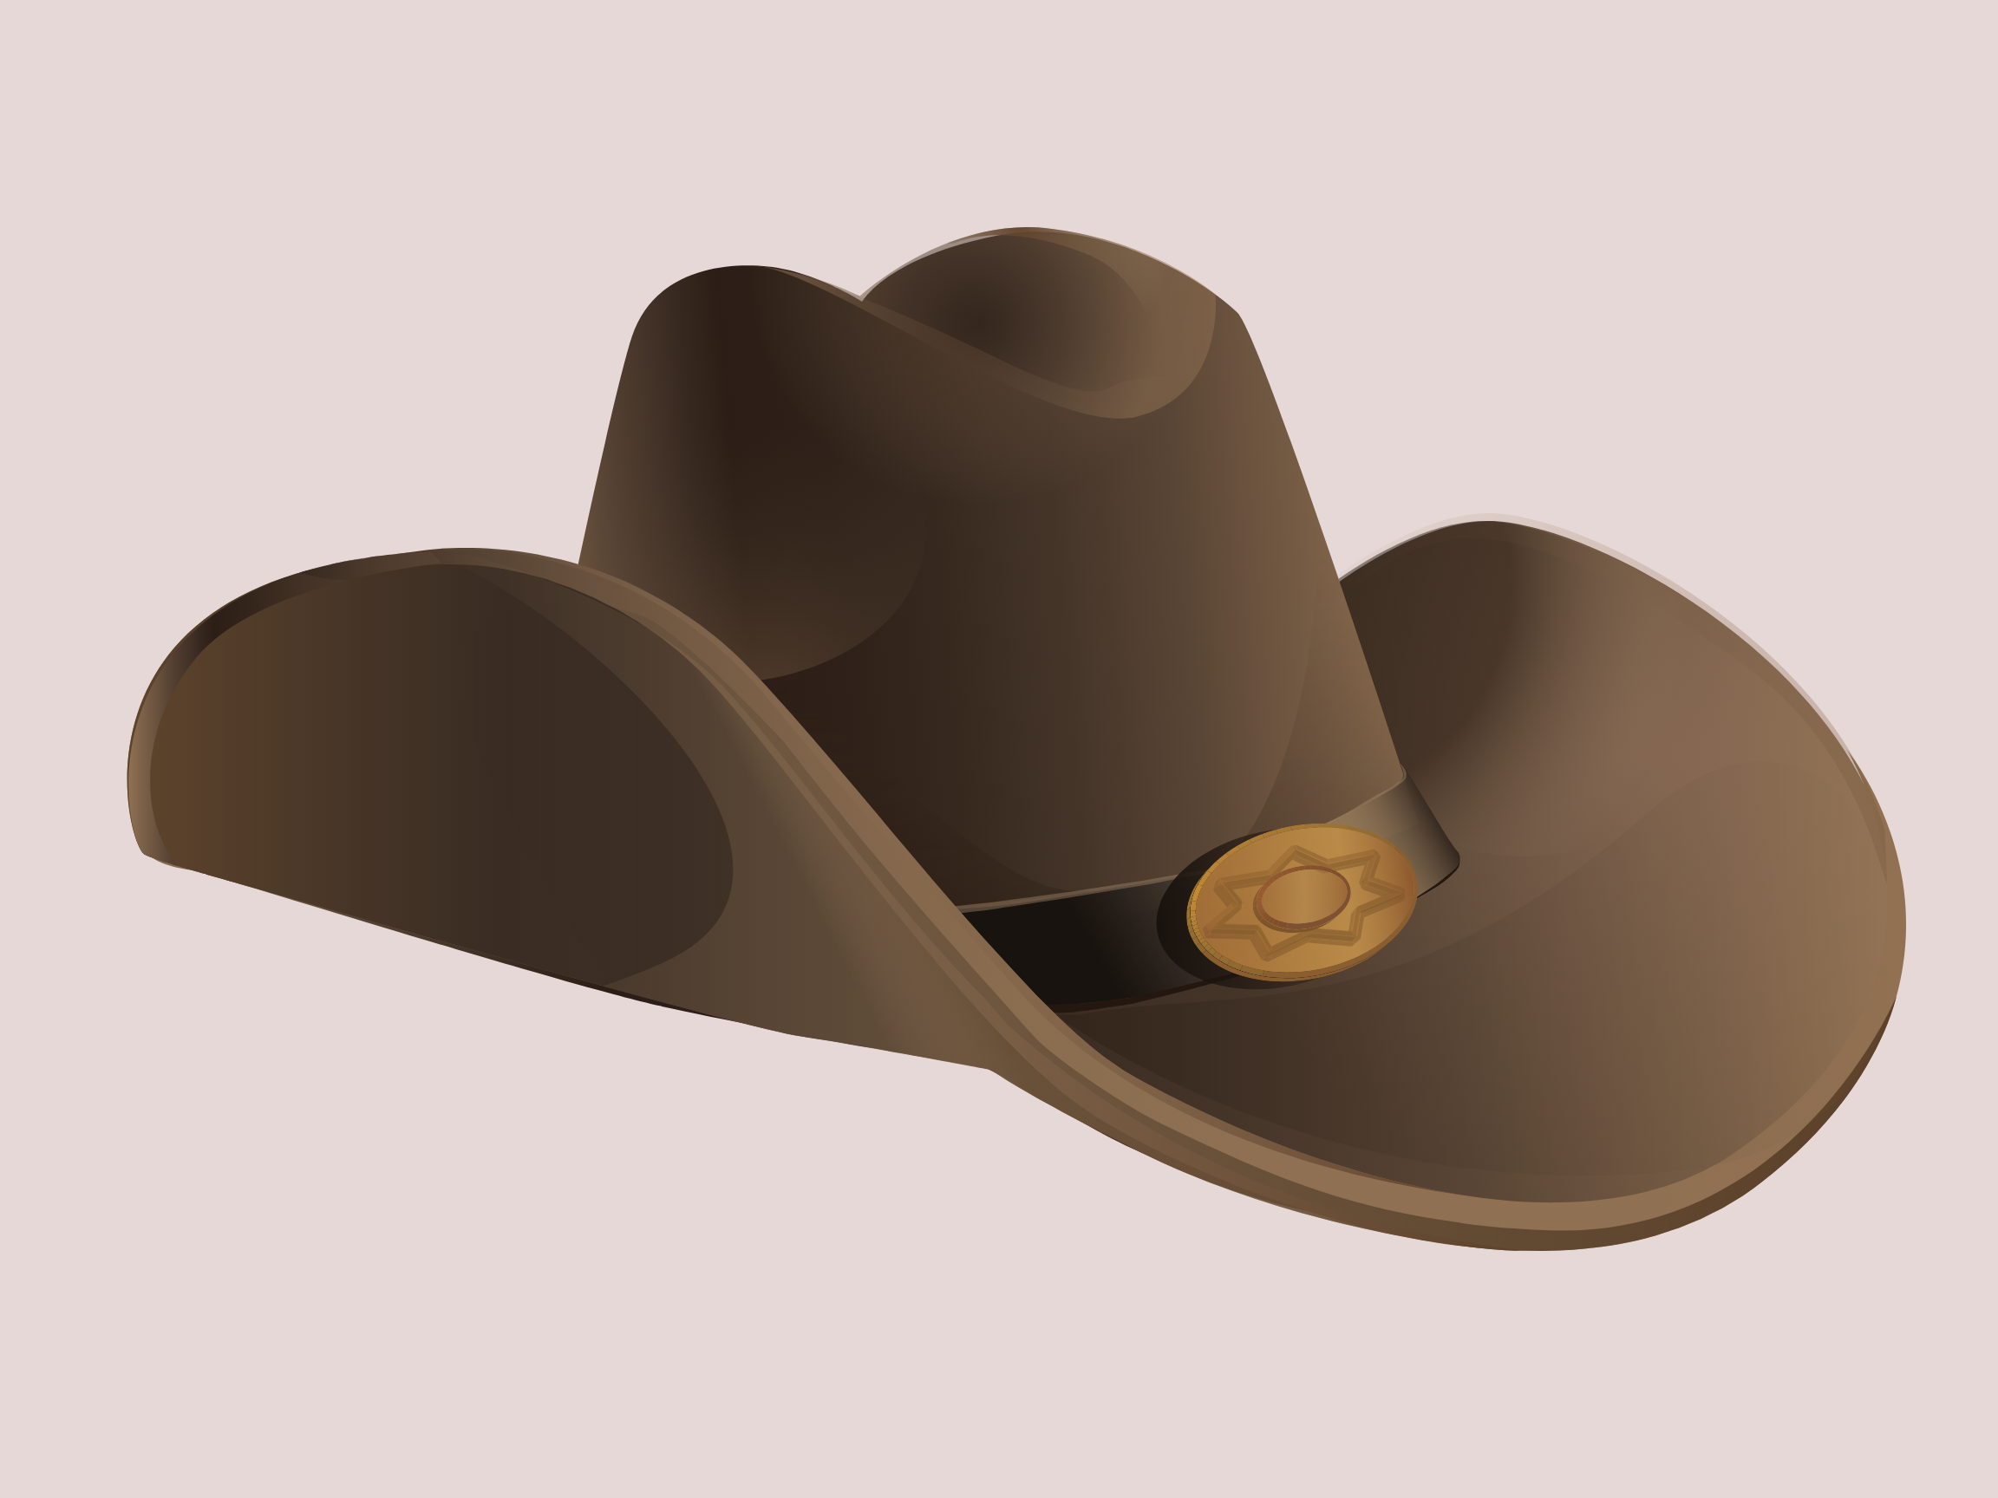

Slide 35
Thank you for
joining our

Slide 36
Notes:
You can Screen Share these Counseling Card slides to go through as you normally would.

