Slide 1
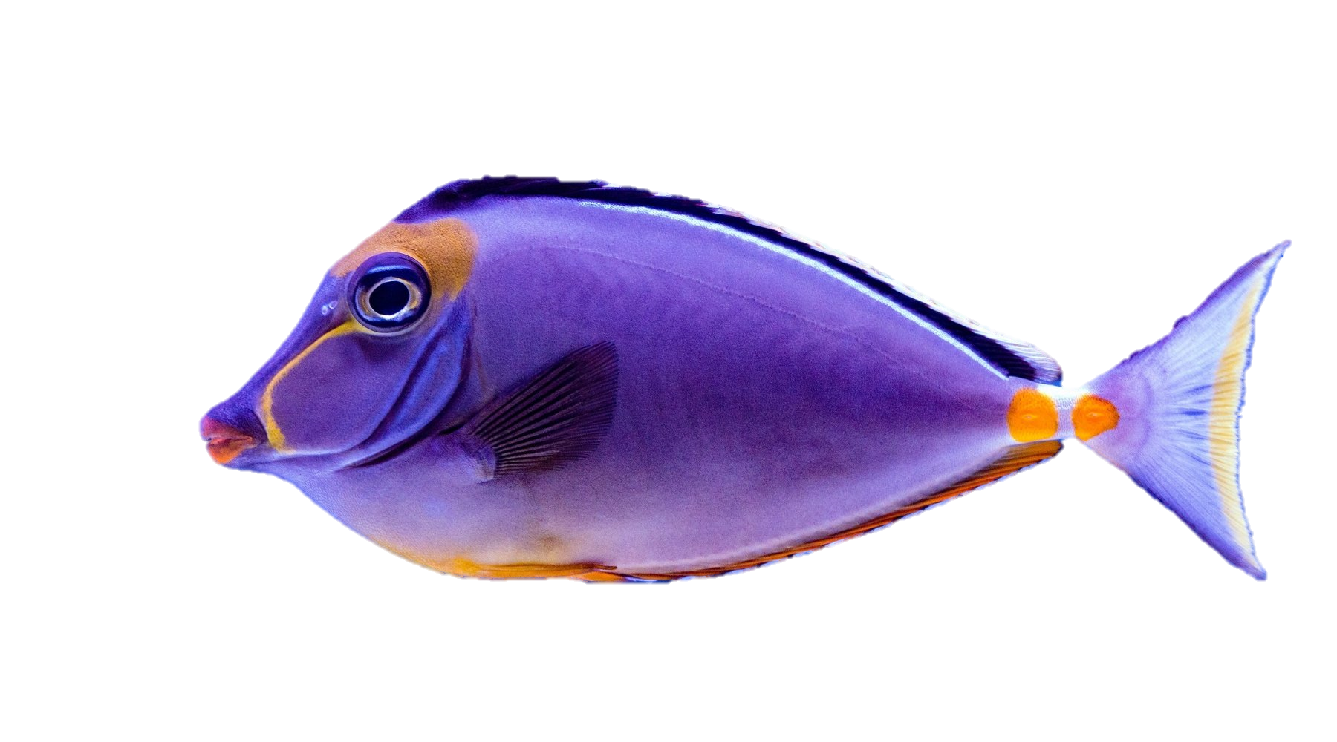
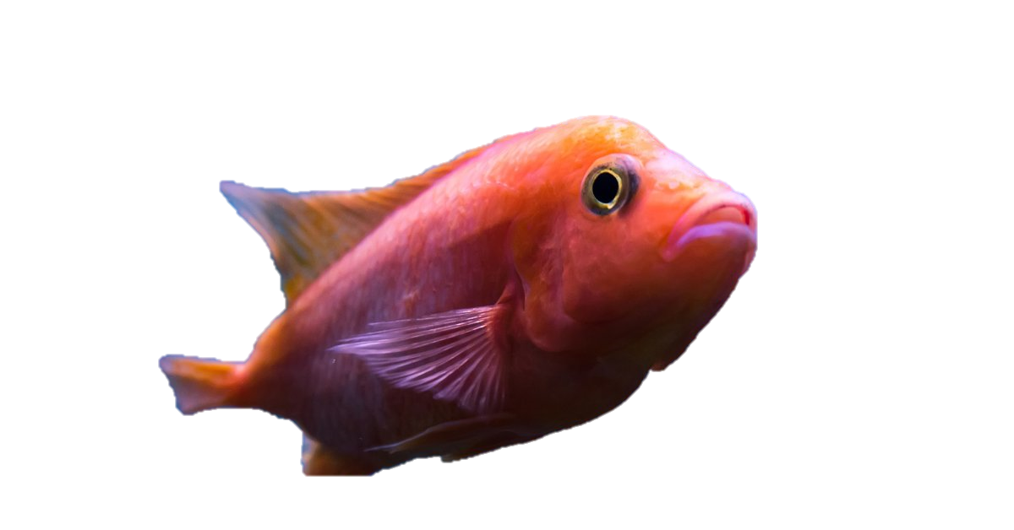
Let’s Go Fishing!
Divide the children into 2 teams.
Once a child answers a question correctly, click the screen to reveal how many points he earned for his team.
The team with the most points at the end wins.

Slide 2
100
200
200
100
200
200
200
200
200
200
200

