Slide 1
Have You Brought Your Gifts?

Slide 4
Dear Heavenly Father, ​
Thank You for....​
_________________
Please ….​
_________________
In Jesus' name,​
Amen​

Slide 6
Have You Brought Your Gifts?

Slide 7
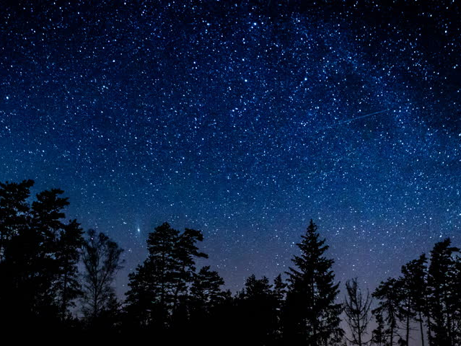

Slide 8
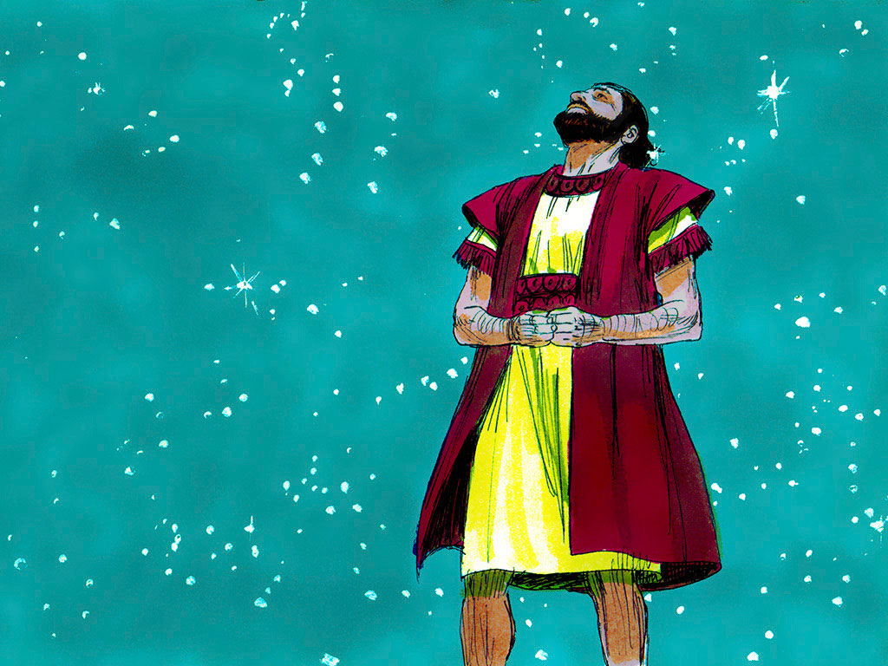

Slide 9
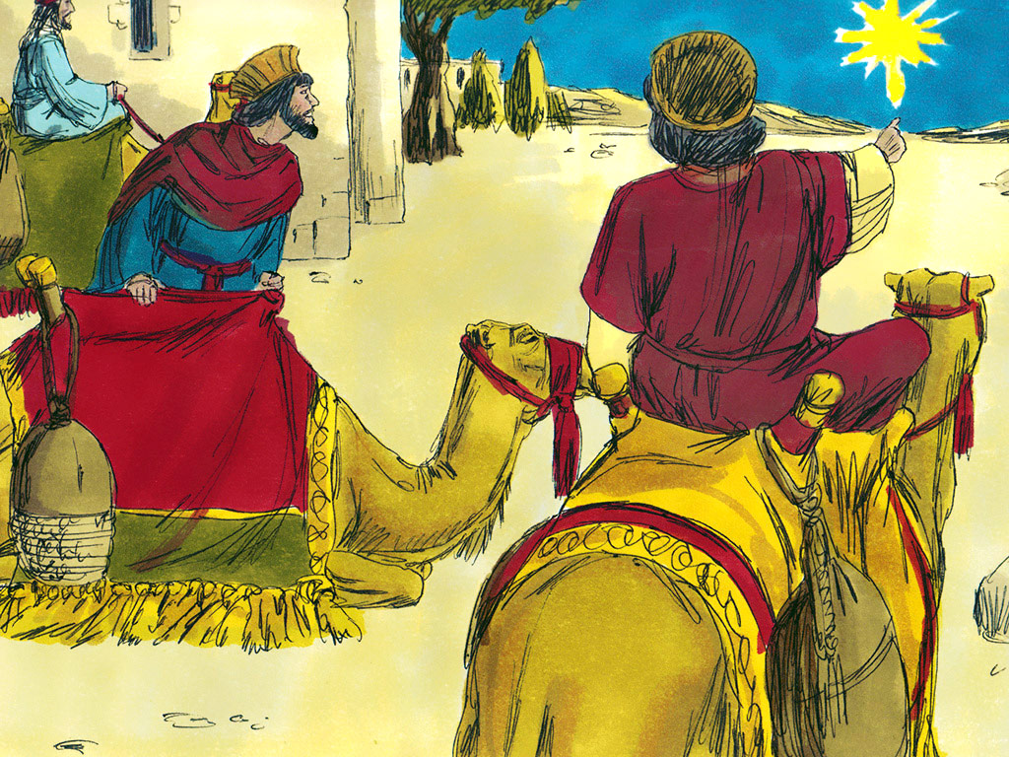

Slide 10
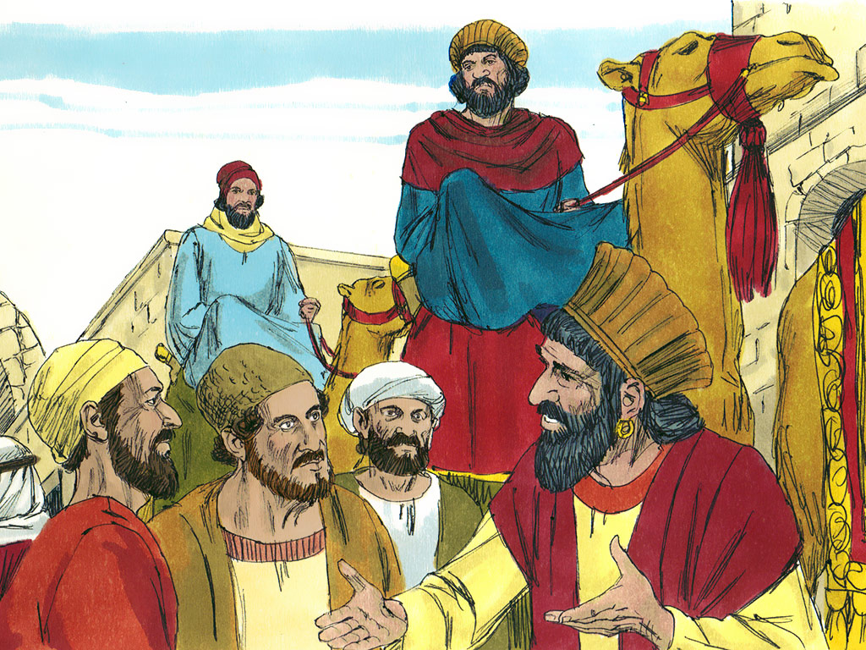

Slide 11
You should have a heart
that wants to worship God.
Life of Christ MT#3
Life of Christ MT#3

Slide 13
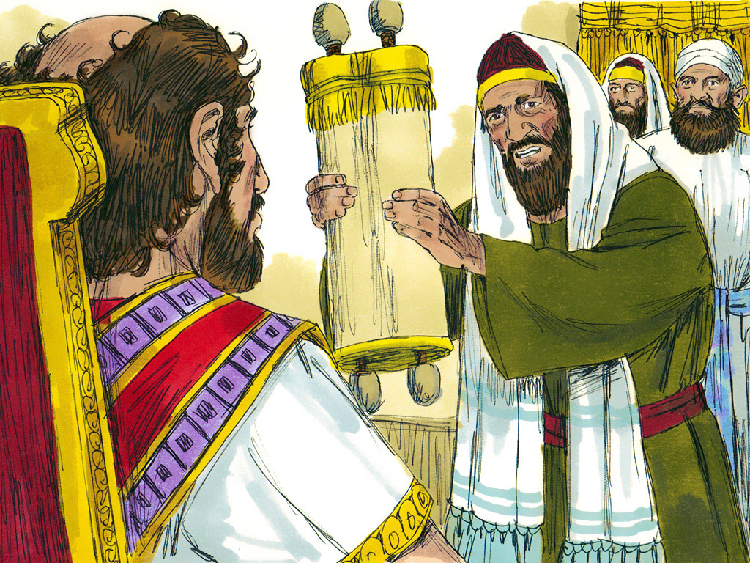

Slide 14
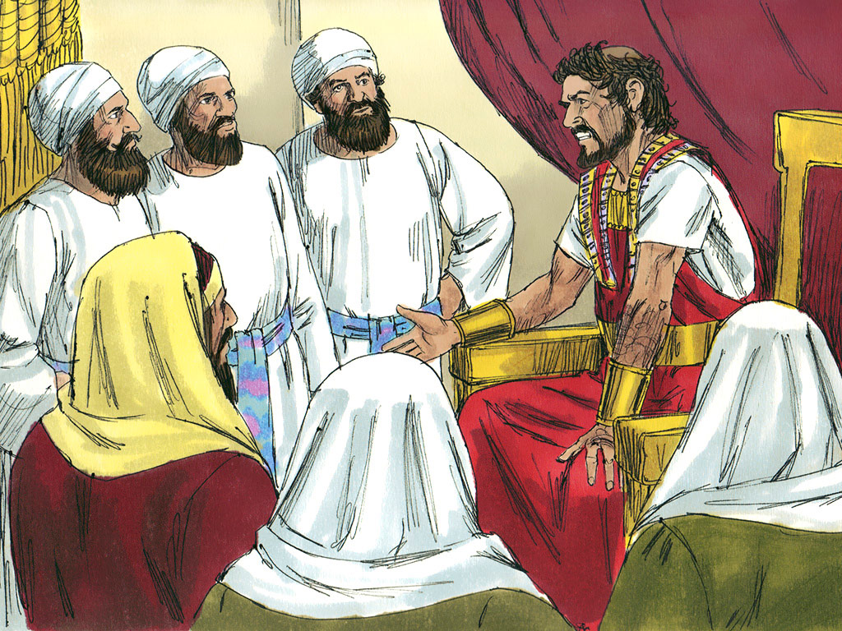

Slide 15
Jeremiah 17:9
“The heart is deceitful
above all things,
and desperately wicked;
who can know it?”

Slide 17
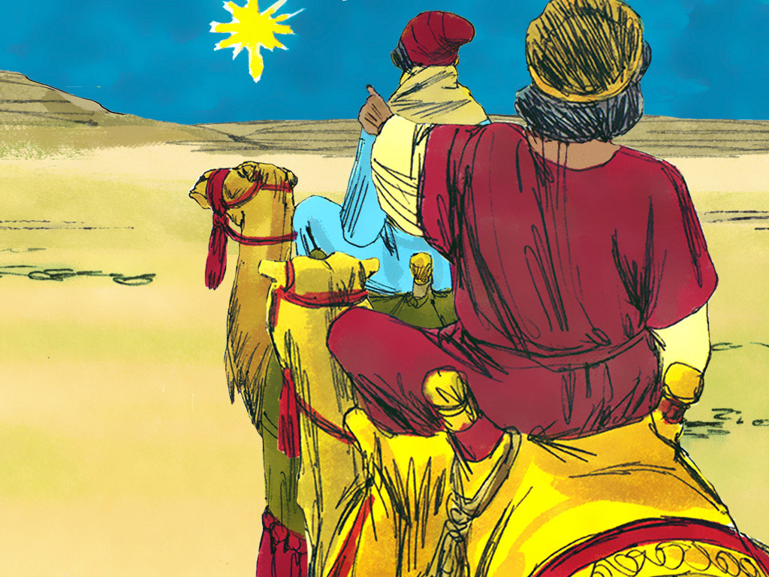

Slide 18
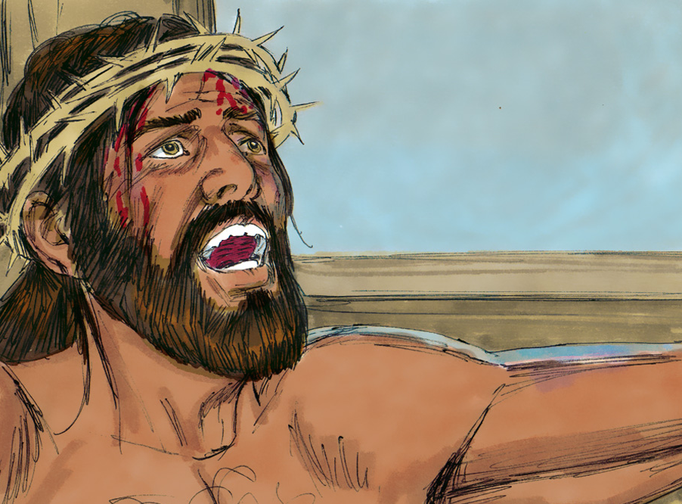
1 Peter 2:24
“Who His own
self bore our sins in His own body
on the tree…”

Slide 20
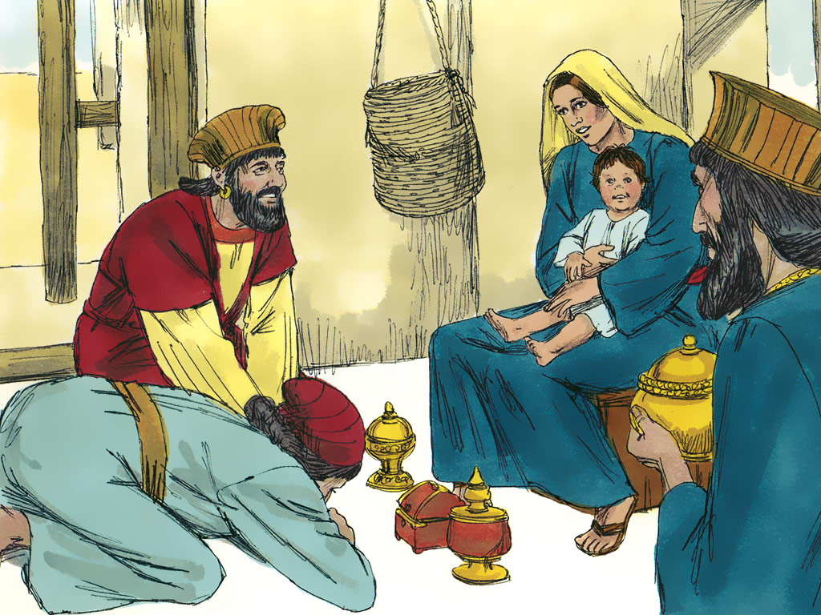

Slide 21
You should have a heart
that wants to worship God.
Life of Christ MT#3
Life of Christ MT#3

Slide 22
Psalm 29:1
"Give unto the Lord
the glory due
unto His Name..."
Life of Christ MT#3

Slide 24
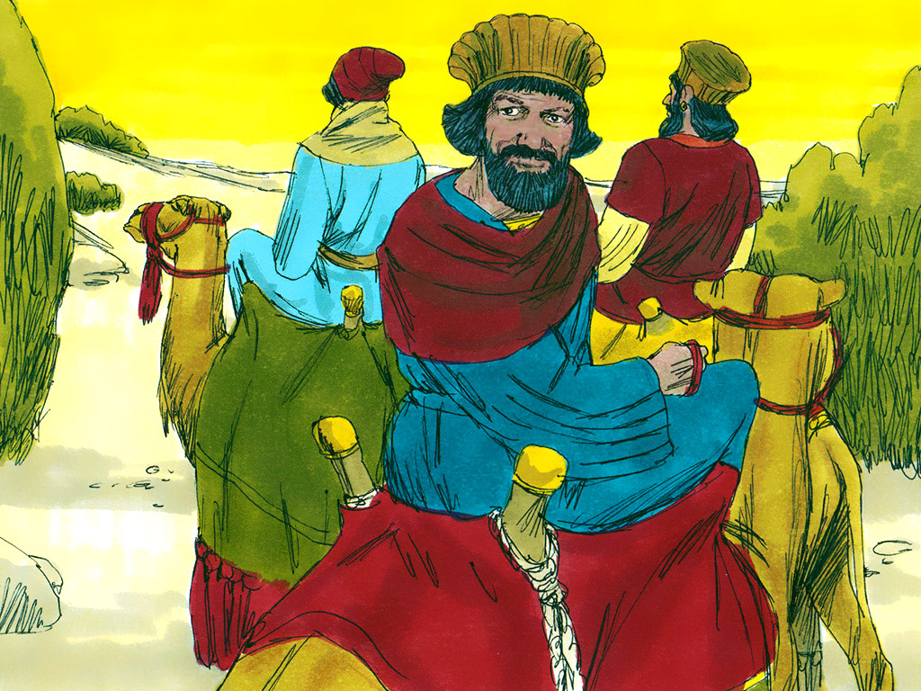

Slide 25
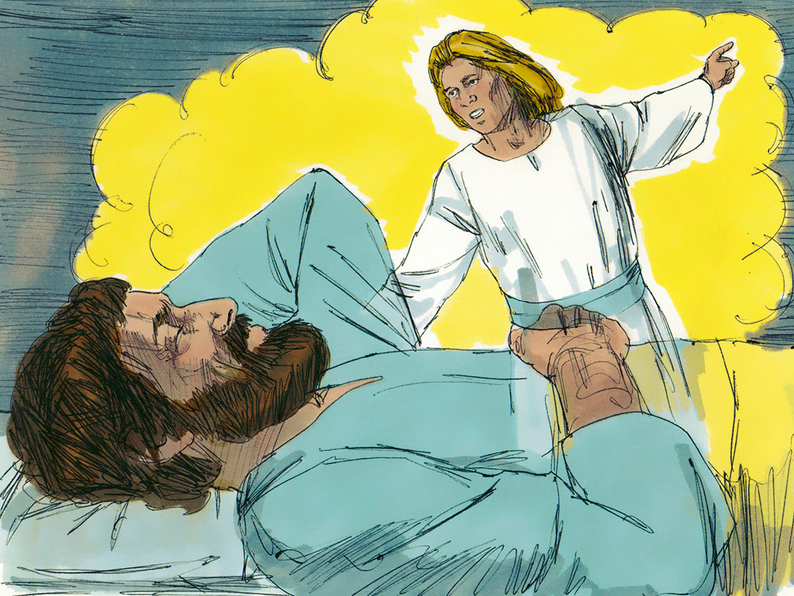

Slide 26
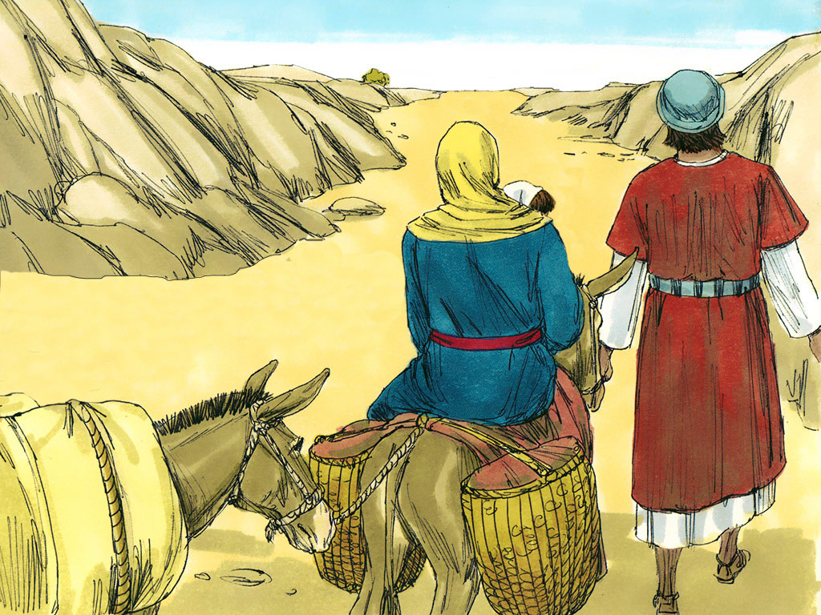

Slide 27
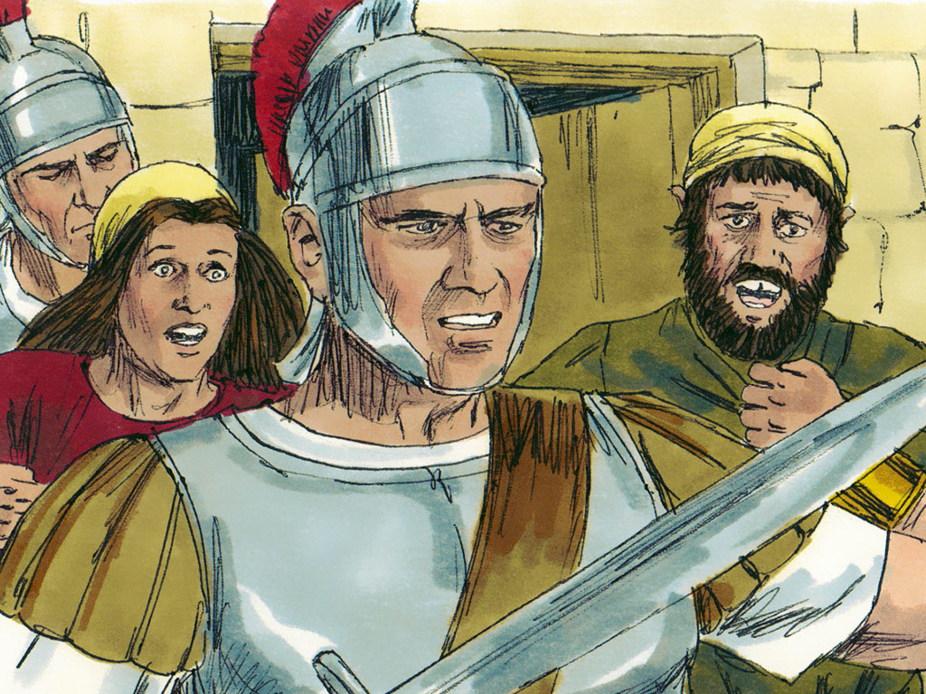

Slide 28
You should have a heart
that wants to worship God.
Life of Christ MT#3
Life of Christ MT#3

Slide 29
Psalm 29:1
"Give unto the Lord
the glory due
unto His Name..."
Life of Christ MT#3

Slide 30
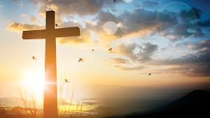
“For the wages of sin is death, but the gift of God is eternal life through Jesus Christ, our Lord.”
Romans
6:23

Slide 32
THANK YOU!
By Your love, You made me
Father thank You.
In Your love, You died for me
Jesus thank You.
God’s love now lives in me
Spirit thank You.
Father, Son, and Spirit are one
We thank You.
Tune: “Michael, Row Your Boat Ashore”

Slide 33
THANK YOU, LORD!
Thank You, Lord
For saving my soul
Thank You, Lord
For making me whole.
Thank You, Lord
For giving to me
Thy great salvation
So rich and free.

Slide 36
Life of Christ MV#3

Slide 37
