Slide 1
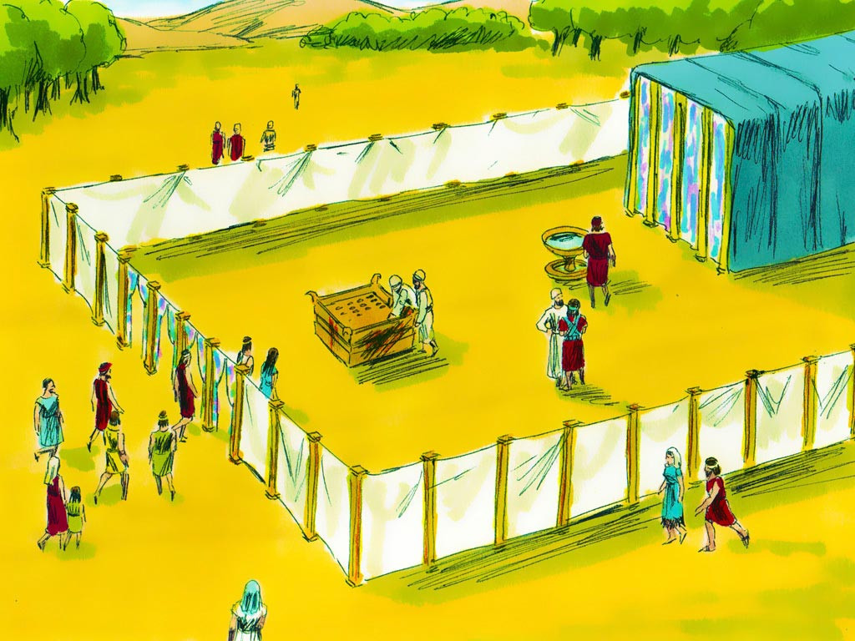
Tabernacle #2

Slide 2
Notes:
Rule Chart

Slide 3
Notes:
Prayer

Slide 7
Notes:
Song: “All that is Good”

Slide 8
Notes:
Bible Lesson

Slide 9
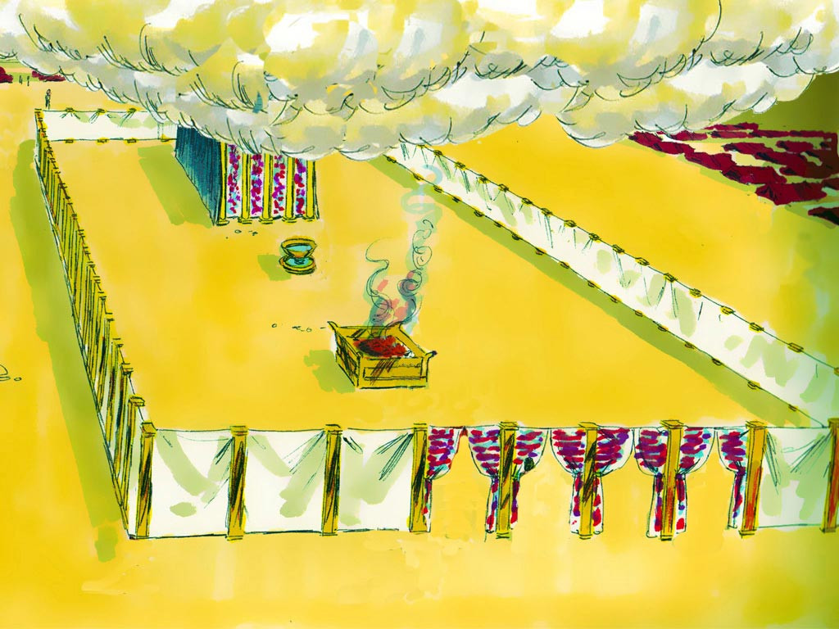

Slide 11
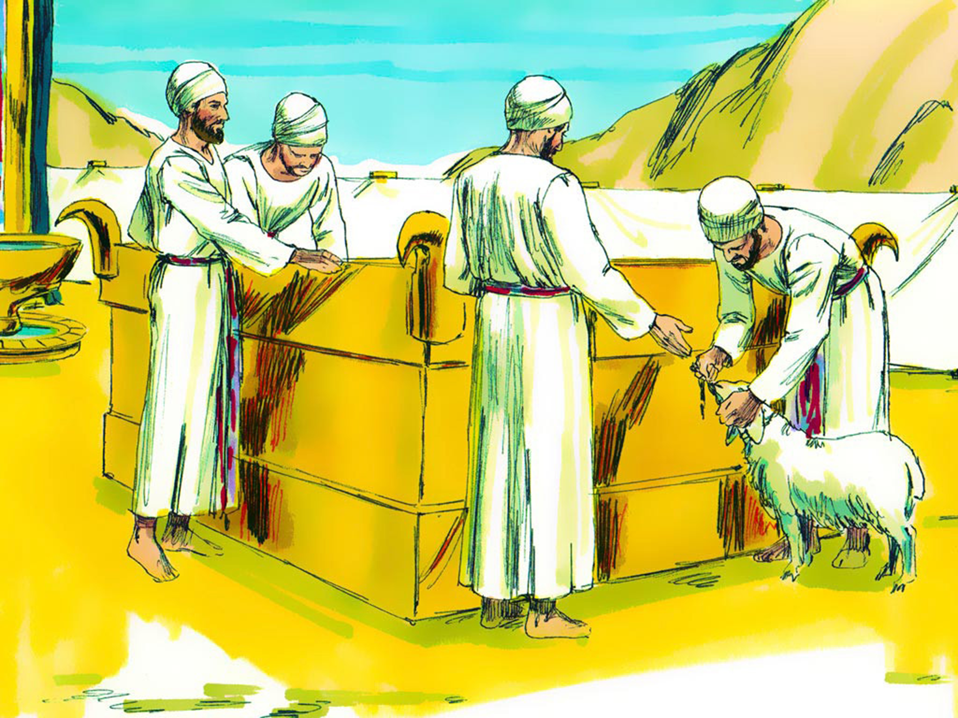

Slide 12
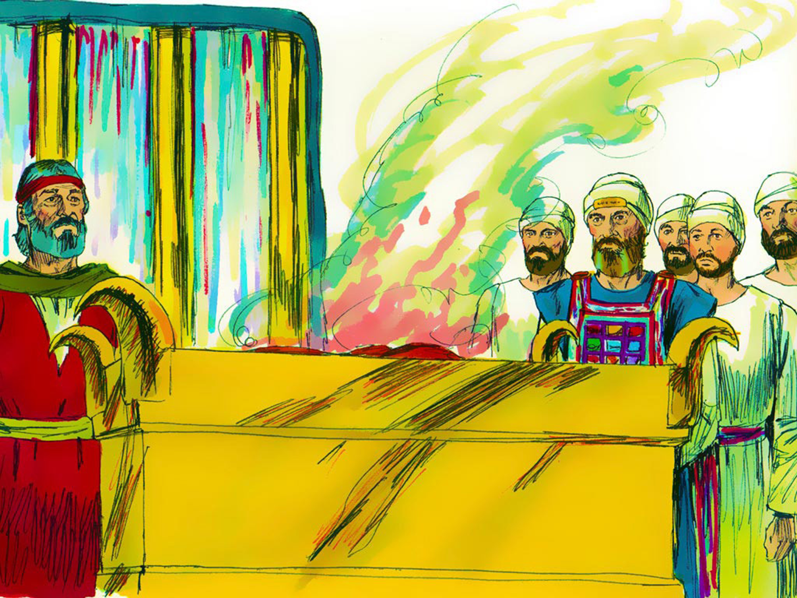

Slide 15
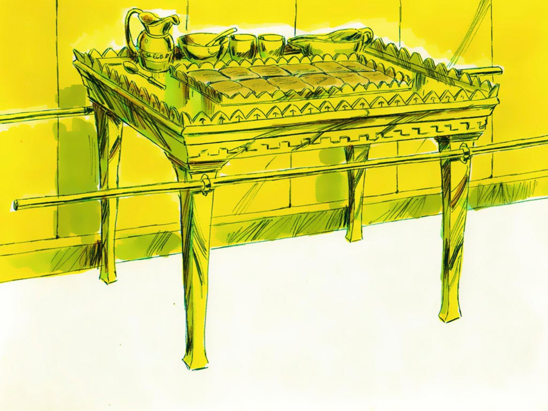

Slide 16
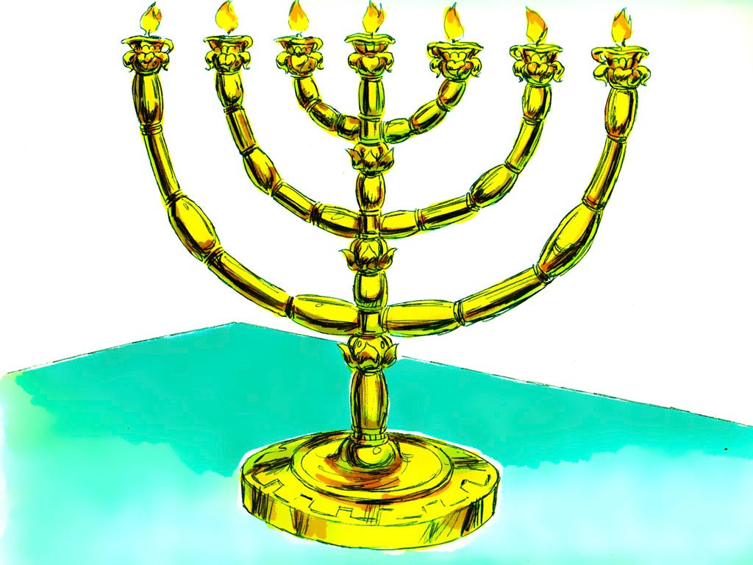

Slide 17
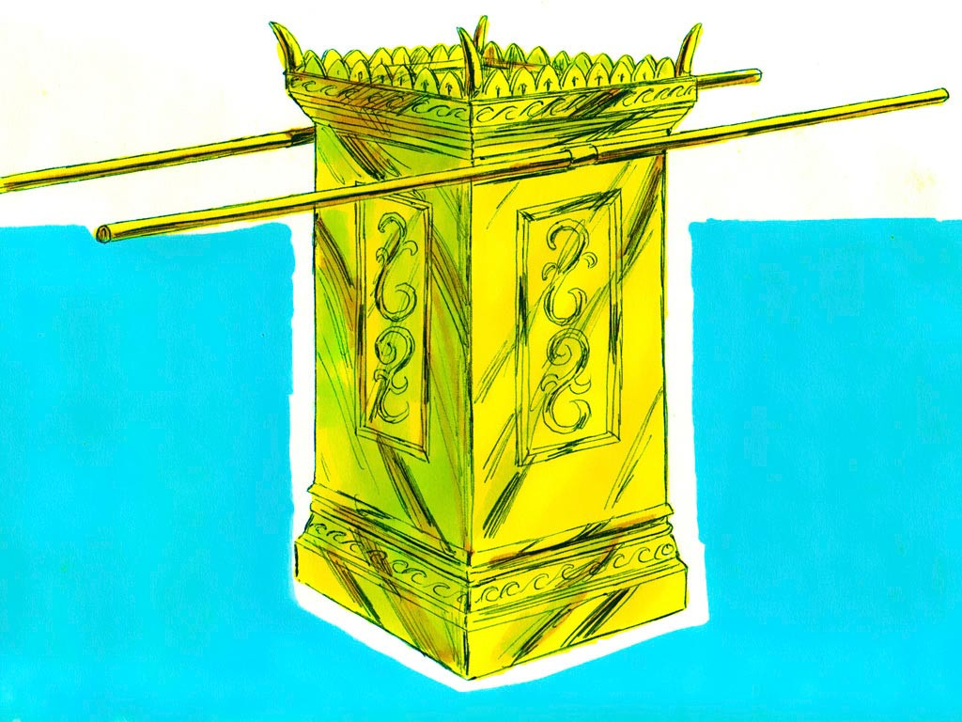

Slide 19
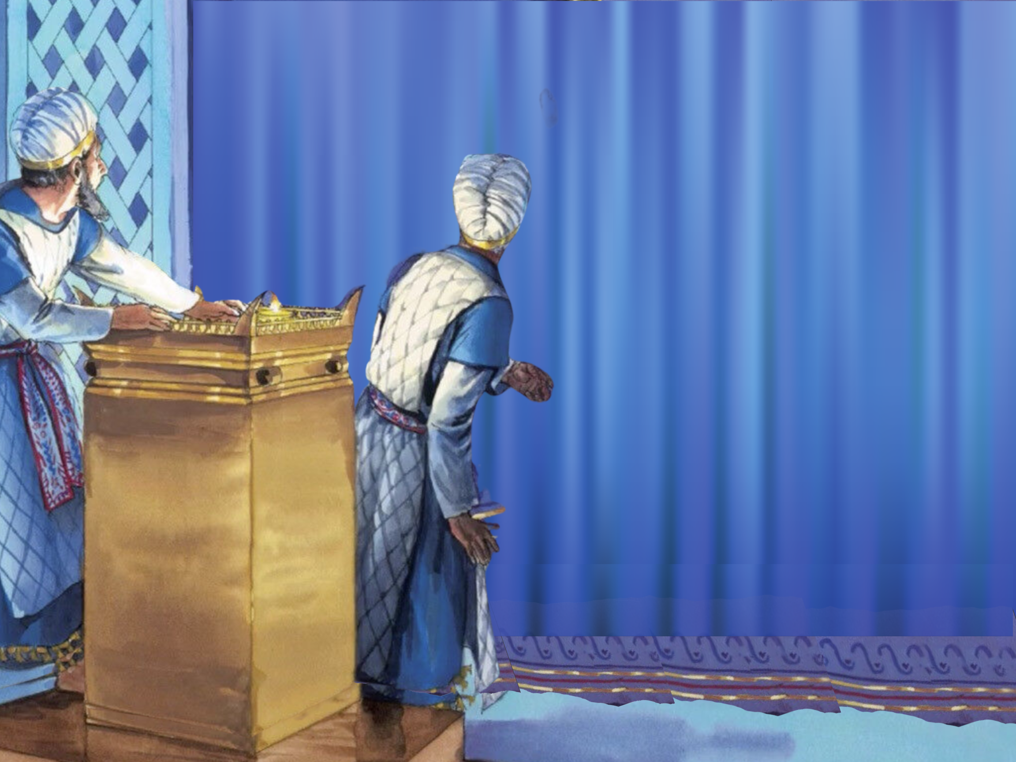

Slide 20
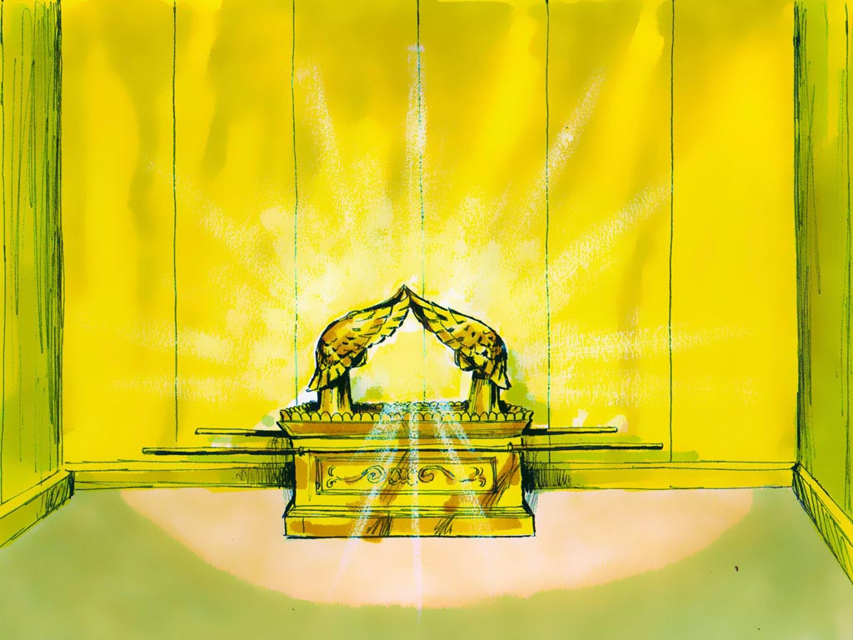

Slide 23
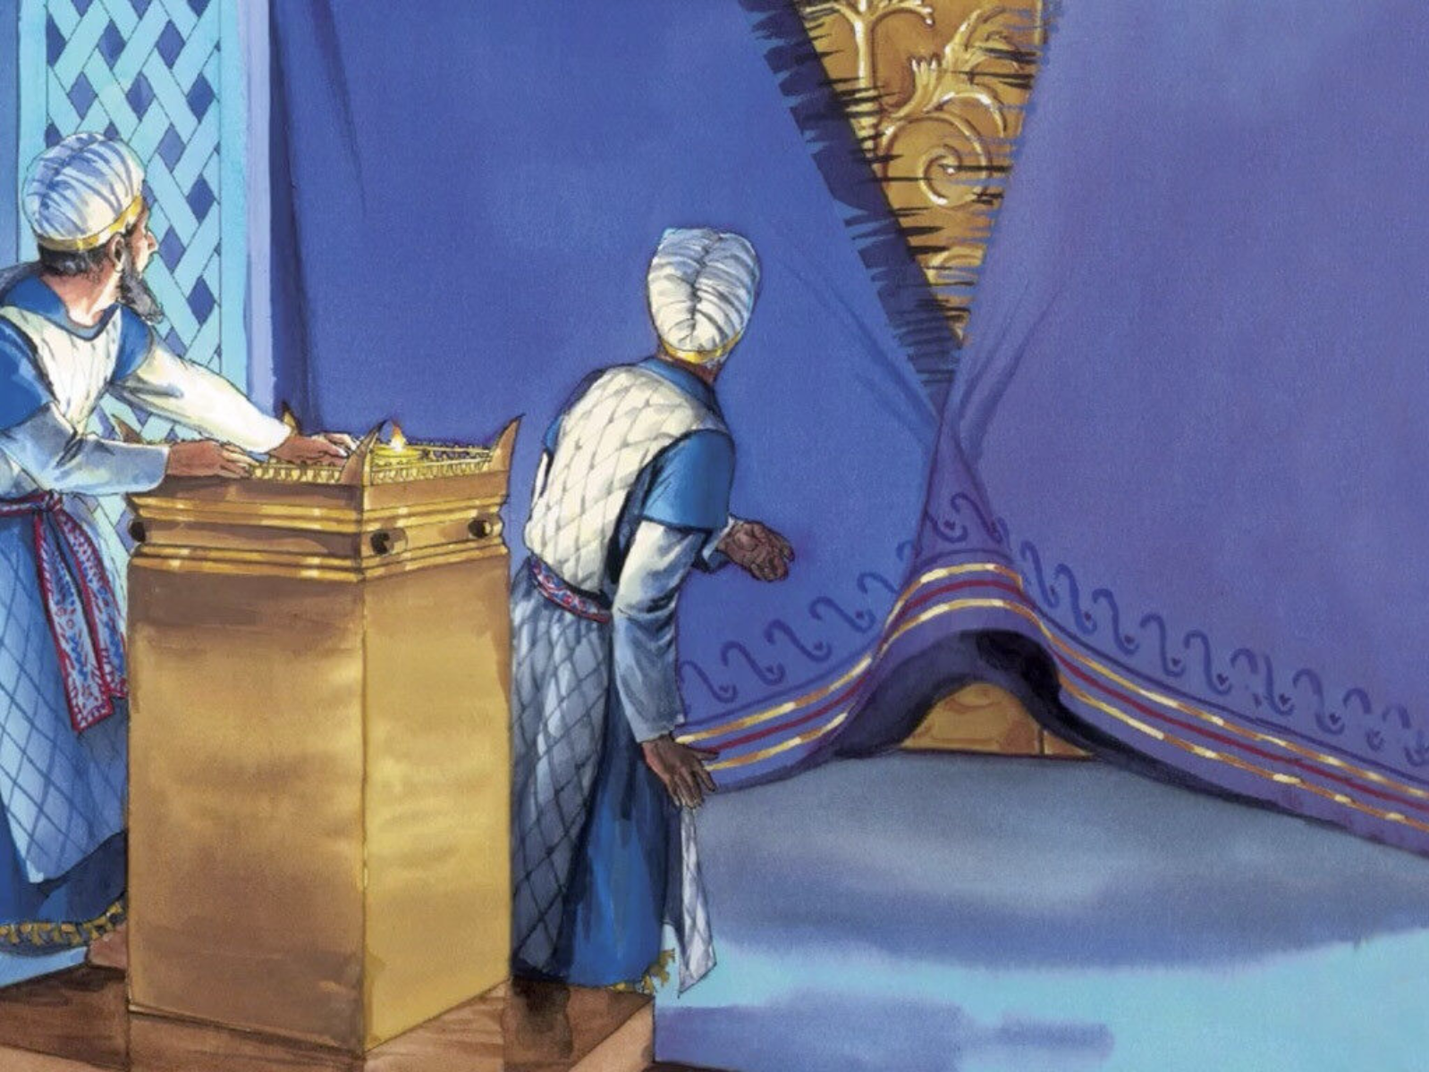

Slide 31
1
2
3
4
5
6
7
8
9
10
11
12
13
14
15
16

