Slide 1
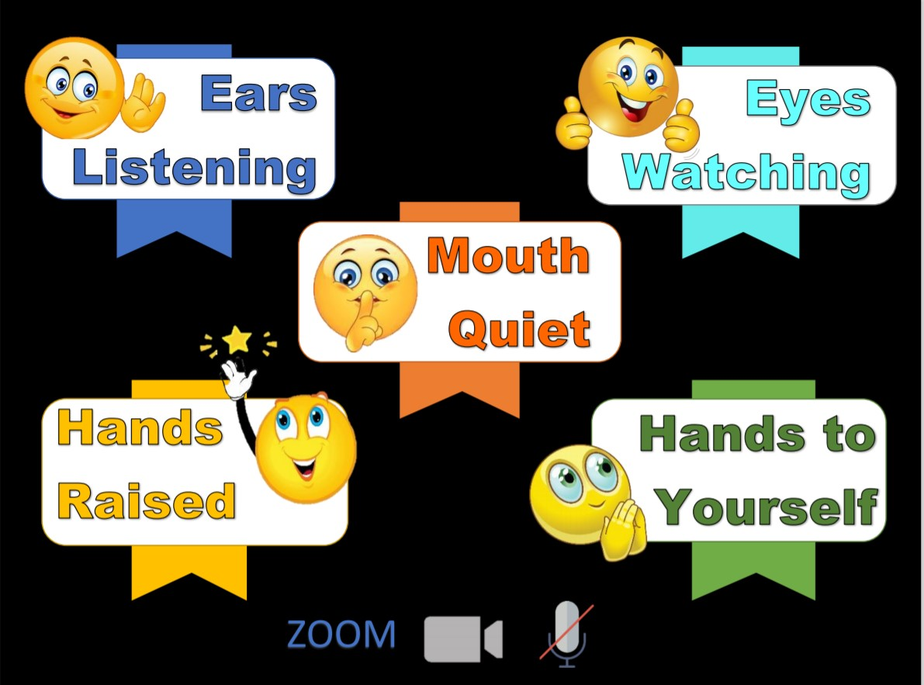
Memory Verse
Main Truth
Books of the Bible

Slide 3
Notes:
Rule Chart

Slide 4
Dear Heavenly Father,
Thank You for
______________
Please
_____________
In Jesus’ name,
Amen.

Slide 5
Notes:
Song: “Shout Hosanna!”

Slide 6
The King Is Betrayed
Matt. 26:17-56; Mark 14:12-52;
Luke22:7-53; John 13:1-38; 18:1-12
Notes:
If prompted by your computer click “Enable Content” when you open this presentation.
Click “Start Presentation” when you are ready to share. You may go to “Slide Show” at the top to choose “Present from current slide” when you need to start from a different slide during club.
Be sure you have this presentation open before starting Zoom.
When you are ready to share this presentation in Zoom click “Screen Share” and choose PowerPoint presentation. Be sure you have checked the box to “Share Computer Sound” before sharing.

Slide 9
“The soul that sinneth, it shall die….”
Ezekiel 18:20

Slide 14
1 John 1:7
“…The blood of Jesus Christ His Son cleanseth us from all sin.”

Slide 17
Don’t be afraid to stand for Jesus

Slide 19
Don’t be afraid to stand for Jesus

Slide 20
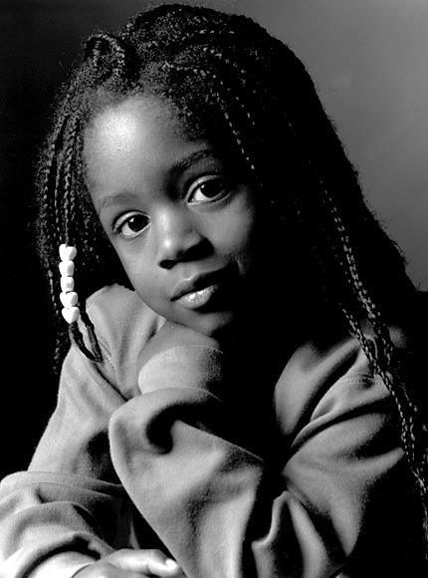
“…God gave us a spirit not of fear….”
2 Timothy 1:7

Slide 24
Don’t be afraid to stand for Jesus

Slide 25
“…God gave us a spirit not of fear….”
2 Timothy 1:7

Slide 26
John 3:16
“For God
so loved the world,
that He gave His only begotten Son, that whosoever believeth in Him should not perish, but have everlasting life.”

Slide 27
Notes:
End Lesson

Slide 29
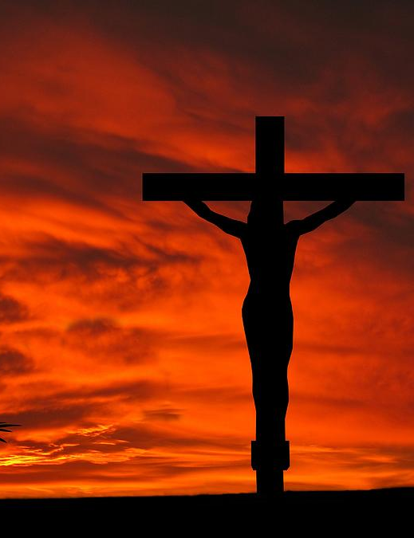
Matthew 26:28
“For this is My blood of the new testament, which is shed for many for the remission of sins.”

Slide 30
Matthew 26:28
“For this is My blood of the new testament, which is shed for many for the remission of sins.”

Slide 32
Zonk
Put PowerPoint in Slide Show mode. Click on the “Zonk” above to pull up the game.
Click on wheel to spin it for points after a student answers a question correctly.
A student can spin as many times as they want. But if they get Zonk, they lose all the points for that turn.

Slide 33
Learning About the bible

Slide 34
Books of the New Testament
Romans
1 Thessalonians
1 Corinthians
2 Thessalonians
14 LETTERS
2 Corinthians
1 Timothy
Galatians
2 Timothy
Ephesians
Titus
Philippians
Philemon
Colossians
Hebrews
Notes:
We have been learning the names of Paul’s Letters. How many letters did Paul write? (14.)
Some of his letters were written to churches and some were written to individual people.
Let’s say the names of the nine letters written to churches.
(Romans, 1 Corinthians, 2 Corinthians, Galatians, Ephesians, Philippians, Colossians, 1 Thessalonians, and 2 Thessalonians}
We have learned the names of three letters that Paul wrote to individual people. Let’s say the names of these letters.
(Place 1 Timothy, 2 Timothy, and Titus. Paul wrote a letter to one other person. His name and the name of the book is Philemon.
Let’s say the four New Testament books that Paul wrote to individual people.
Most people believe that Paul wrote one other book. It is called Hebrews.
This book, or letter, was written to Jewish, or Hebrew, people who believed that Jesus was the Messiah and had placed their trust in Him to be their Saviour from sin.
Let’s review all the names of Paul’s Letters. (Practice together.)

Slide 35
Books of the New Testament
THE GOSPELS
LETTERS
Matthew
Romans
1 Thessalonians
Mark
1 Corinthians
2 Thessalonians
2 Corinthians
1 Timothy
Luke
Galatians
2 Timothy
John
Ephesians
Titus
HISTORY
Philippians
Philemon
Acts
Colossians
Hebrews
Notes:
Now we will practice saying the names of all of the books of the New Testament that we have learned.
(Practice several times saying the names of the Gospels, the book of History, and the 14 books of Paul’s Letters.)

Slide 36
Notes:
You can Screen Share these Counseling Card slides to go through as you normally would.

