Slide 2
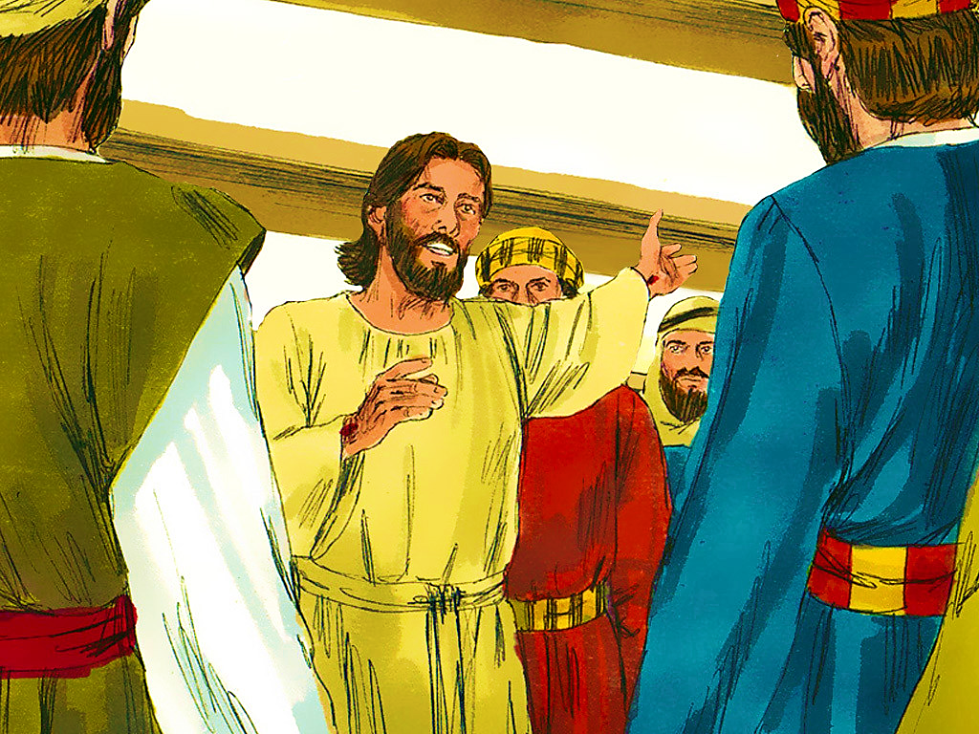
2-1
Notes:
2-1

Slide 4
2-1
Notes:
2-1

Slide 5
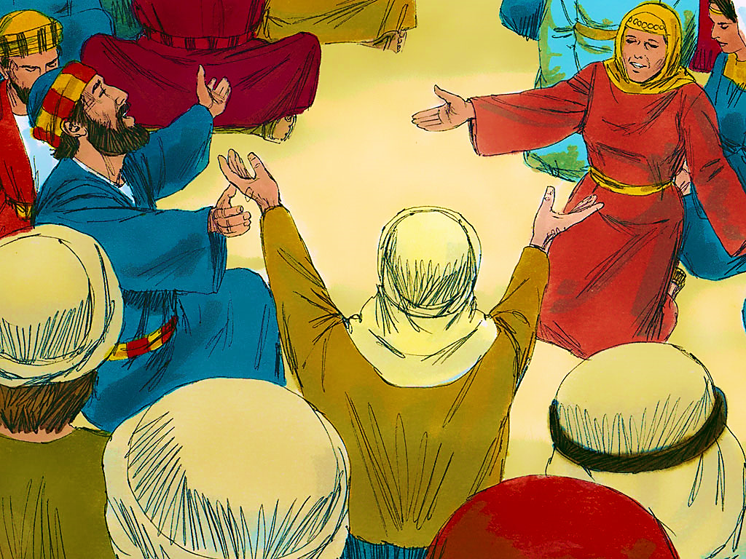
2-2
Notes:
2-2

Slide 6
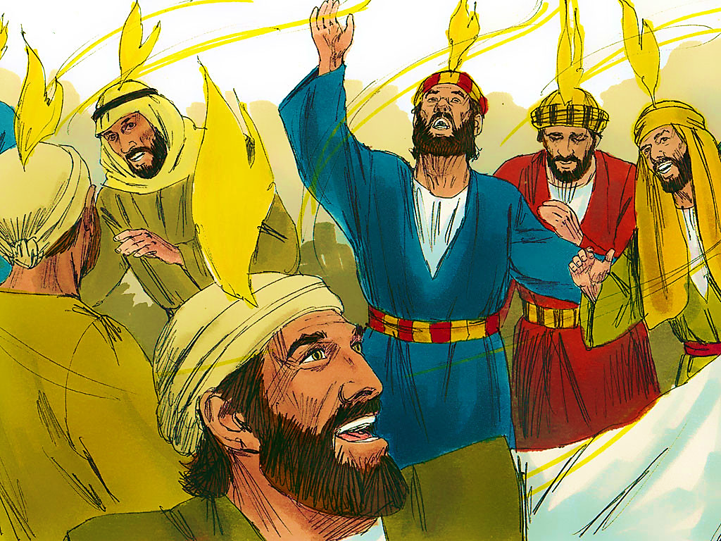
2-3
Notes:
2-3

Slide 7
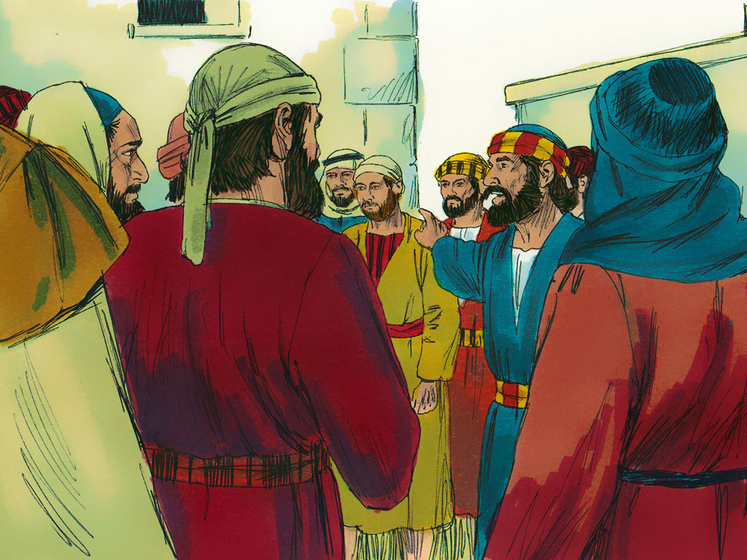
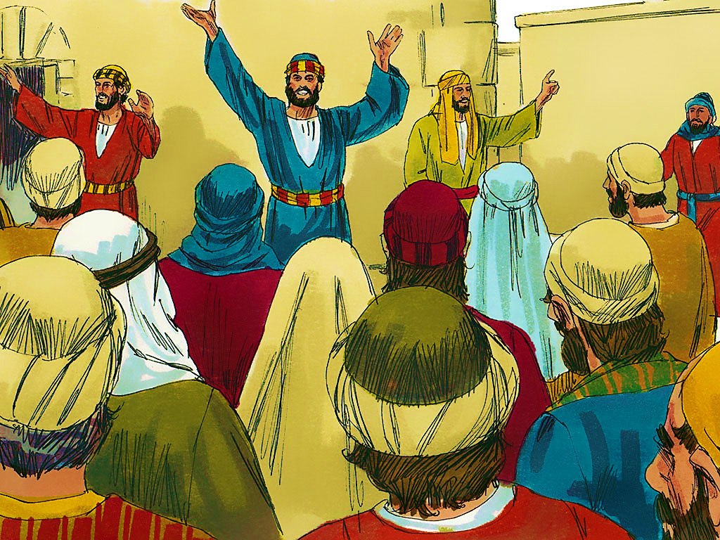
2-4
Notes:
2-4

Slide 9
2-4
Notes:
2-4

Slide 10
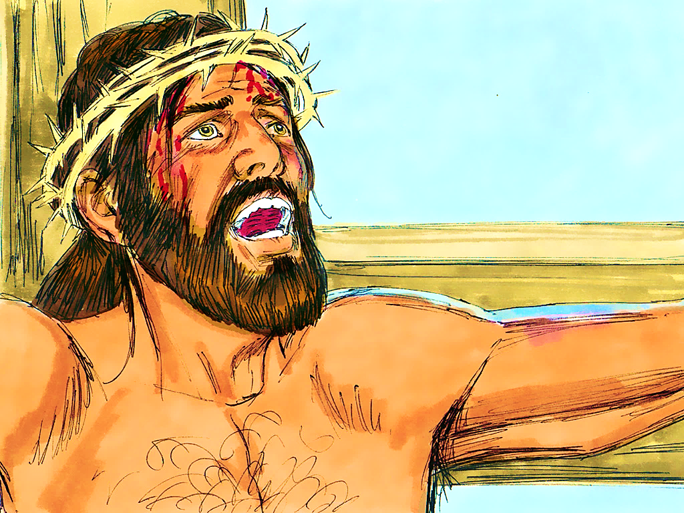
2-5

Slide 11
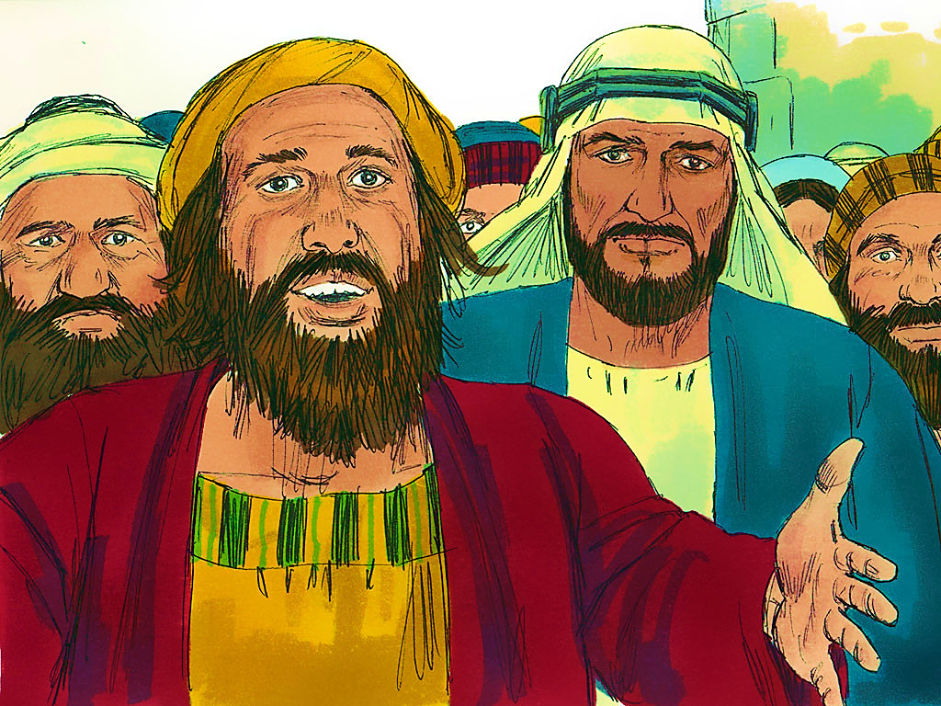
2-6
Notes:
2-6

Slide 13
Notes:
End Lesson

