Slide 1
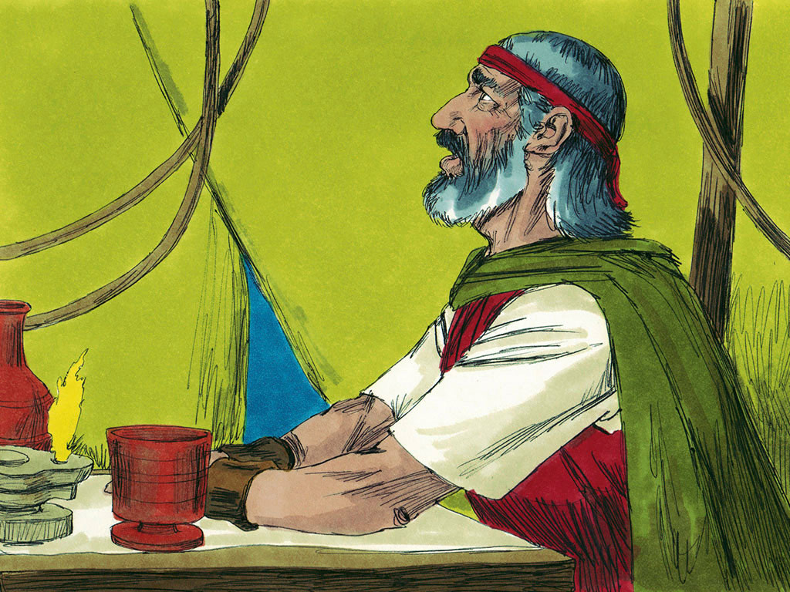
MOSES #10
“God’s Patience with His people”

Slide 3
Notes:
Rule Chart

Slide 4
Notes:
Prayer

Slide 8
Notes:
Song: “My God is Powerful”

Slide 9
Notes:
Bible Lesson

Slide 10
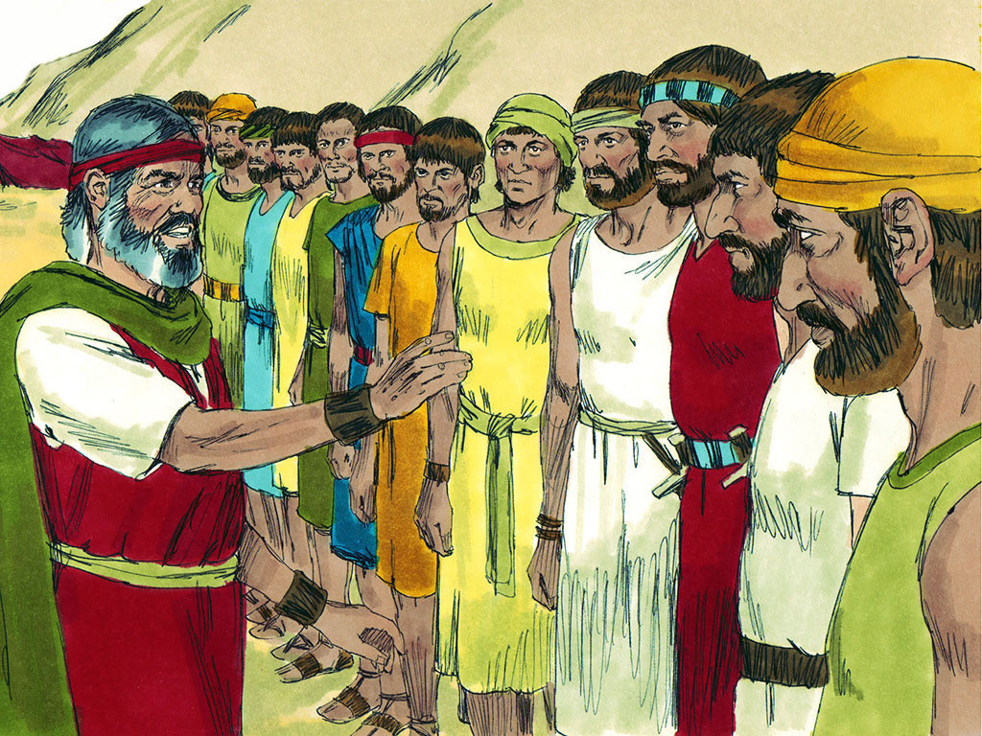
Notes:
3-1

Slide 12
Notes:
3-1

Slide 13
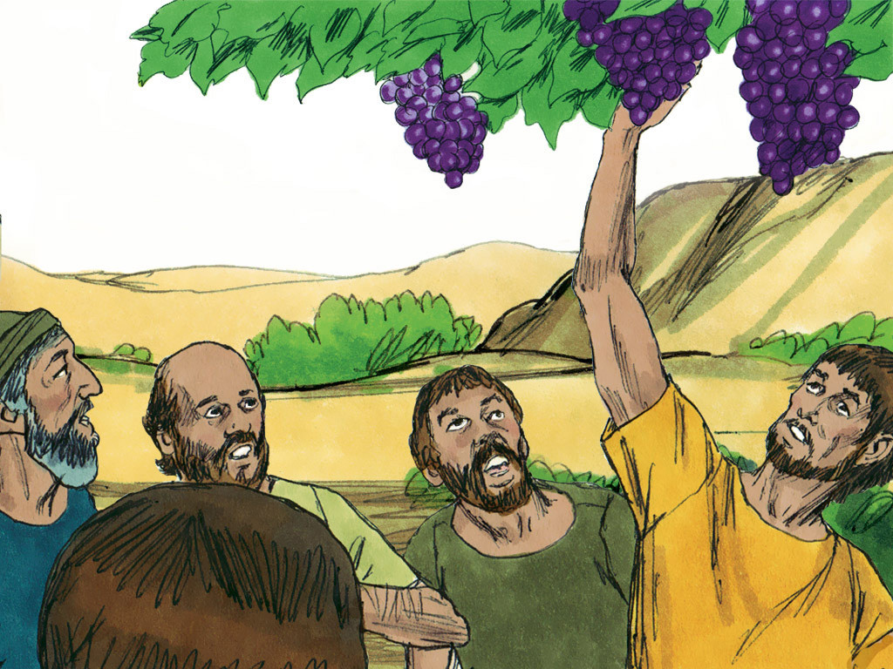
Notes:
3-2

Slide 14
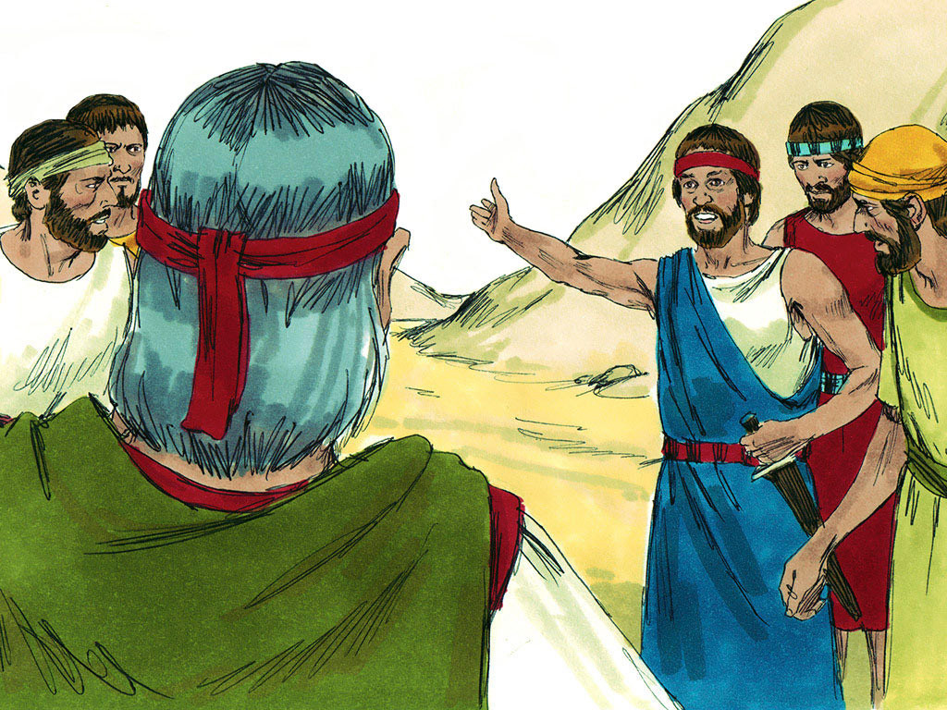
Notes:
3-3

Slide 16
Notes:
3-3

Slide 17
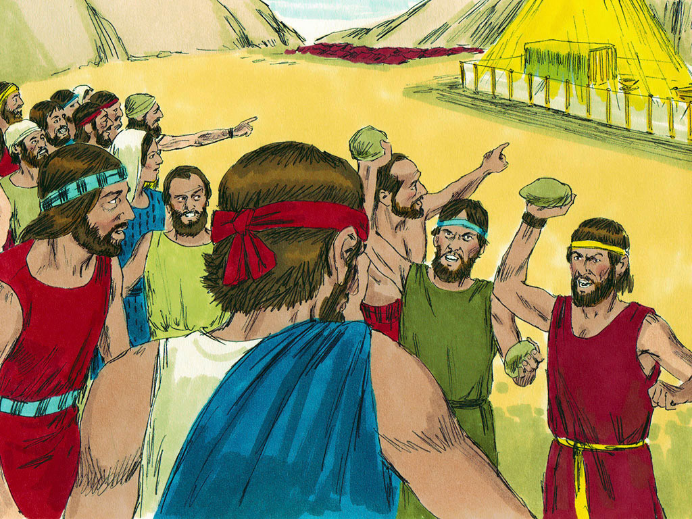
Notes:
3-5

Slide 18
Notes:
3-6

Slide 20
Notes:
3-6

Slide 23
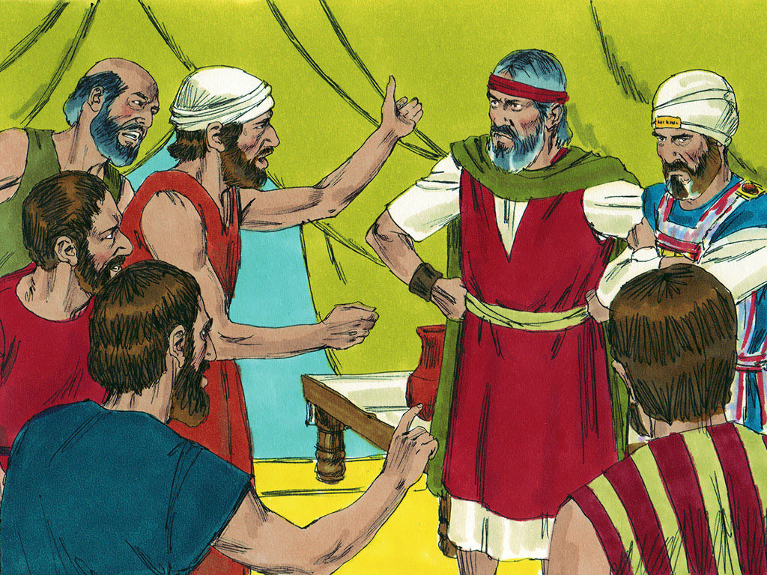
Notes:
4-1

Slide 27
Tic-Tac-Know
Divide your group into two teams. Ask review questions alternately. When a child answers correctly, he may place one of his team’s playing pieces in any square he chooses. The object is to be the first team to get three in a row, horizontally, vertically, or diagonally.

Slide 28
New Game

