Slide 1
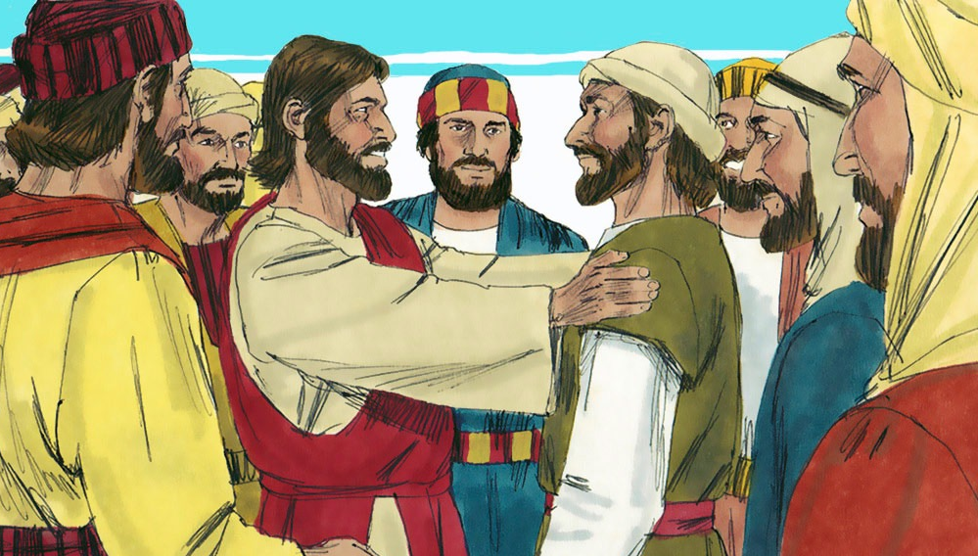
“Jesus Chooses His Disciples”
Matthew 4:17-22;Mark 1:16-20;
Luke 5:27-32, 6:12-16; John 1:29-51

Slide 4
Notes:
"God is Good!"

Slide 5
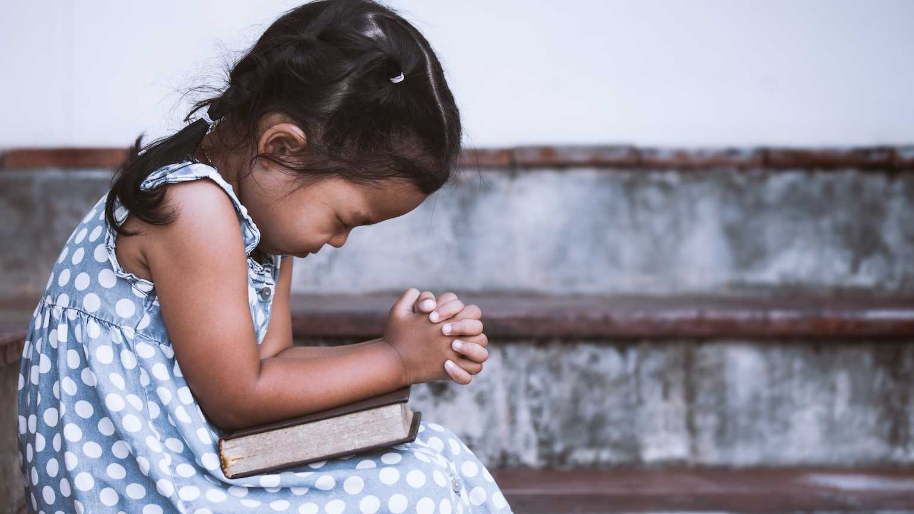
Dear Heavenly Father,
Thank You for...
___________________
Please…
___________________
In Jesus' name,
Amen

Slide 6
“Jesus Chooses His Disciples”
Matthew 4:17-22; Mark 1:16-20;
Luke 5:27-32, 6:12-16; John 1:29-51

Slide 7
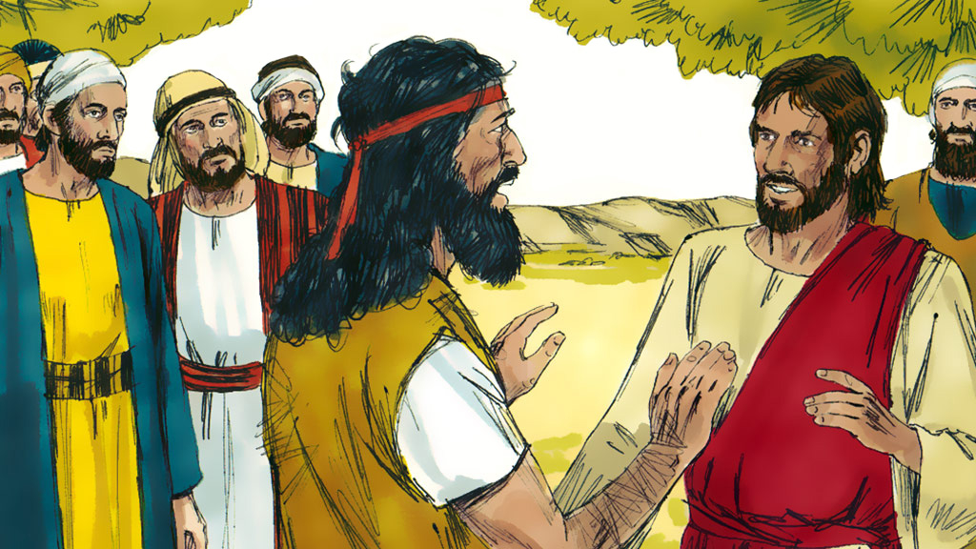

Slide 8
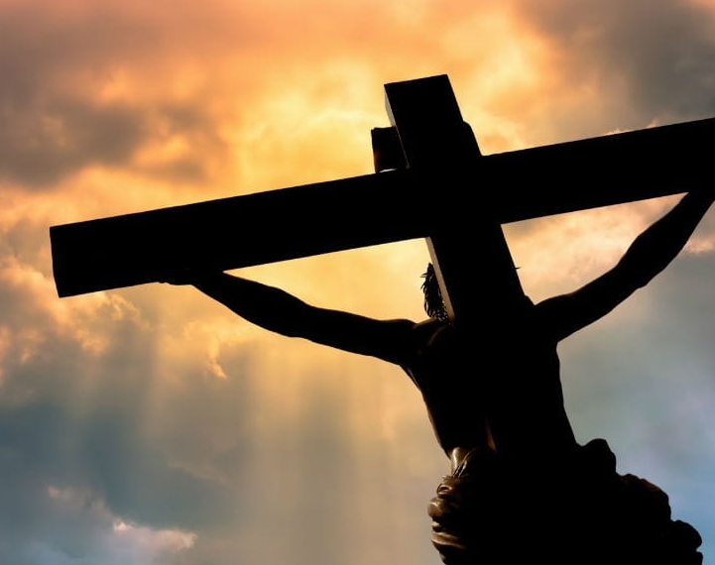
“…Without shedding of blood is
no remission.”
Hebrews 9:22b

Slide 10
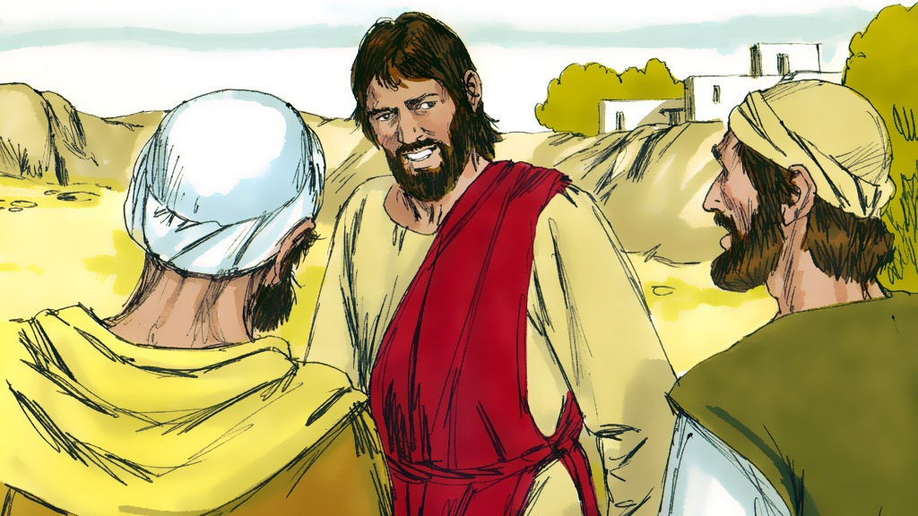

Slide 11
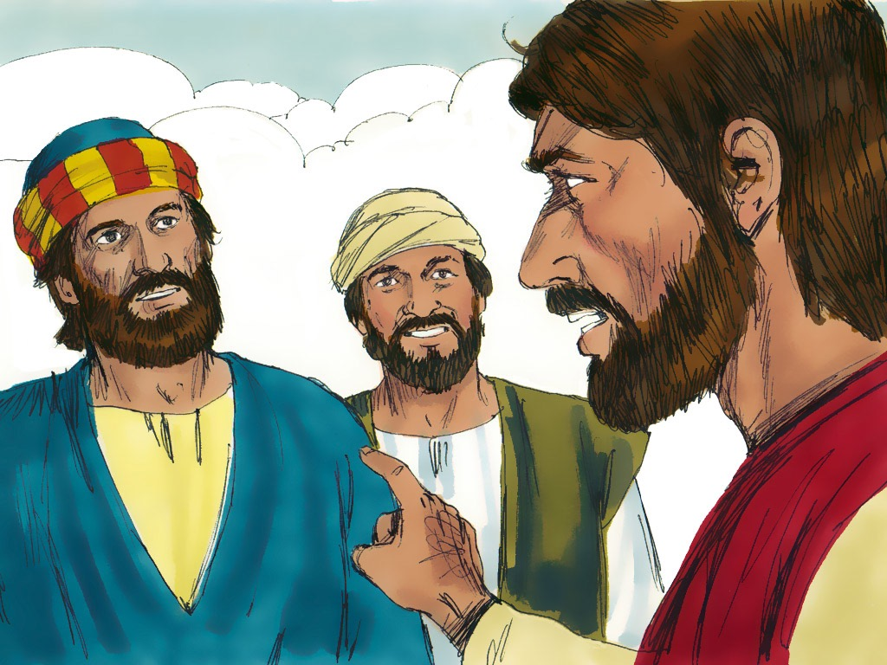

Slide 12
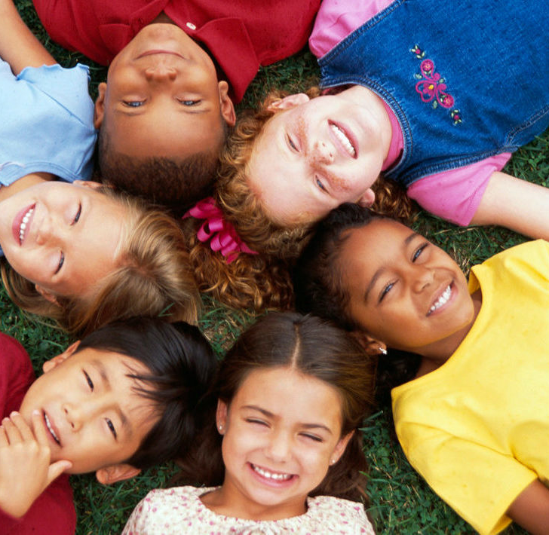
God has chosen
you to do something special for Him.

Slide 14
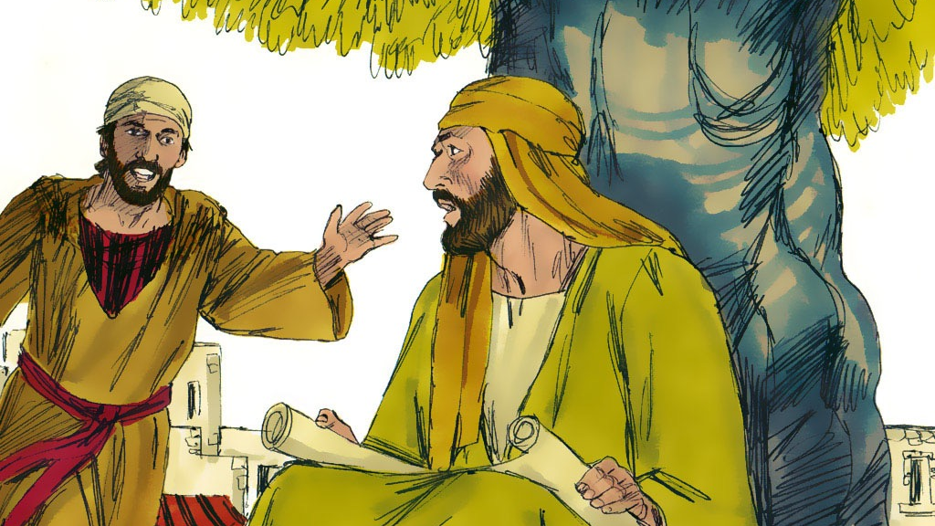

Slide 15
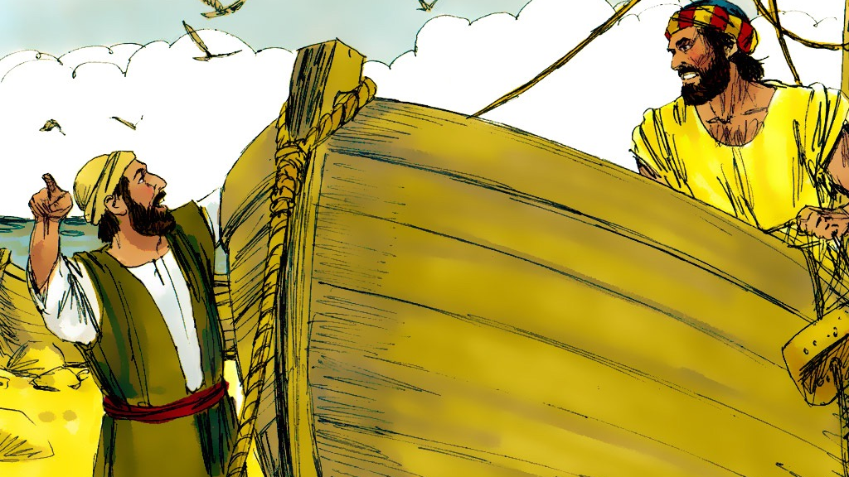

Slide 16
God has chosen
you to do something special for Him.

Slide 17
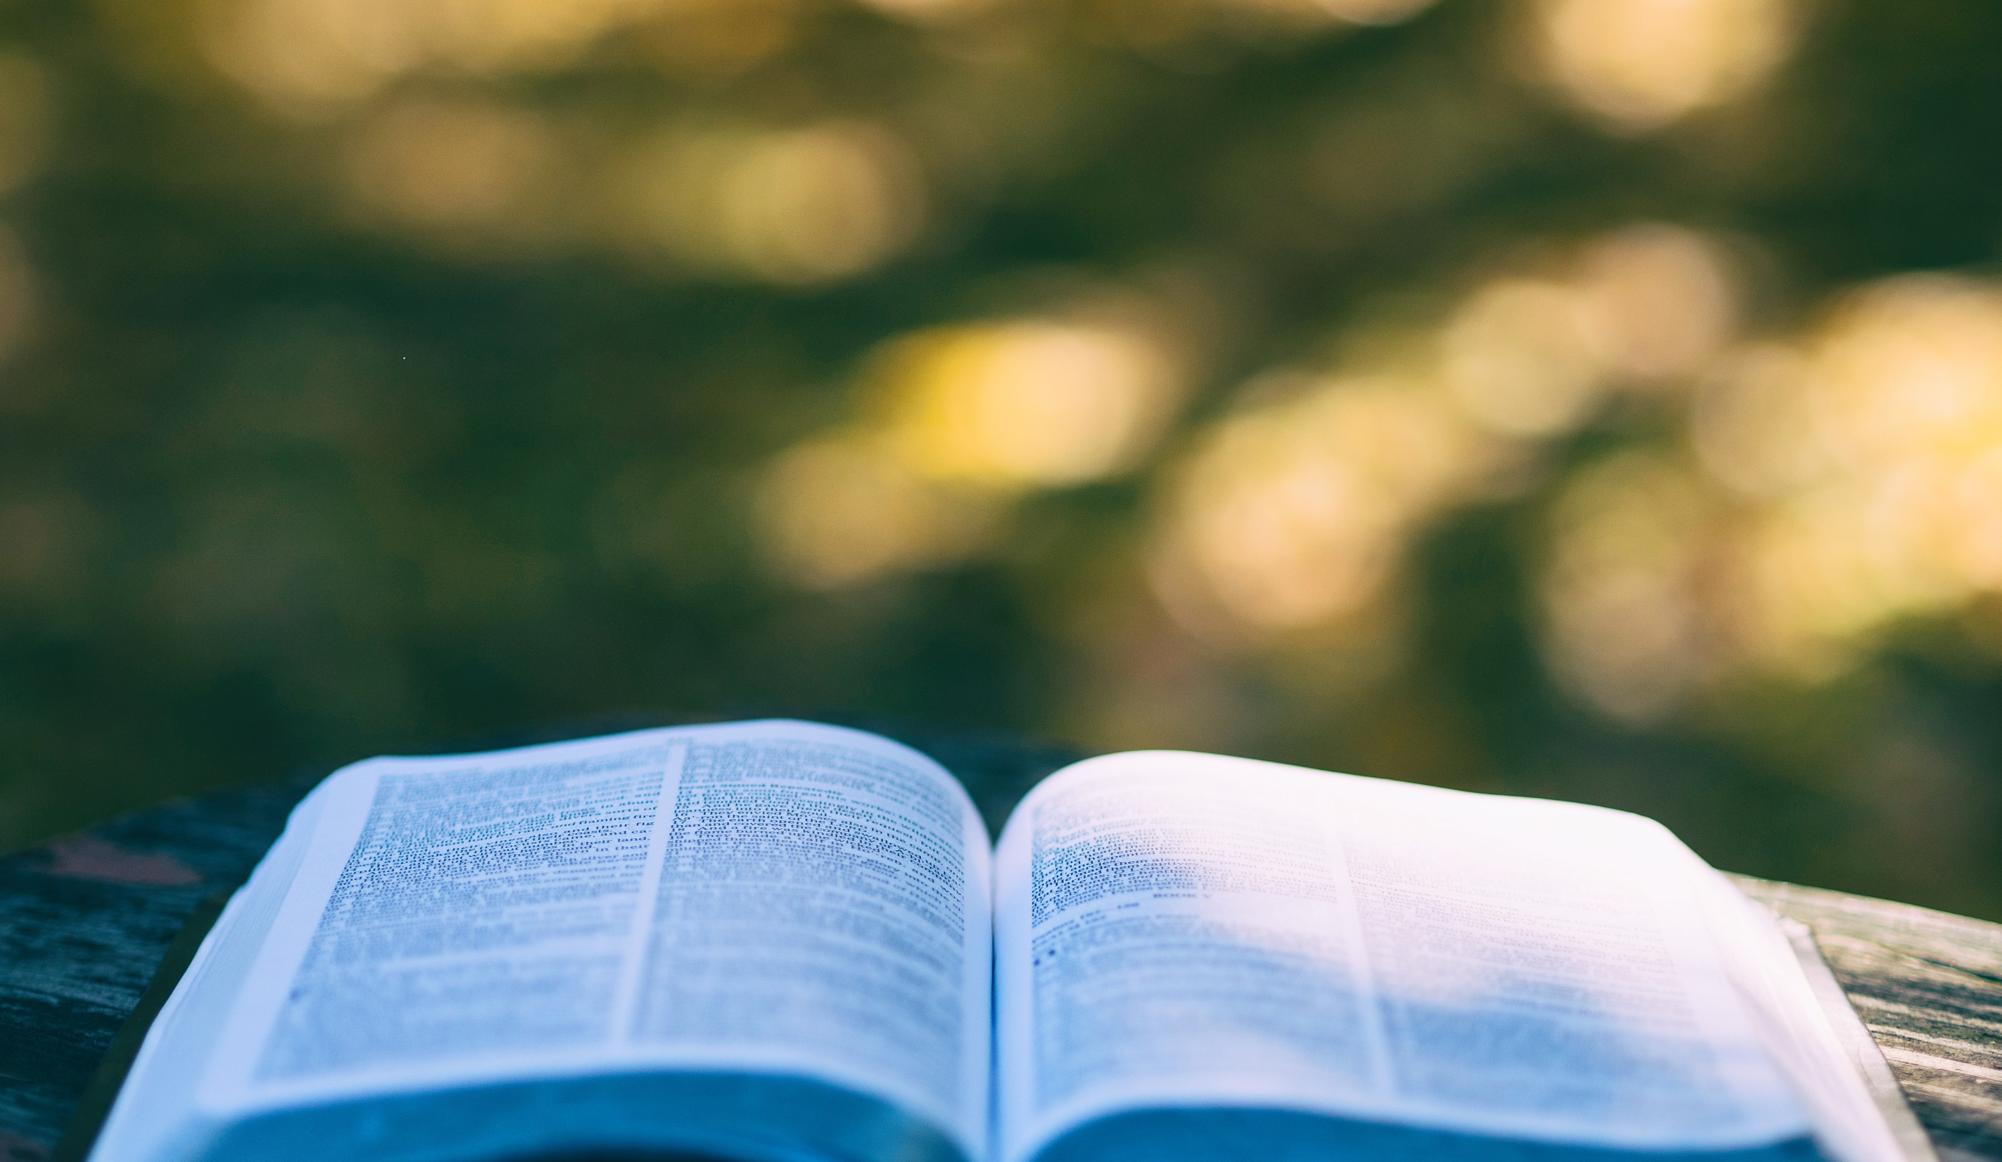
John 15:16
“Ye have not chosen Me,
but I have chosen you,
and ordained you,
that ye should go and
bring forth fruit….”

Slide 19
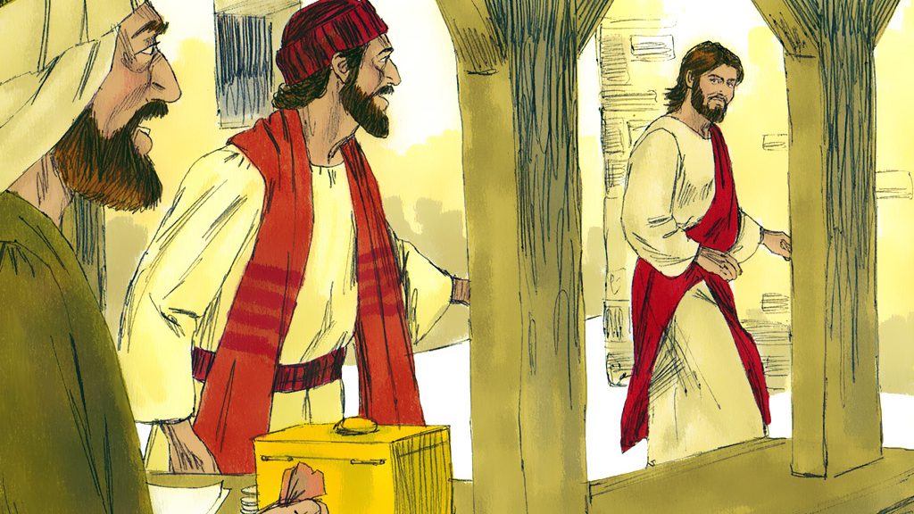

Slide 20
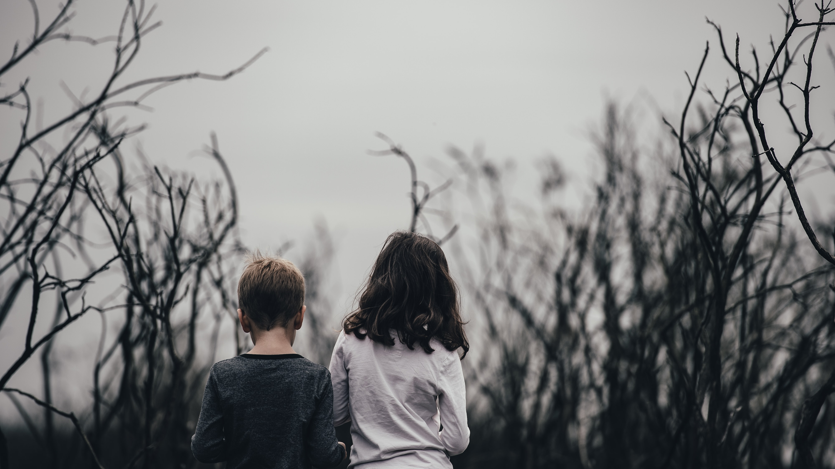
“…There is none righteous,
no, not one.”
Romans 3:10

Slide 22
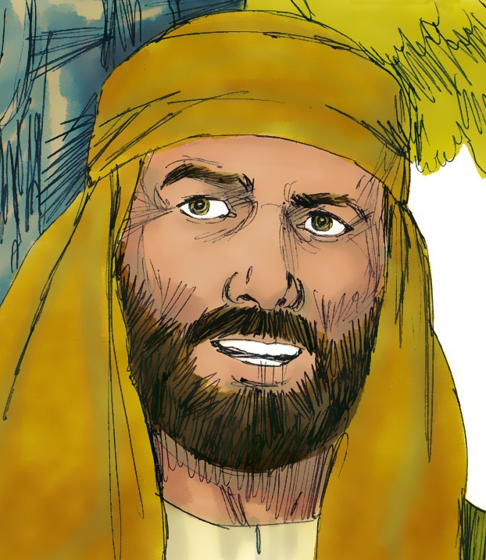
Jesus' Disciples

Slide 23
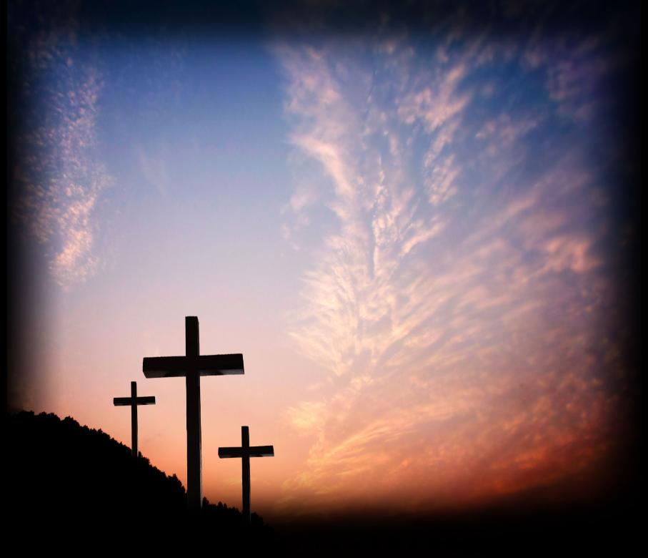
“Not by works of
righteousness
which we have done,
but according to
His mercy He saved us….”
Titus 3:5

Slide 24
God has chosen
you to do something special for Him.

Slide 25
John 15:16
“Ye have not chosen Me,
but I have chosen you,
and ordained you,
that ye should go and
bring forth fruit….”

Slide 26
Notes:
“There were Twelve Disciples”

Slide 28
John 15:16
“Ye have not chosen Me,
but I have chosen you,
and ordained you,
that ye should go and
bring forth fruit….”

Slide 29
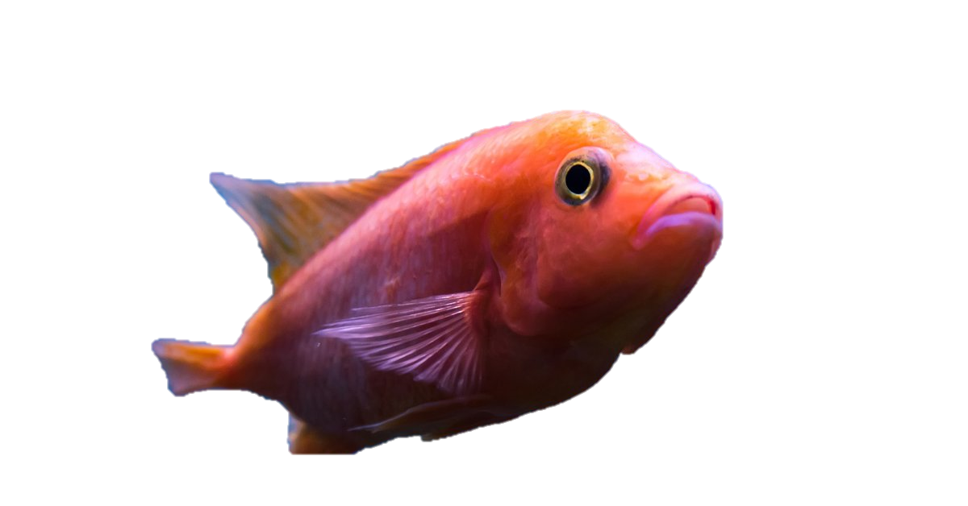
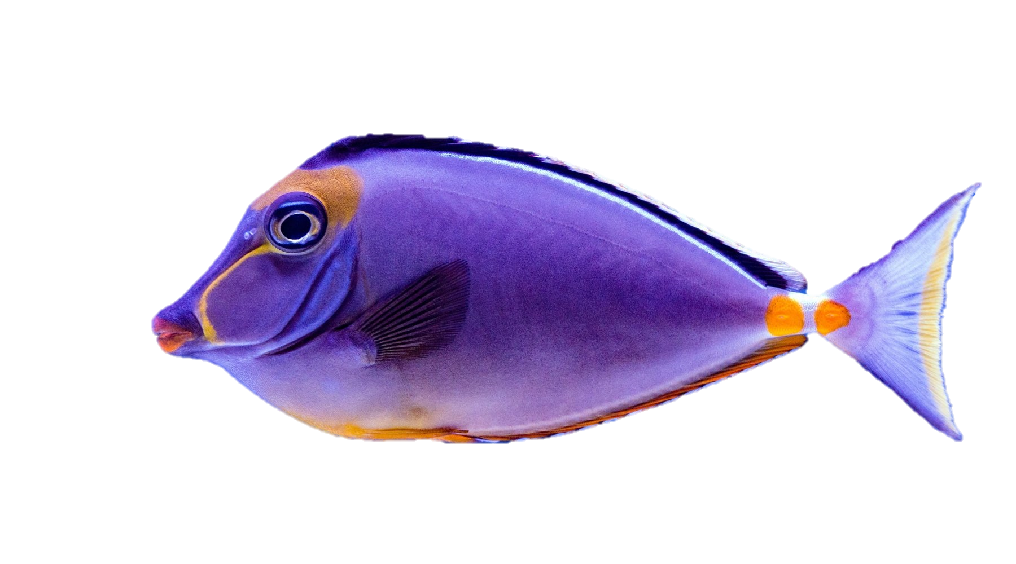
100
200
200
100
200
200
200
200
200
200
200

