Slide 1
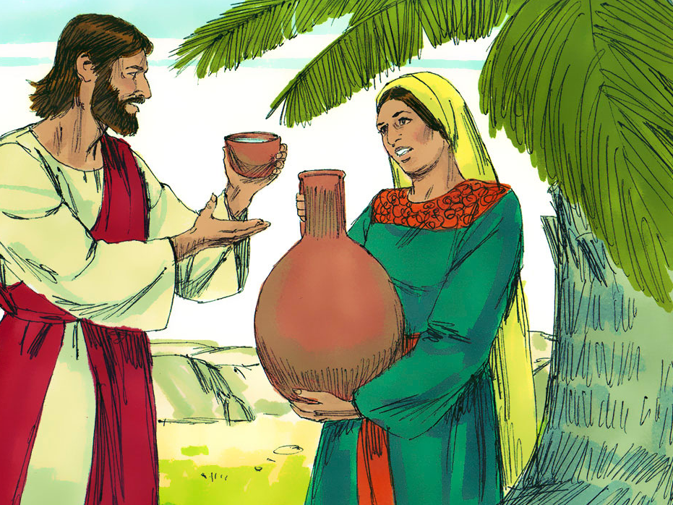
The Woman at the Well
John 4:3-42

Slide 4
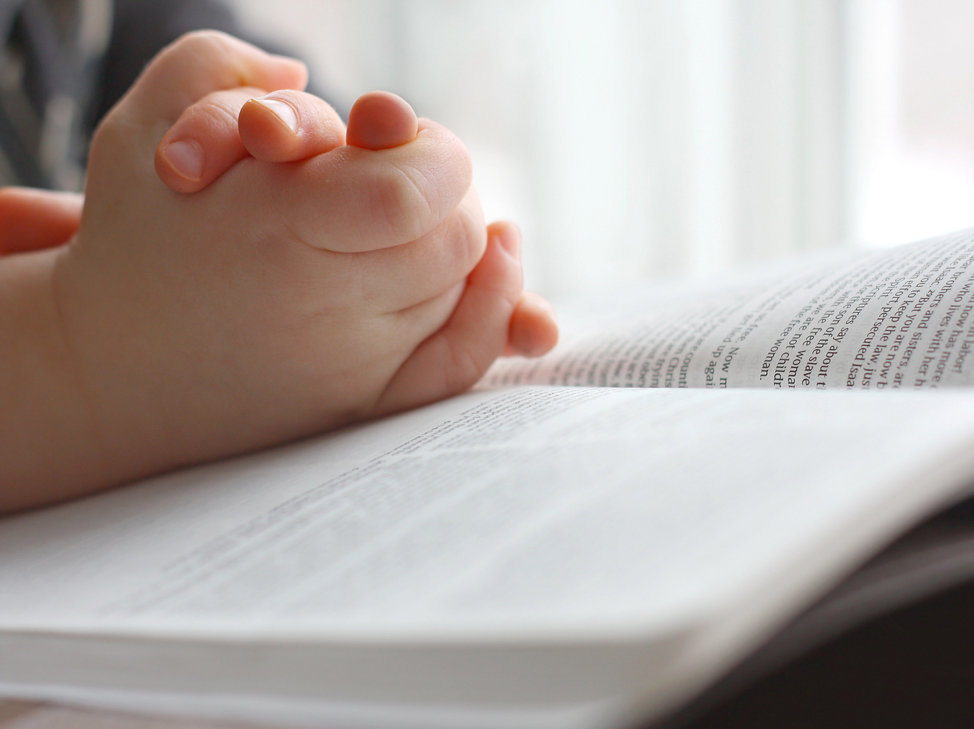
Dear Heavenly Father,
Thank You for …____________
Please … __________________
In Jesus’ name,
Amen.

Slide 5
Notes:
“Jesus Strong and Kind”

Slide 6
The Woman at the Well
John 4:3-42

Slide 7
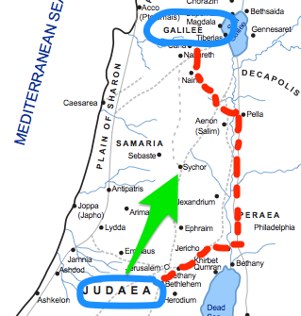

Slide 8
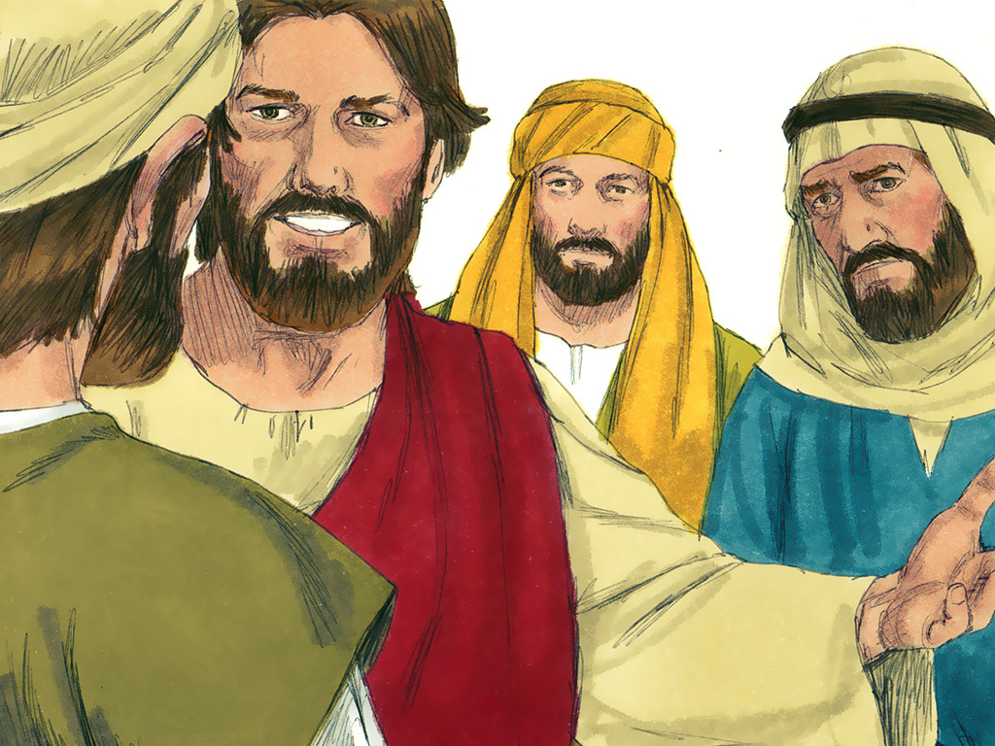

Slide 9
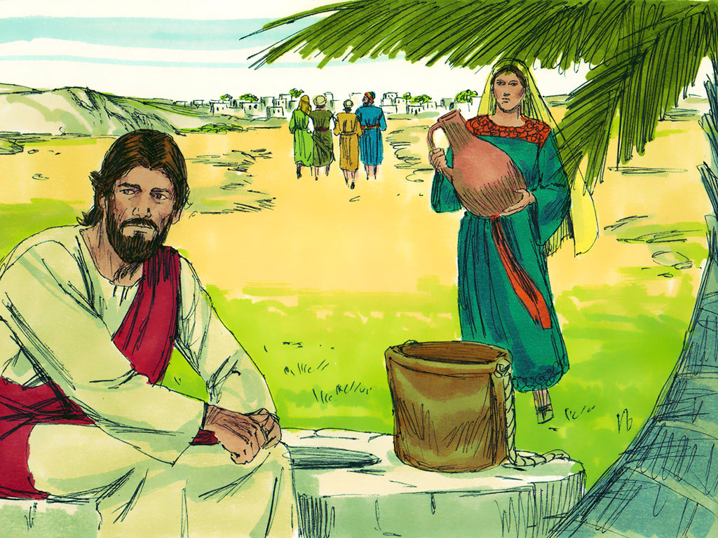

Slide 10
God wants you to show His love
to those who are
different from you.

Slide 12
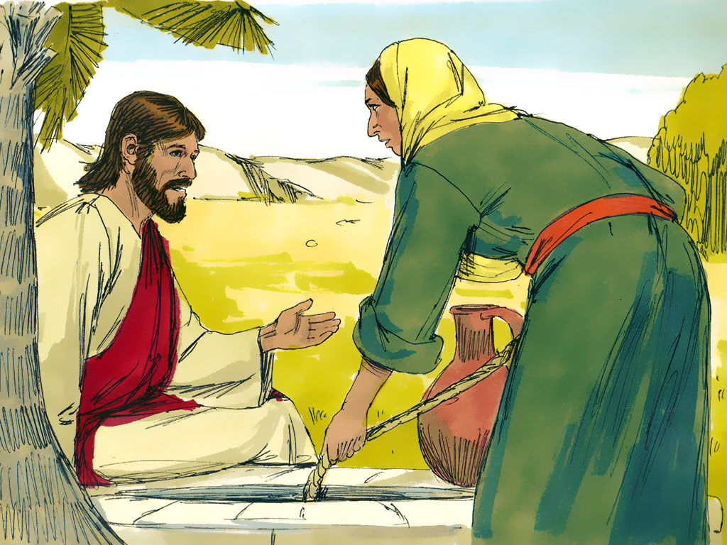

Slide 13
1 Corinthians 15:3-4
“Christ died for our sins
according to
the Scriptures;
and that He was buried,
and that He rose again
the third day
according to
the Scriptures.”

Slide 15
Psalm 14:3
“They are all gone aside…
there is none that
doeth good,
no, not one.”

Slide 16
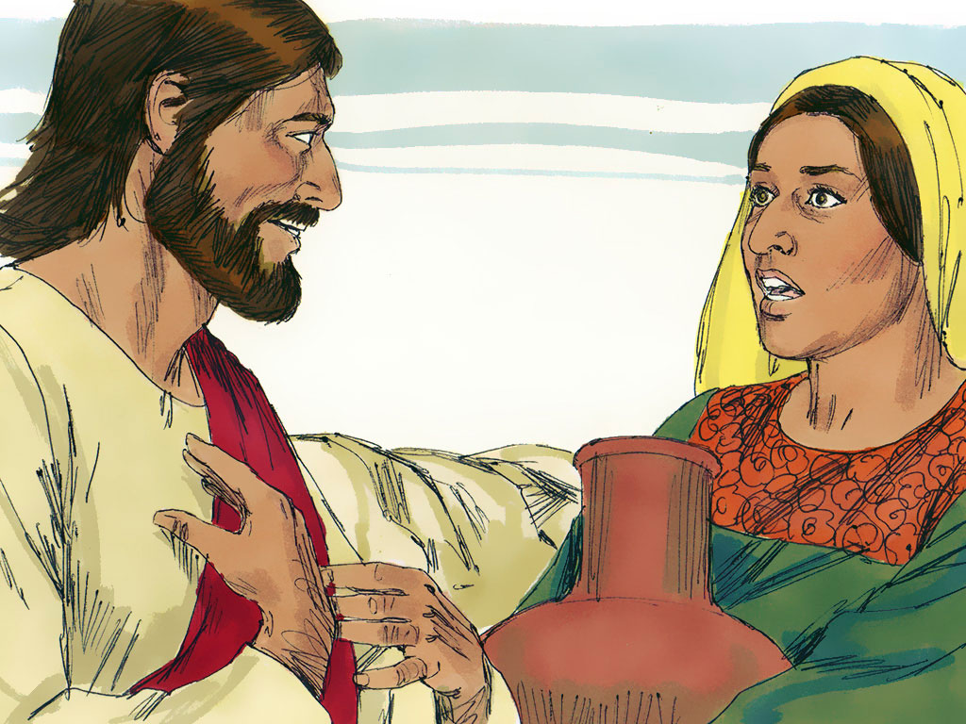

Slide 17
Mark 12:31
“…Thou shalt love
thy neighbour as thyself.
There is none other commandment
greater than these.”

Slide 18
God wants you to show His love
to those who are
different from you.

Slide 19
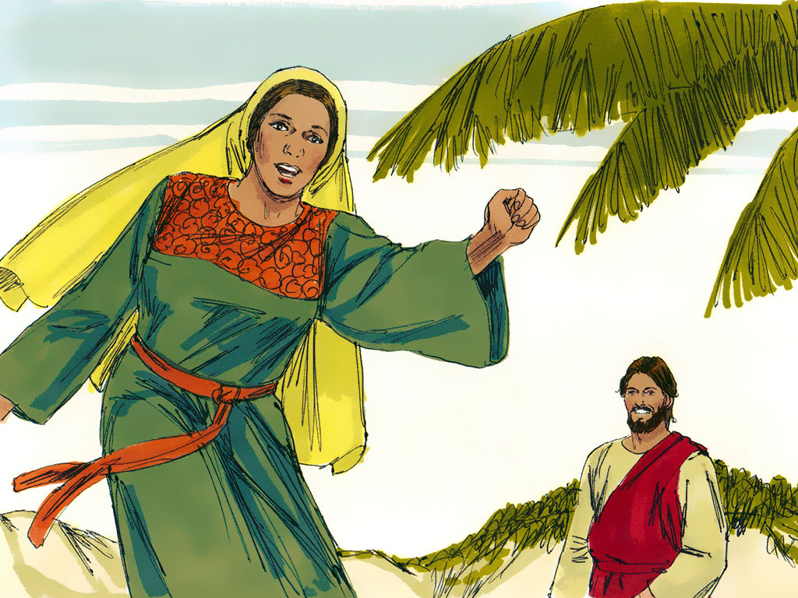

Slide 20
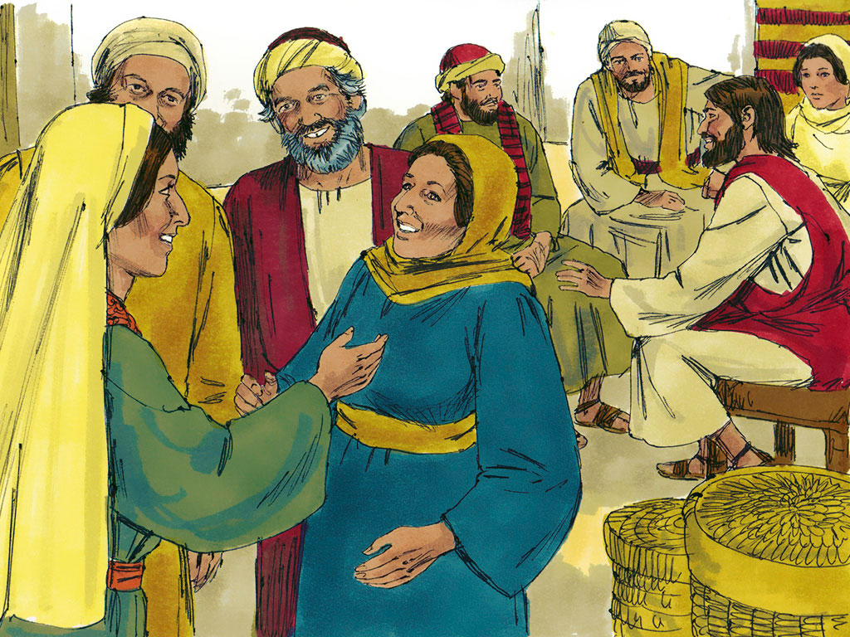

Slide 21
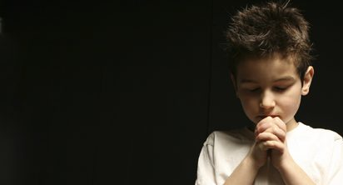
Romans 6:23
“For the wages of sin
is death;
but the gift of God
is eternal life
through Jesus Christ
our Lord.”

Slide 22
Mark 12:31
“…Thou shalt love
thy neighbour as thyself….”

Slide 23
God wants you to show His love
to those who are
different from you.

Slide 24
Notes:
1 John 4:7-8

Slide 25
Notes:
“God Forgave”

Slide 27
Mark 12:31
“…Thou shalt love
thy neighbour as thyself….”

Slide 28
Zonk
Put PowerPoint in Slide Show mode. Click on the “Zonk” above to pull up the game.
Click on wheel to spin it for points after a student answers a question correctly.
A student can spin as many times as they want. But if they get Zonk, they lose all the points for that turn.

